Slide 1
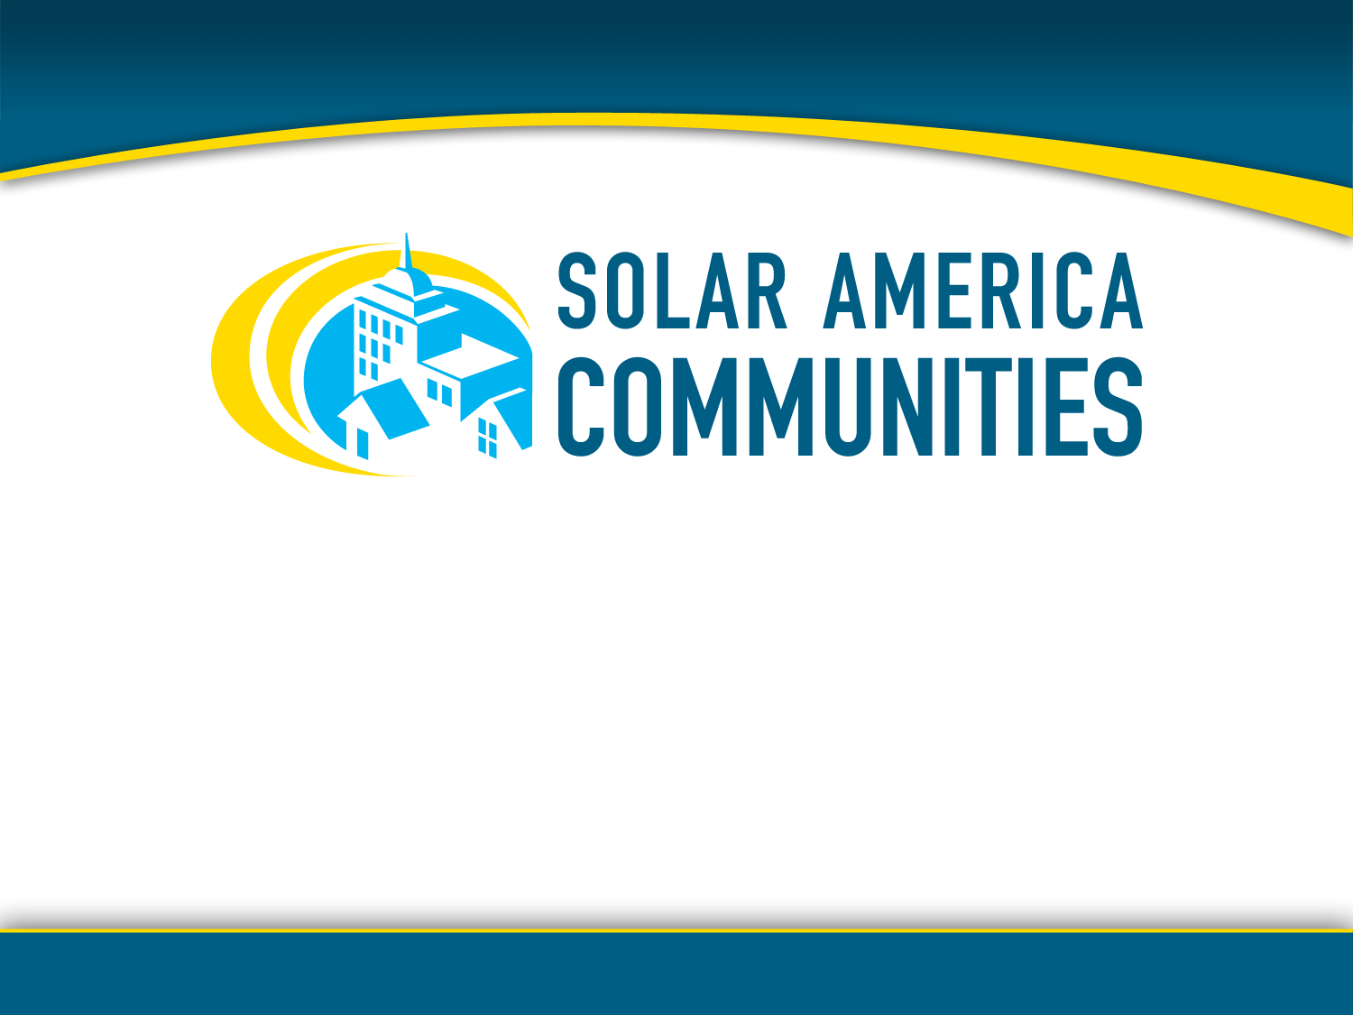
Solar on Brownfields:
Getting Started with Solar in Your Community
Brownfields 2011 Conference
Philadelphia, PA
April 3, 2011
Notes:
Trainers from the Solar America Communities program:
Andrea Luecke, The Solar Foundation: www.TheSolarFoundation.org
Christy Herig, Solar Electric Power Association: www.SolarElectricPower.org
Justin Barnes, North Carolina State University, Database of State Incentives for Renewables and Efficiency: www.dsireusa.org

Slide 2

"I'd put my money on the sun and solar energy. What a source of power! I hope we don't have to wait till oil and coal run out before we tackle that."
- Thomas Edison

Slide 3


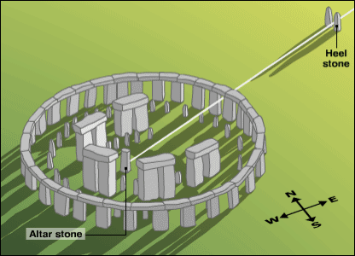
Heliocaminus solar heater of ancient Rome
Stonehenge summer solstice sun alignment
Ra – ancient Egyptian sun god
Notes:
Solar energy has been used for thousands of years to passively heat buildings and water and has been worshipped by cultures and used as a calendar and a compass.
The ancient Greeks were the first to use passive solar design in their housing. As early as 400BC entire Greek cities were built in this way.

Slide 4

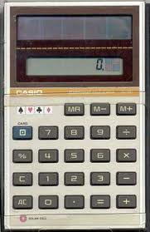
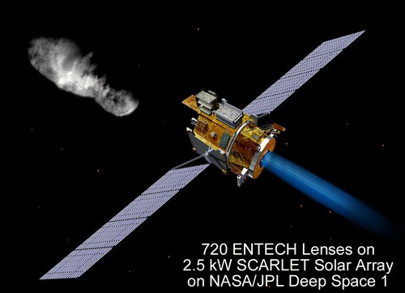
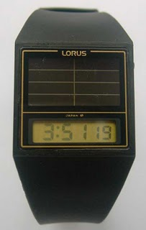
Satellite Photos: NREL
Calculator: Casio
Watch: Lorus
Notes:
In the early 1800’s, a trace mineral, selenium, was found to have photovoltaic - or electrical current producing – properties.
In the early 1950’s, three Americans working on small transistors found that if you build transistors in a certain way, using silicon, you would have an effective solar cell, or photovoltaic cell.
Beginning in the late 1950s, photovoltaics were used to power U.S. space satellites. The success of photovoltaics in space generated commercial applications for photovoltaic technology.
The simplest photovoltaic systems power many of the small calculators and wrist watches used today.

Slide 5

Top-10 Solar Trends for 2011
U.S. solar market rising
More financing opportunities
Utilities embracing ownership
Factories expanding
Hybrid solar market emerging
Rise of building-integrated solar
Notes:
On December 29, 2010, Reuters announced its ‘Top 10 Solar Trends for 2011.’
There is so much buzz and excitement surrounding solar energy because it has the ability to touch all aspects of our lives – markets, architecture, research and development, economic development, jobs, education, etc.

Slide 6
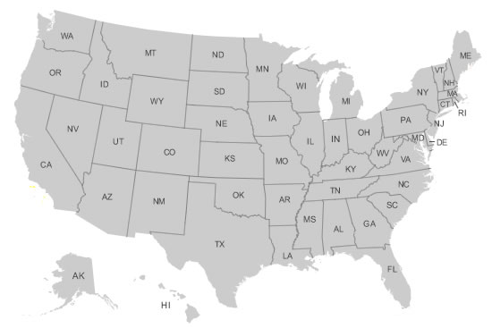
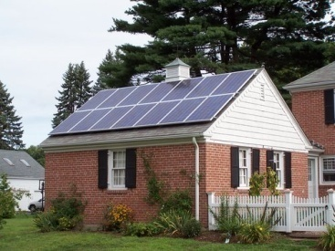
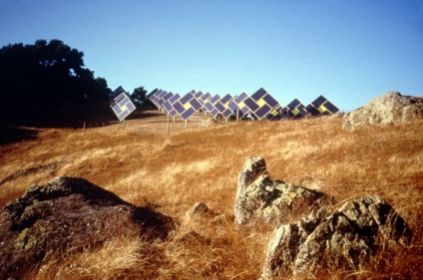
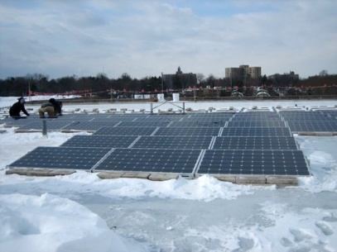
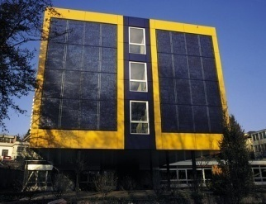
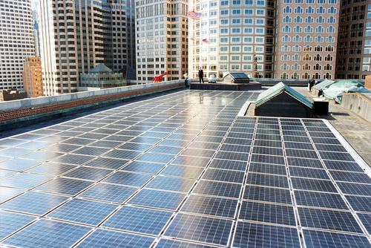
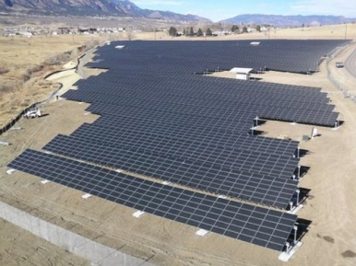
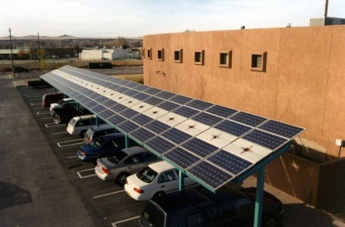
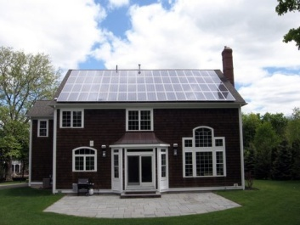
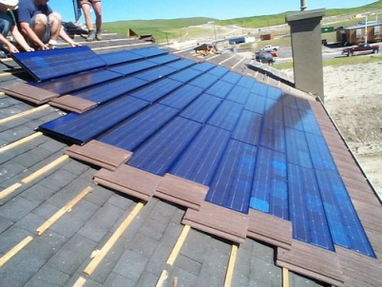
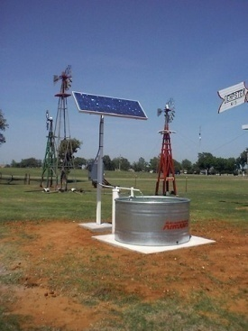
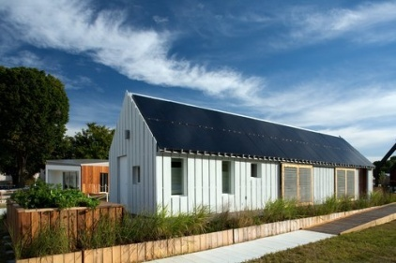
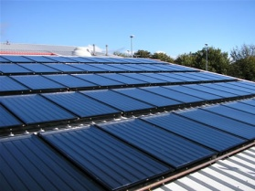
Notes:
Communities across the country have taken advantage of and capitalized on these trends – communities not only in the sunbelt but also all over the country – including Alaska.
There are solar energy systems on firehouses, on your neighbor’s roof, on schools, on landfills, on big-box stores - solar is pumping water out of wells, solar is being used as a shade structure, solar is being incorporated into building design, solar is everywhere and everyday more and more.

Slide 7
Your community has an opportunity to capitalize on these trends!
Notes:
Your community has an opportunity to capitalize on these trends too!
As you will learn today – there are many reasons to be excited and the environmental reasons are only part of it. Solar creates jobs – it helps the US maintain its competitive advantage, it is a major export industry – feeding money back into the local economy, and helps promote energy independence.
We will get to all of that – but first I’d like to tell you who we are and why we are here:

Slide 8
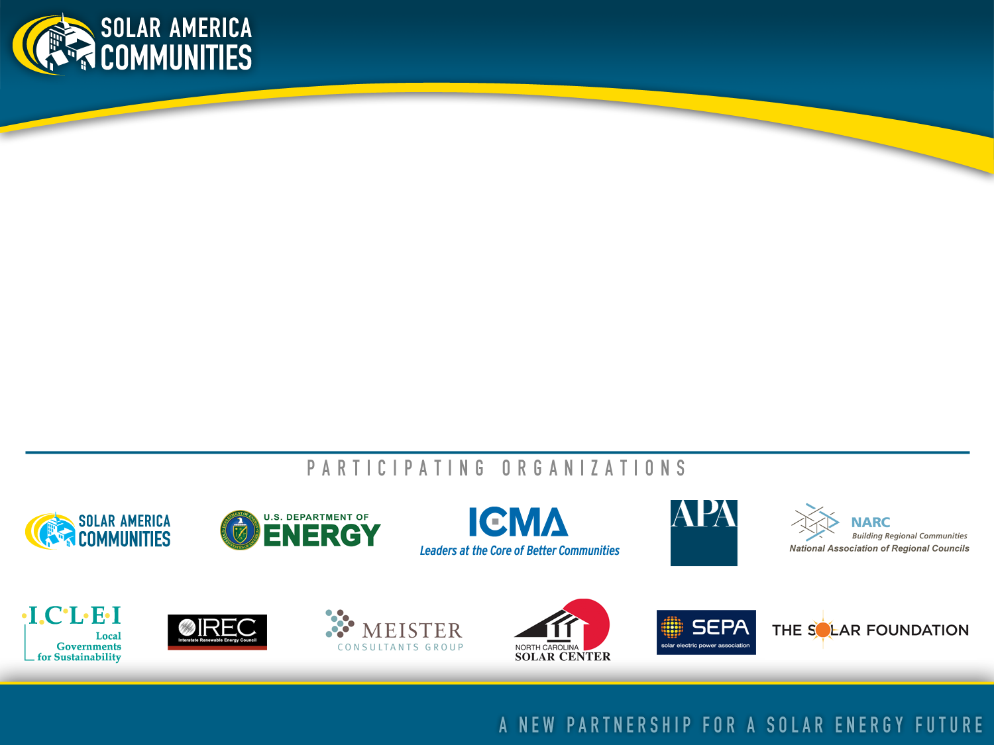
About Solar America Communities
Solar America Communities is a U.S. Department of Energy (DOE) program designed to increase the use and integration of solar energy in communities across the United States.
The International City/County Management Association and ICLEI-Local Governments for Sustainability USA were selected by DOE to assist local governments throughout the U.S. implement best practices and accelerate the adoption of solar energy.
For more information visit www.SolarAmericaCommunities.energy.gov.

Slide 9
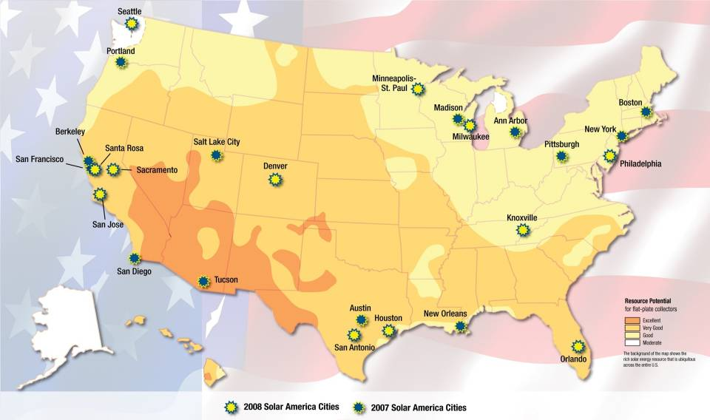

Solar America Cities
Notes:
The Solar America Communities program was inspired by the highly successful “Solar America Cities” program where the Department of Energy designated 25 US cities in diverse regions throughout the country as “Solar America Cities.”
This program began in 2007 and is still in operation.
The map shows where the 25 Solar America Cities are located.

Slide 10
Our Mission:
Enable local governments, community and private sector stakeholders to replicate successful solar practices and quickly expand local adoption of solar energy
Our Objectives:
Increase installed capacity of solar electricity in U.S. communities
Reduce solar electric project execution time via permitting, inspection and interconnection
Improve building and zoning codes/regulations for solar electric technologies
Increase access to solar electric purchasing options
Notes:
Best practices are starting to emerge and there is more and more momentum pushing cities toward sustainability.

Slide 11
Why Should You Care About Solar?
Because many contaminated sites offer:
  1. Existing infrastructure
  2. Potentially lower transaction costs
  3. Improved public support and faster permitting/zoning
Notes:
As you think through your options on what to do with your contaminated sites, there are three reasons you should care about solar…
Because many contaminated sites offer:
1. Existing infrastructure i.e. transmission lines, roads and railway
2. Potentially lower transaction costs as compared with “greenfield” sites
3. Improved public support and faster permitting/zoning. Note: this isn’t always the case, but generally people are eager to improve the appearance and use of these lands

Slide 12
Installing solar energy on contaminated sites may:
  Increase property’s economic value
  Further environmental sustainability by maximizing land use
  Provide clean energy for use on-site
  Create local jobs
  Provide a “cap”
Notes:
12
Placing solar energy on these sites may:
1. Increase economic value for the property
2. Further environmental sustainability by maximizing land use – and reduce the stress on greenfields
3. Provide clean energy for use on-site, locally, and/or to utility grid
4. Create local jobs
5. Provide a “cap” after remediation

Slide 13

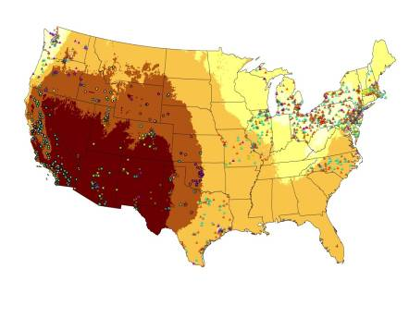
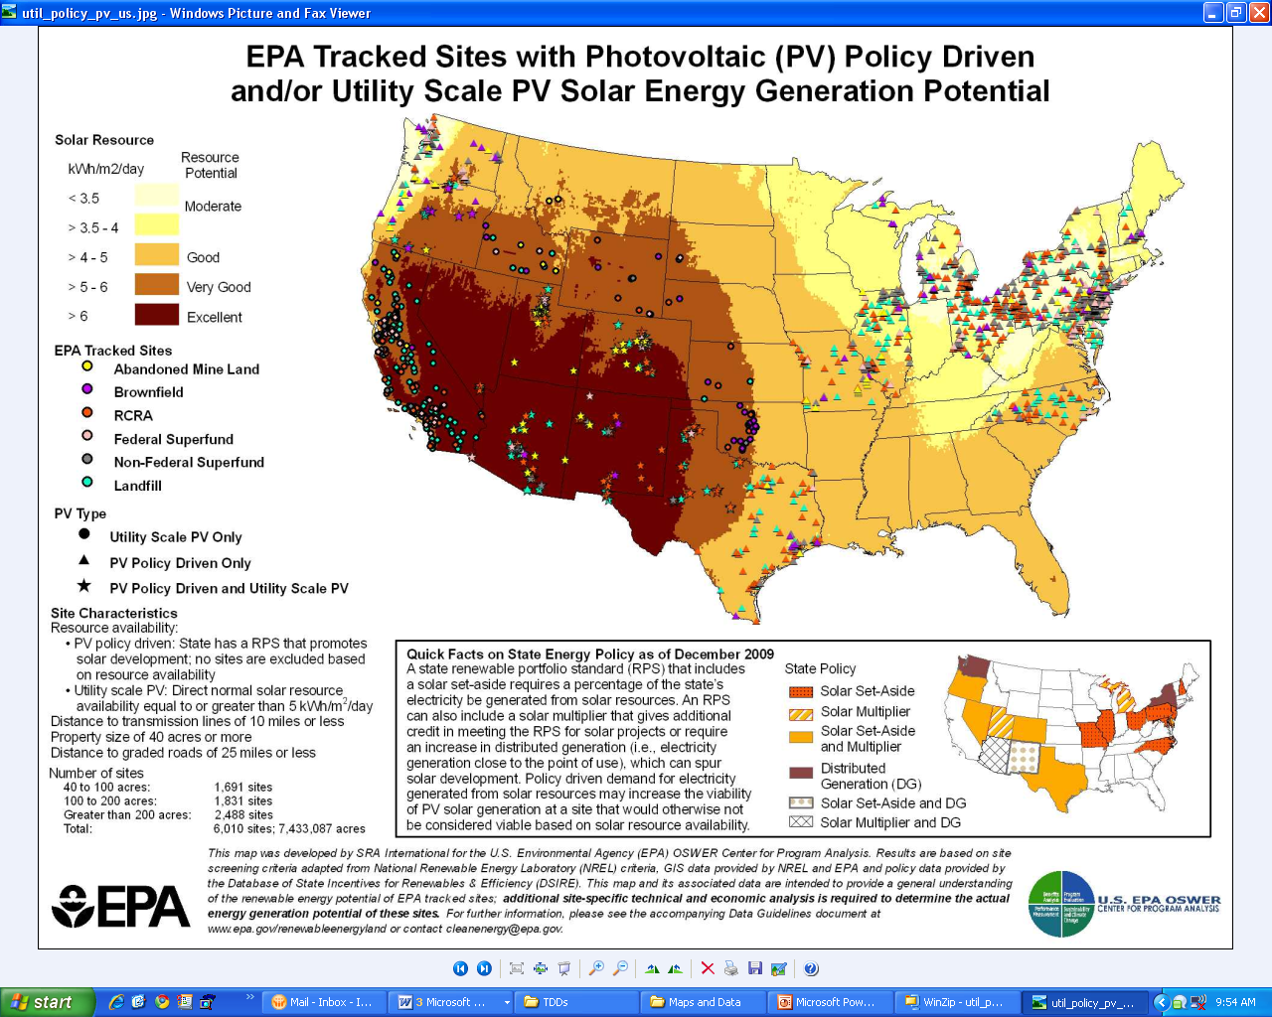
Re-Powering America’s Lands
EPA promotes “siting” renewable energy on contaminated sites
Notes:
The EPA has been working on matching contaminated sites with renewable energy (such as solar and wind) for some time now.
Through their RE-Powering America’s Lands program, they have created this interactive mapping tool that not only has over 11,00 contaminated sites mapped, but it also enables the user to search by renewable energy type or by contaminated land type.
The EPA estimates that there are about 490,000 contaminated sites in the United States.

Slide 14
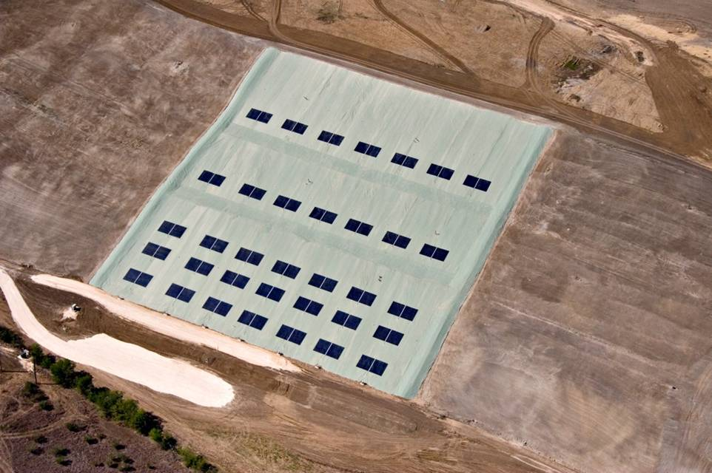
Tessman Road Landfill Type of Site: Landfill - Municipal Solid Waste Location: San Antonio, TX | Size of PV system: 130 kW Photo credit: Republic Services, Inc.
Notes:
The Tessman Road Landfill is a municipal solid waste landfill located outside of San Antonio, Texas.
In 2008, the site was closed using an innovative geomembrane cover system known as a Solar Energy Cover (SEC), which functions as both an effective landfill cap and mounting surface for flexible PV panels.
The geomembrane used at Tessman Road Landfill is a 60-millimeter thermoplastic polyolefin. The SEC system covers 5.6 acres of 18-degree south facing slope. Construction commenced in December 2008 and was completed by April 2009. Estimated electricity output from the solar array is 182,319 kilowatt-hours. Coupled with landfill gas technology, the site produces 9 megawatts of electricity.
It is owned and operated by Republic Services, Inc. Engineering design services for the solar project were provided by HDR Engineering Inc.

Slide 15
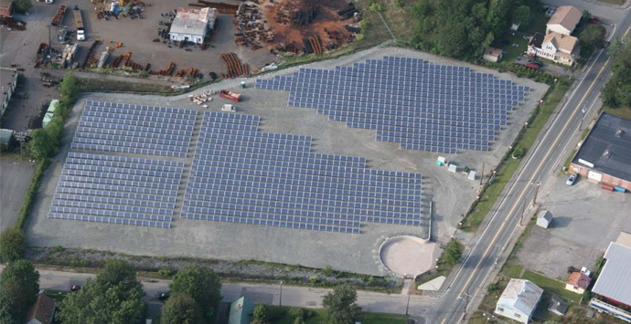
Brockton Brightfields Type of Site: Remediated Landfill Location: Brockton, MA | Size of PV system: 425 kW Photo credit: AECOM
Notes:
The Brockton Brightfields site is a remediated landfill in Brockton MA with a 425 kW solar array on top. 425 kW is large enough to power about 77 homes.
There was contamination on this urban landfill site and the contamination was remediated in 2004.
The city is leasing the land for the project from Bay State Gas Co.
There were not many other uses for this site because of the type of “cap” the remediation required.
“Caps” generally consist of a clay or membrane liner covered by sandy soil and then topsoil. “Caps” are vulnerable to erosion, animals, sunlight degradation of the liner, etc. Solar can sometimes help maintain the “cap’s” integrity.

Slide 16
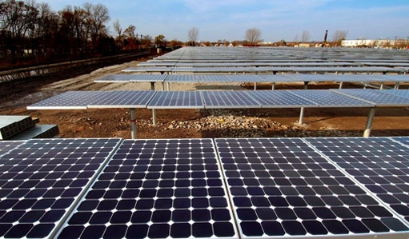
Exelon City Solar Type of Site: Remediated Industrial Brownfield Location: Chicago, IL | Size of PV system: 10 MW Photo credit: Exelon
Notes:
This is a $60 million project with 32,292 PV panels producing enough energy to power 1,500 homes on the site of an industrial brownfield property that had been vacant for 30 years.
Exelon Generation (one of the nation’s largest utilities) owns and operates the 10 MW plant and will market the electricity it generates.
The project was a big jobs creator, creating 200 construction jobs, almost half of contractors on the project were minority-owned businesses, and much of the construction materials were sourced from companies on Chicago's South Side.
www.exeloncorp.com/PowerPlants/exeloncitysolar/Pages/Profile.aspx

Slide 17
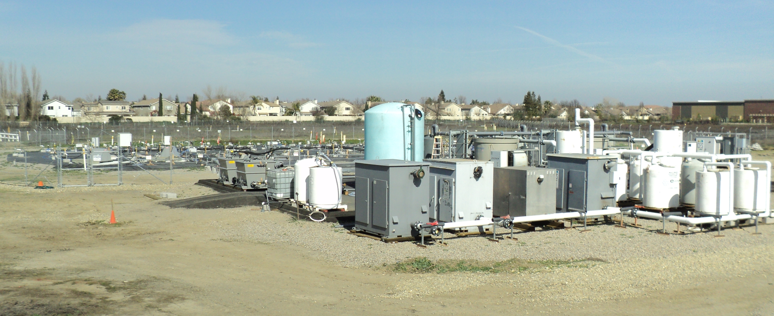
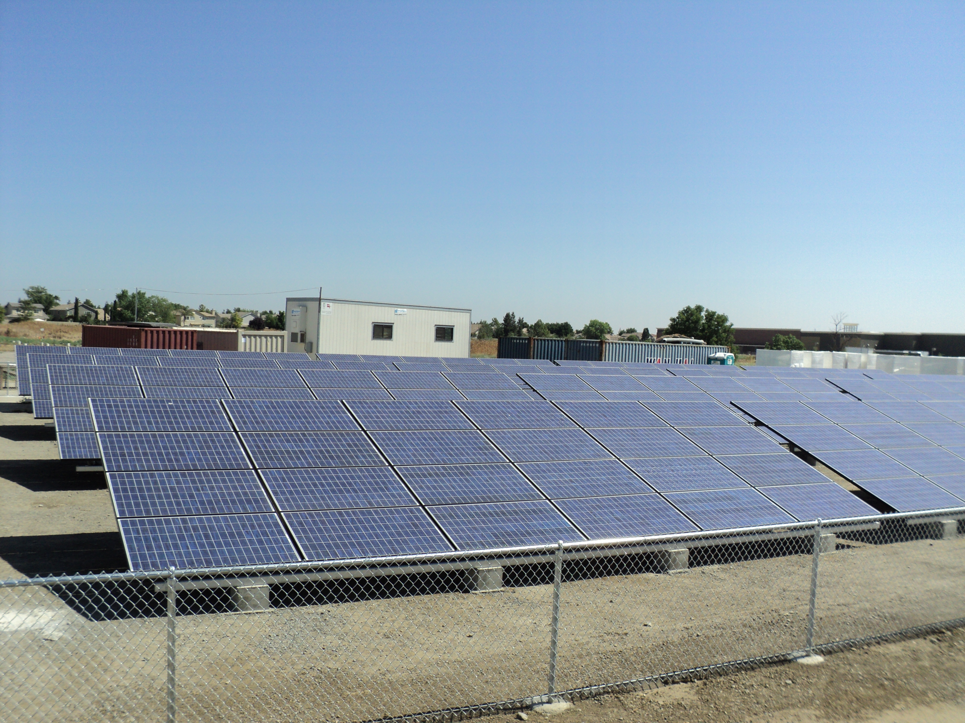
Frontier Fertilizer Type of Site: Superfund Location: Davis, CA | Size of PV system: 5.7 kW Photo credit: EPA
Notes:
Frontier Fertilizer – a Superfund groundwater remediation project in Davis, CA. The 8-acre parcel of Superfund site is being redeveloped for residential use.
This 5.7 kW solar electric system powers ongoing water treatment at the site. Using solar to power the pumps saves them $1,500 annually in energy costs.
http://www.epa.gov/oswercpa/docs/success_frontierfertilizer_ca.pdf

Slide 18
Be the Next Community to Put Solar on a Brownfield!
Notes:
Lisa Milligan from ICLEI is here and her hometown Scituate, MA announced a few weeks ago that Brightfields Development, LLC (from Wellesley, MA), is going to remediate a former landfill with solar--some 9,500 panels will be mounted on the landfill.
http://www.brightfieldsllc.com/index.php/news-a-links/press-releases.html
Also this year, Philadelphia Industrial Corporation is installing a 1.5 MW solar PV system on a 7 acre former incinerator and shipyard landfill that has heavy metals contaminants. http://www.epa.gov/oswercpa/docs/success_navyyard_pa.pdf
Brownfields and contaminated lands are in major metropolitan areas, in our backyards, and in our hometowns. They affect us all.
Solar can be a good solution for low or negative valued sites with contamination, unfavorable location, geo-technical issues, or other challenges.

Slide 19
Workshop Objectives
At the end of today, you will be able to:
1. Identify the benefits and barriers to solar development in your community
2. Recognize actions you can take to overcome barriers
3. Start working with your community to “go solar” on brownfields and other sites

Slide 20
Workshop Agenda
Intros
Solar technology basics
Benefits and barriers to going solar
Lunch from 12:00 – 1:00
Overcoming barriers
  Policies (financial and regulatory)
  How to get started and engage stakeholders
  Installing solar on local government facility/land/brownfield
Adjourn at 3:00
Notes:
This workshop is more or less a “Solar 101” – but throughout the workshop we will be weaving in case studies, best practices and practical advice for people particularly interested in brownfields.

Slide 21
On Your Radar…
Today’s workshop presentation & notes will be posted here:
www.SolarAmericaCommunities.Energy.Gov/Resources
AT PHILADELPHIA CONVENTION CENTER
  Monday: Panel Session. Energizing Local Governments: Solar America Communities Partnership, 2:30 – 3:45, Room 113B
  Monday: Economic Development Forum. 11:30 – 4:30
  Sunday-Tuesday: Solar America Communities Booth. Exhibit Hall Booth 621 (Opens Sunday at 5:30)
  Sunday-Tuesday: PV America Conference
Notes:
Economic Redevelopment Forum: http://www.brownfields2011.org/en/Article/34/Brownfields_2011_Launches_the_Economic_Redevelopment_Forum
Formerly known as the Transaction Forum, (a staple of the Brownfields Conference since 2004), this event traditionally focused on providing property owners, redevelopment agencies, and communities an opportunity to market their contaminated properties directly to the real estate development industry.
This year, the Forum will also focus on the new importance of government financial incentives geared to spur economic development and get projects funded when traditional loans and sources of equity are hard to find.
There will be a special session focused on renewable energy as a redevelopment option and will provide informational opportunities for developers particularly interested in this sector.
PV America 2011: http://www.pvamericaexpo.com/PVA11/Public/Enter.aspx
Nearly 3,000 buyers, technology experts and industry leaders are present

Slide 22

Working Together Today…
Children Celebrating New 10 kW PV Array
Cooper Elementary School, Milwaukee Wisconsin
Notes:
Workshops are a 2-way dialogue – clarifying questions are welcome during the presentation, but if question/comment takes us too far off track we may have to finish responding to the question/comment at a later time.
We want to hear from you. We want your input so we can improve.
Respect diverse viewpoints. We intend to foster a safe learning environment where there is mutual respect for everyone.

Slide 23
Notes:
Attendees of National Brownfields Conference in Philadelphia, PA April 3, 2011
23

Slide 24
What is “Solar Energy?”
Energy from the sun that is
converted into thermal or electrical energy
Notes:
The nations overall energy portfolio includes thermal, electric and combustion loads. All of these loads can be offset and/or completely met with solar energy. There are opportunities challenges and barriers - some technical, but many political.

Slide 25

DOE Video: www.youtube.com/watch?v=0elhIcPVtKE
Notes:
Most people understand the thermal energy transfer from the sun to the earth’s surface, but the light can also be captured through the photovoltaic effect as shown in this video

Slide 26
Common Solar Technologies
PV, or photovoltaic or solar electric
SHC or SHW, or solar thermal
CSP, or concentrating solar power
Notes:
Any Technical field can be a world of acronyms these days.
SHW – solar hot water
SHC – solar heating and cooling
CPV – concentrating PV
CSP is also sometimes called CST or concentrating solar thermal

Slide 27
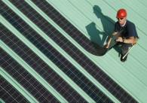
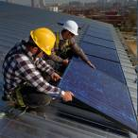
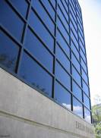

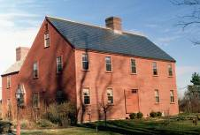
Photovoltaic (PV)
Directly generates electricity from sunlight
Different types
  Crystalline silicon
  Thin-film
  Concentrating PV (CPV)
BIPV
  Shingles
  Skylights
  Architectural glass and granite like materials
Source: www.ecofriend.org
Source: NREL
Photo Source: NREL
27
Notes:
Note that crystalline silicone is sometimes differentiated into both Multi-crystal and single crystal
Building-integrated photovoltaics (BIPV) are PV materials that are used to replace conventional building materials in parts of the building envelope such as the roof, windows, skylights, or facades. They are increasingly being incorporated into the construction of new buildings as a principal or ancillary source of electrical power, although existing buildings may be retrofitted with BIPV modules as well.
The advantage of integrated photovoltaics over more common non-integrated systems is that the initial cost can be offset by reducing the amount spent on building materials and labor that would normally be used to construct the part of the building that the BIPV modules replace. These advantages make BIPV one of the fastest growing segments of the photovoltaic industry.
27

Slide 28
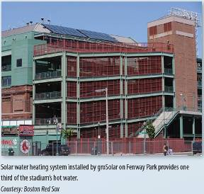
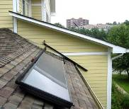
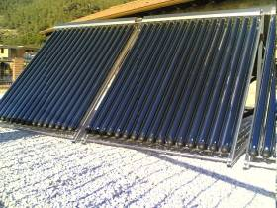
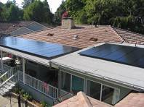
Solar Thermal SHW or SHC
Solar energy used to heat water or other medium
Applications include:
  Solar pool heating
  Domestic hot water use
  Process hot water
  Space heating
  Solar assisted cooling
Notes:
28
Solar pool heating is a thriving and cost effective market.
Domestic hot water applications are typically a hybrid of gas and solar or electric and solar. It is important to size the systems correctly for the use ( family size) and geographic location ( solar resource)
Process hot water is used on commercial and industrial applications. Process hot water typically requires a higher temperature collector
Space heating applications are similar to residential gas or oil radiator systems. The solar is sometimes used as an assist to these systems. Often a SHW system is combined with space heating
Solar assisted cooling is the use of the solar input to an absorption cooler. Residential size absorption cooling is not common in the US, but it is available. Commercial solar cooling systems are more common. Solar thermal assist can also be applied to heat pipe dehumidifiers

Slide 29
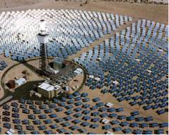
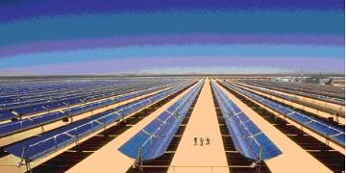
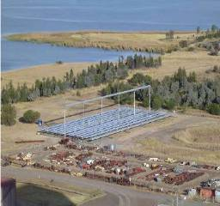
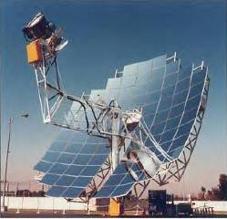
Concentrating Solar Power (CSP)
Central receiver or “power tower”
Parabolic trough
Parabolic – dish engine
Compact linear fresnel reflector
Source EPRI and NREL
Notes:
Concentrated solar power (CSP) are systems that use lenses or mirrors to concentrate a large area of sunlight, or solar thermal energy, onto a small area. Electrical power is produced when the concentrated light is converted to heat which drives a heat engine (usually a steam turbine) connected to an electrical power generator. CSP works best in the desert where there is lots of direct sunlight. These are typically utility scale powerplant applications. Utilities are also developing hybrid plants where the CSP is used to reduce fuel consumption at an existing fossil plant.
CSP should not be confused with photovoltaics, where solar power is directly converted to electricity without the use of steam turbines. The concentration of sunlight onto photovoltaic surfaces, similar to CSP, is known as concentrated photovoltaics (CPV).

Slide 30
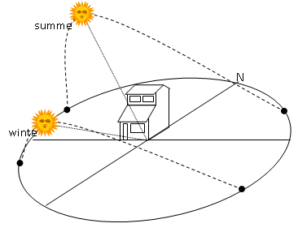
Site Specific Considerations
Notes:
But you can’t put solar anywhere – there are some site specific considerations for you to keep in mind….
Shading - Solar PV panels can be affected by numerous types of obstructions. Examples include trees, clouds, bird droppings, dust and even the shading from other solar panels.
Solar Access Rights – Solar Access laws vary by state and region. There will be more on this in the afternoon. Solar access laws protect the right of an individual to both install and operate solar panels. A thorough access law addresses both unwarranted restrictions to construction as well as changes that may occur after construction like tree shading and newly constructed higher buildings. Currently, 34 states have some sort of solar access rights established to protect individuals.

Slide 31
Site Specific Considerations
Notes:
31
Structural Capacity and integrity– Buildings that are being proposed for construction can easily modify system plans to incorporate solar PV panels. However, older building been analyzed to ensure that the current roof has the load capacity to handle the solar PV panels. If a roof is close to the end of its expected life, replacing the roof could be a viable option. Many companies can install the solar panels and the new roof at the same time, if needed.
Wind Loading – Due to the large surface area of panels, the effects of wind speed must be considered when installing solar panels. Therefore, it is necessary to hire a structural or civil engineer to properly perform wind loading calculations and other possible code requirements.
Interconnection to the grid – If you are developing in a area where solar is “new”, the approval process from the utility may be lengthy
Maximum energy output for a fixed system is always facing South at latitude tilt. A more horizontal tilt gives more summer energy and a more vertical tilt gives more winter energy.

Slide 32
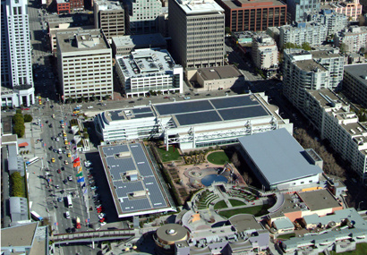
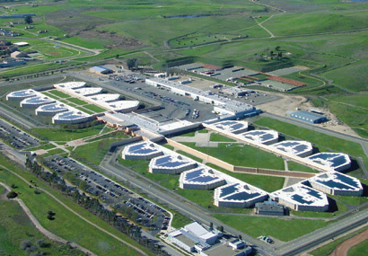
Site Specific Considerations
Moscone Center
San Francisco, CA
Source: SunPower Website
Notes:
As an example, in a dense urban environment future redevelopment must be considered. In less dense applications, the potential for tree shading is still possible.

Slide 33
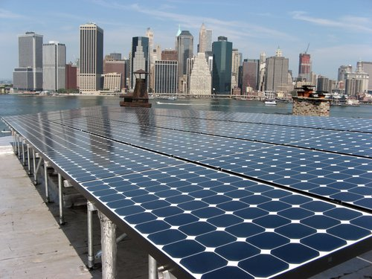
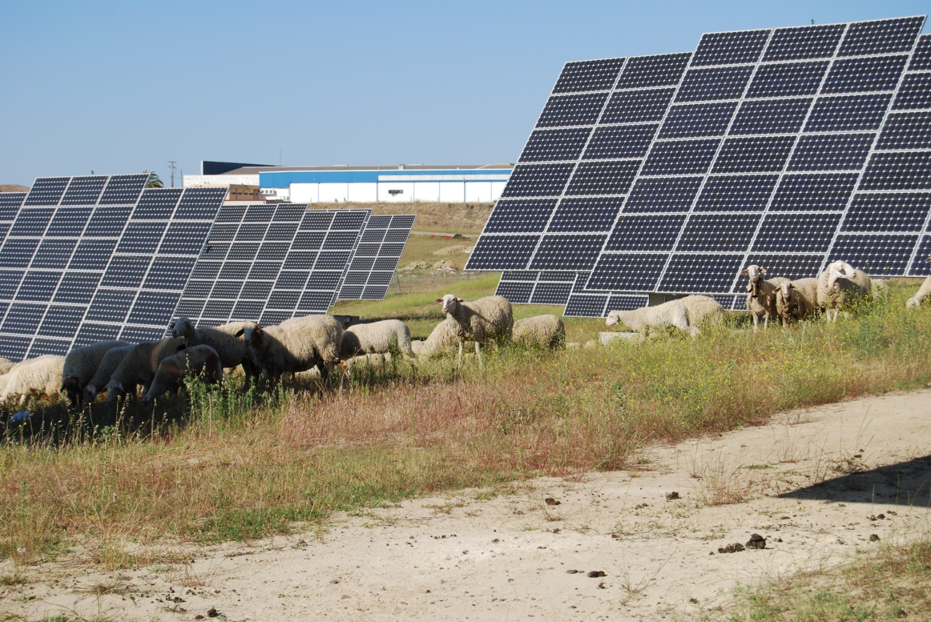
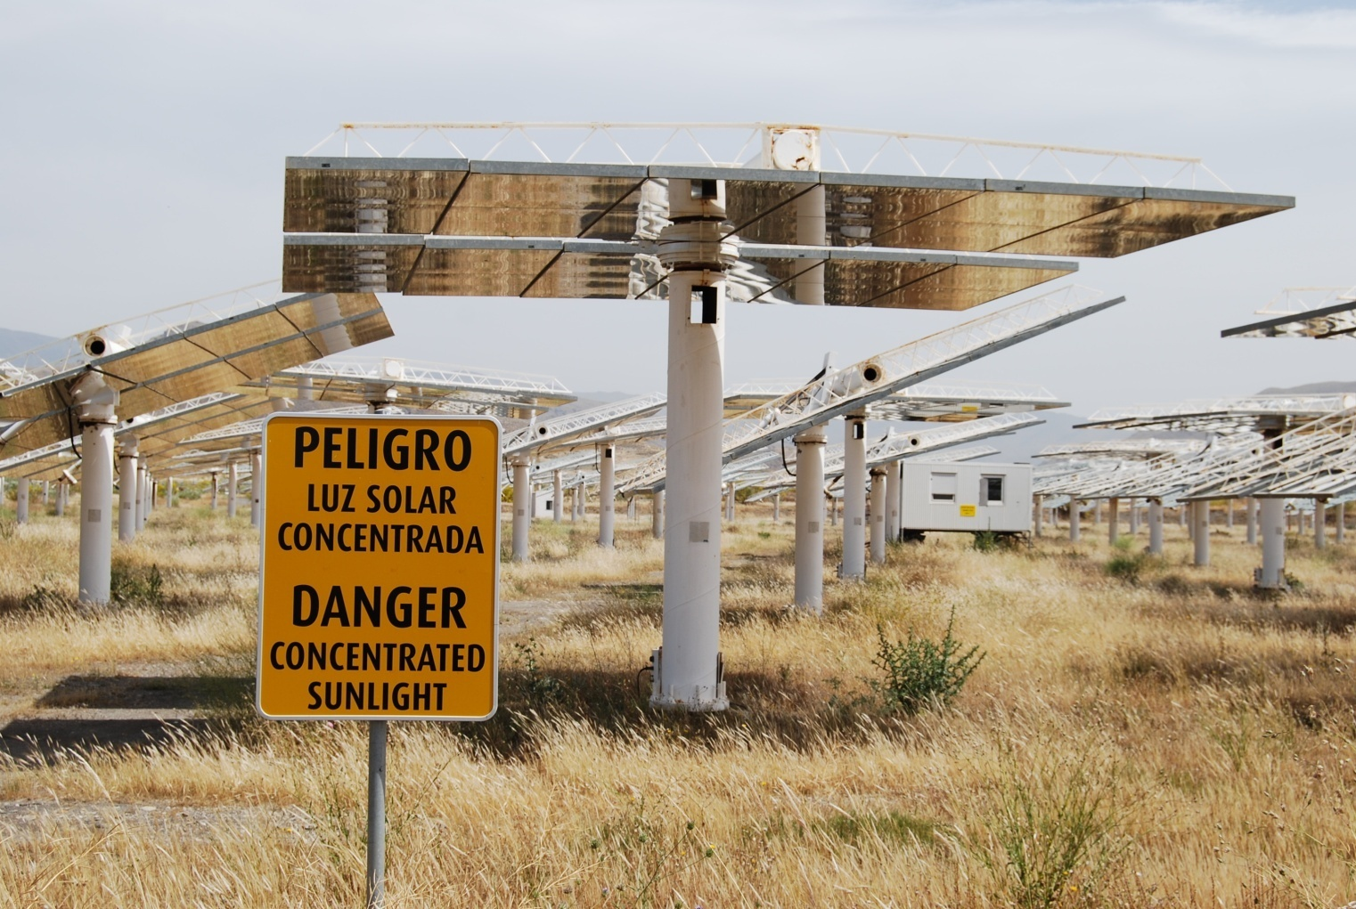
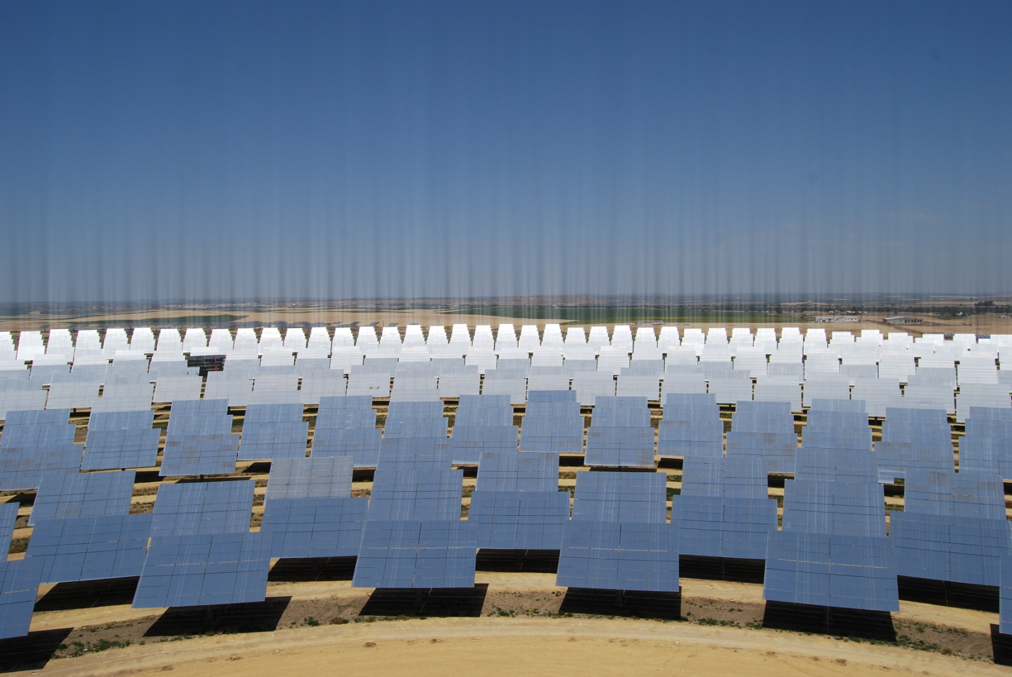
Review Activity
Notes:
Name two ways of capturing sun’s energy (PV and thermal)
Name three types of solar technologies, their characteristics… ( PV SHW, CSP, BIPV)
Two reasons solar works on Brownfields.
1. Increase economic value for the property
2. Further environmental sustainability by maximizing land use – and reduce the stress on greenfields
3. Provide clean energy for use on-site, locally, and/or to utility grid
4. Create local jobs
5. Provide a “cap” after remediation
Name two site specific consideration for solar projects
(Shading, Solar Access Rights, structural capacity and integrity, wind loading, interconnection to the grid, seasonal output)

Slide 34
Workshop Agenda
Intros
Solar technology basics
Benefits and barriers to going solar
Lunch from 12:00 – 1:00
Overcoming barriers
  Policies (financial and regulatory)
  How to get started and engage stakeholders
  Installing solar on local government facility/land/brownfield
Adjourn at 3:00

Slide 35

Benefits of Going Solar
Notes:
Solar has lots of benefits:
Adds jobs and develops local economies
Helps us remain competitive in terms of innovation
Is a smart investment - while the cost of coal has more than doubled in recent years – solar is free and clean
It is so beneficial that all new homes in Spain and Israel must by law have solar water heating systems built in.
http://www.green-buildings.com/content/78229-solar-water-heaters-required-hawaii-homes
It is so beneficial that more and more policies are enacted to encourage solar installations.

Slide 36
Solar Adds Jobs
U.S. Solar Industry Employment
26% Job Growth!
Solar Jobs
Source: The Solar Foundation’s National Solar Jobs Census 2010
Blue columns represent The Solar Foundation’s Census results
Green columns represent previous best estimates by SEIA
Notes:
Solar creates jobs. As of August 2010 the National Solar Jobs Census found that there are approximately 93,000 solar jobs in the US. This is double what previous best-guess estimates indicate.
Between August 2010 and August 2011, job numbers are expected to increase by 26%, representing 24,000 net new solar jobs across the country.
These findings show an industry that is growing much more rapidly than the economy as a whole, which is creeping along with only 2% average job growth rate across all sectors.
With a national unemployment rate hovering around 9% and with close to 15 million Americans out of work (not counting the underemployed and discouraged workers), the job growth of the solar industry is great news!
36

Slide 37
Hiring Expectations – All Firms
Between August 2010 – August 2011
Source: The Solar Foundation’s National Solar Jobs Census 2010
To Access: www.thesolarfoundation.org
Notes:
The Solar Foundation's National Solar Jobs Census found that over half of all solar companies plan to add workers over the next 12 months, while only 2.2% expect to cut workers over the period.
Solar jobs include: installation, roofing, electrician, sales, engineering, planning, assembly, legal, clerical, marketing, policy.
This broad range indicates that there are opportunities for people with varying degrees of expertise and experience to enter the solar industry.
Note: solar employers are reporting difficulty finding qualified workers and while there are many people currently being trained for solar installation jobs, for example, employers want them to be highly skilled and with experience.
37

Slide 38
Manufacturing and Wholesale Trade are growing the fastest at 36%!
2010 Jobs New Jobs (12 Months)
Source: The Solar Foundation’s National Solar Jobs Census 2010
To Access: www.thesolarfoundation.org
Notes:
The National Solar Jobs Census found that manufacturing and wholesale trade are the fastest growing subsectors both with 36% next year. This might come as a big surprise, considering all the news about US manufacturing being at its lowest point in terms of employment since before WWII.
Even though there have been a few announcements about solar manufacturers closing their US facilities in favor of overseas production, as the U.S. solar market grows, more manufacturers recognize the value in locating their manufacturing facilities domestically (to be close to the production of polysilicon and a very large market).
In October 2010, Suntech was the first Chinese company to establish a manufacturing facility within the U.S.
http://seia.org/galleries/default-file/Trade_Balance_Factsheet.pdf
38

Slide 39


Notes:
Domestic companies are also expanding.
These pictures are from the largest manufacturer of thin film solar panels – First Solar – a US company headquartered in Perrysburg Township, Ohio (where it employs more than 1100 employees)
Mid-March, 2011, First Solar confirmed that it will build its second manufacturing plant in Mesa, Ariz.
The facility, scheduled to open next year, will include 600 jobs and produce more than 250 megawatts of thin-film solar panels a year.
http://www.renewable-energy-sources.com/2011/03/18/first-solar-to-build-solar-module-factory-in-mesa-arizona/

Slide 40
Solar is Big Business
Source: SEIA/GTM Research - 2010 Year in Review Report
To Access: http://www.seia.org/galleries/pdf/SMI-YIR-2010-ES.pdf
Notes:
The solar industry has become the fastest growing energy sector and one of the fastest growing industries in any sector across the U.S.
http://www.seia.org/cs/news_detail?pressrelease.id=1281
http://blogs.forbes.com/afontevecchia/2011/03/25/solar-industry-rising-can-energys-fastest-growing-sector-keep-it-going/
It’s big business and it means business:
Growing by 300% in just four years, it went from a $1.5 billion industry in 2006 to a $6 billion industry in US in 2010.
$1.4 billion in venture capital flowing into the solar industry in 2009
To Access SEIA/GTM Year in Review 2010 Executive Summary: http://www.seia.org/galleries/pdf/SMI-YIR-2010-ES.pdf

Slide 41
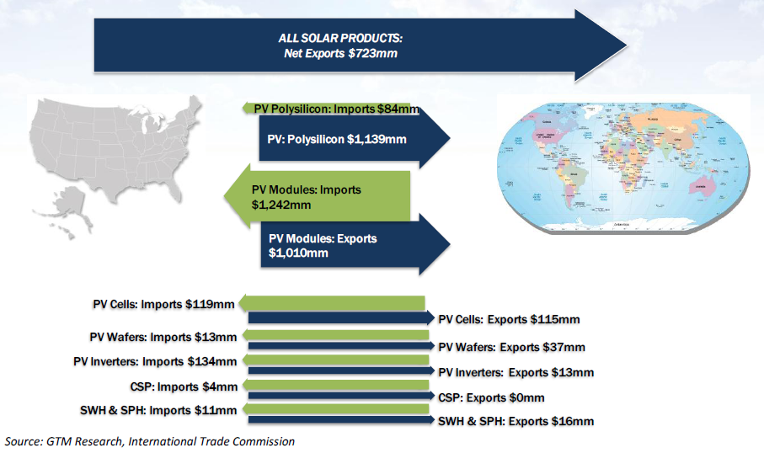
Net exports totaling $723m in 2009
Source: SEIA/GTM Research
To Access: http://www.seia.org/galleries/default-file/Solar_Trade_Assessment.pdf
Notes:
Solar is a major export industry.
A new report put out by SEIA and GTM Research in December 2010 found that net exports totaled $723 million in 2009.
http://www.seia.org/galleries/default-file/Solar_Trade_Assessment.pdf
This is more than the GDP of several developing countries including Tonga, Liberia, Dominica, etc.
In fact - the US exports $2.2B more solar products than it imports
These exports help to feed money into local economies
This report shows that US trade in the solar industry is more balanced than in the overall economy, which had a trade deficit of $374 billion in 2009.
(Note: $723 million net export number is just the tip of the iceberg. There is a lot more potential for exportation. The US is just getting started.)

Slide 42
Solar Develops Local Economies
Increased revenue opportunities for landowners
Improves regional economic competitiveness
Notes:
Solar develops local economies:
Increased revenue opportunities for landowners
Land leases for solar farms
Property taxes from solar farms
Improves regional economic competitiveness
Induces private capital investment – making region more attractive.
Serves as a catalyst for other clean-tech companies and investments – making region more attractive.
Stabilizes long-term energy prices - acting as a hedge against rising electricity rates – making region more attractive.
Enables the region to avoid additional costly environmental controls on other industries – making region more attractive.
Depends on where you are, but it can decrease region’s reliance on energy imports, saving ratepayers money – making region more attractive.
42

Slide 43
Solar is a Smart Investment
Solar is a proven technology
Prices for modules are decreasing, while energy costs are increasing
Rebates, grants, and incentives are available to increase return on investment
Solar is a clean, reliable solution to many urban infrastructure goals and objectives

Slide 44
Solar is Clean and mitigates:
  green house gas, NOX and SOX
  mercury pollution
  thermal energy pollution
  mining impacts
  water issues
Notes:
Solar is clean, but note that these numbers are based on the overall US generation profile. Some states and even regions will be more or less depending on fuel mix.
Total emissions From EIA State Profiles data 2002, divided by total 2002 production adjusted in accord with the EIA projected improvements in power plant emissions by 2015. Then multiplied by the expected 1626 MWhrs per MW
Based on NREL data on water consumed for electric power generation by state. http://water.usgs.gov/pubs/circ/2004/circ1268/htdocs/table12.html
Each kilowatt of PV electricity annually offsets up to 16 kilograms of nitrogen oxides, 9 kilograms of sulfur oxides, and 2,300 kilograms of carbon dioxide (CO2). If the industry grows by 25% per year (as predicted), PV in the United States will offset 10 million metric tons of CO2 per year by 2027.

Slide 45
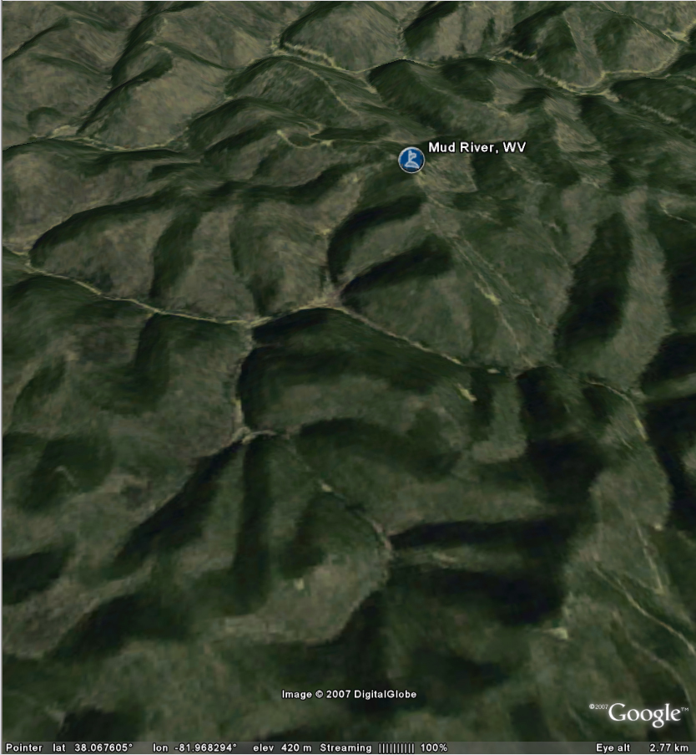
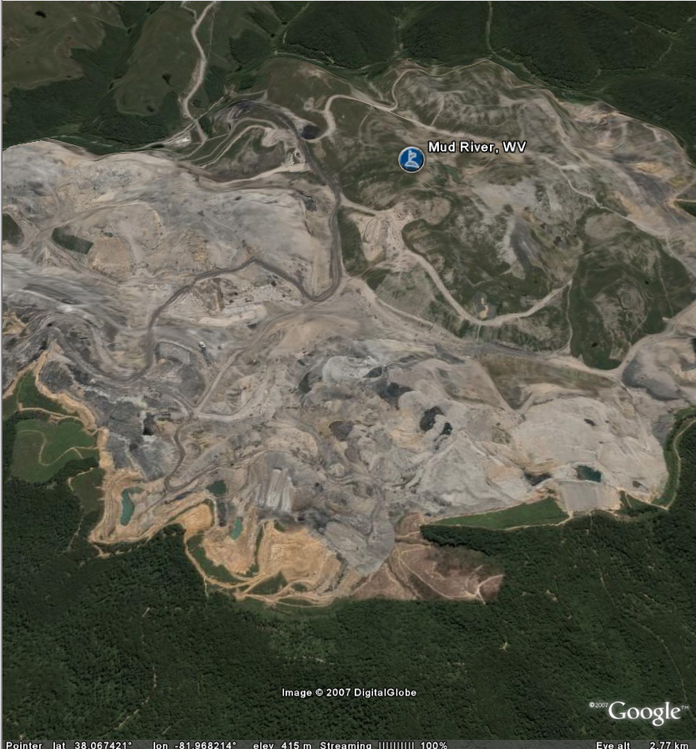
Mud River, West Virginia,
before and after mountaintop removal coal mining
Source: http://earth.google.com/outreach/cs_app_voices.html
Notes:
Coal mining and oil drilling also have environmental consequences.

Slide 46
Solar Helps Communities Achieve Energy Goals
Most states require renewable energy procurement for utilities
States in the Northeast, West, and Midwest exploring / implementing carbon emission caps
Many cities, especially those in non-attainment zones, have greenhouse reduction goals
Notes:
Renewables Portfolio Standards (RPSs)
29 states (+ D.C.) have RPSs
16 states (+ D.C.) have specific solar or distributed generation requirements
Many communities with or without municipal utilities have set their own portfolio standards or GHG emission goals
Communities w/munis include Orlando, Gainesville, Sacramento
Communities w/o munis include Aspen, Boulder

Slide 47
Solar Mitigates Land Use Issues
Solar is infinitely modular, the ultimate distributed generator
Distributed generation mitigates the need for grid upgrades and related construction disruption
Redevelopment
  Sustainable, green, aesthetic standards
  Brownfields to Brightfields
Notes:
Solar is most commonly a distributed generator and is sited at the customer load (either rooftop or building integrated).
Built Out Areas – can reduce the need for transmission and distribution (T&D) upgrades and service small loads which are extremely expensive because of the cost to run service and read the meter.
Solar can also meet new load requirements in the built out urban environment where construction for new T&D is disruptive to transportation and other community operations.

Slide 48
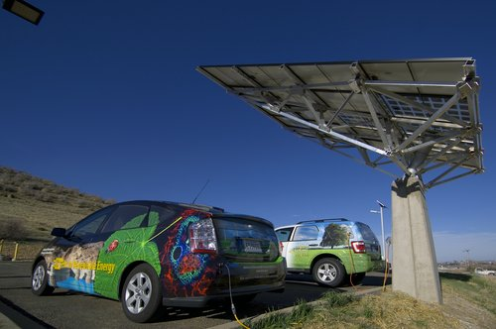
Solar Assists in Creating Clean Transportation Infrastructure
Photo Credit: NREL
Notes:
Solar promotes energy security. From an economic point of view, this relates to supply and price stability
The United States consumes 20 million barrels of oil every day
The U.S. economy has become dangerously dependent on foreign oil.
57% of all oil consumed in the U.S. is imported.
70% of all oil consumed in the U.S. is used for transportation.
Solar Applications in the transportation sector include
Alternative fuel vehicles – As communities move towards cleaner transportation fleets and public services that include charging stations for plug-in hybrids and electric vehicles, solar systems resource profile and electronic interconnection work complimentary with these new transportation technologies.
Public transit wait areas weather protection – Often the small amount of lighting needed for safety is perfectly suited to a small solar energy system rather than a service drop and the associated construction disruption of traffic flow.

Slide 49
Solar Assists in Creating Clean Transportation Infrastructure
Photo Credit: NREL
Notes:
Safety lighting - with the advent of very high efficiency lighting, solar powered street and safety lighting is very common. Lighting additions are easily done without extra electric service and the associated construction. Communities in more disaster prone areas are implementing a minimum percentage of DG powered street lighting to assure safety lighting during disaster recovery and the long term outages.
Traffic control reliability – nearly standardized on remote solar power
Distributed generation supports increased load in urban areas decreases traffic disruptions – In built-out high density urban areas, distribution upgrades for load increases or even power quality disrupt already congested areas. Often DG support of the grid can eliminate the need for an upgrade. Distributed generation support of the grid can eliminate need for distribution upgrades, thereby avoiding increased traffic congestion caused by such upgrade projects

Slide 50
Solar Strengthens Energy Infrastructure
Energy portfolio diversity:
  increases reliability
  decreases environmental risks to utilities
  reduces utility investment uncertainty and risk
  can support a strained grid
Notes:
Environmental regulation is changing rapidly often w/o grandfathering.
The risk associated with making an investment in a ten year lead time coal plant, with an extremely large capacity and investment is much higher than small incremental investments in distributed PV systems. Even the two year lead time of a combined cycle plant has more risk.
Capital investments are recovered more quickly with immediate revenue streams.
The impact and probability of non-availability of one large plant is much greater than 1000 small plants.
Solar can support a strained grid if correctly integrated . The distributed solar can support voltage and supply reactive. It can also reduce grid losses.

Slide 51


Solar Generation Coincides with Peak Demand/Price
% peak demand match based on utility loads
Notes:
The solar fuel’s highest availability is coincident with AC load that drives high peak energy costs. The map is based on the solar match to utility peak demand. In specific urban areas or large urban buildings the percent match will be higher. But it is not 100%.

Slide 52
When Local Governments Lead Solar Efforts, They Show Leadership and Social Responsibility
Notes:
Mayors and other elected and appointed officials are responsible for the welfare of their constituents. There is a lot of pressure to be socially responsible, but there is an equal amount of pressure to spend budgets wisely. When local governments lead solar efforts, they show leadership and social responsibility – but their efforts can also result in cost savings.
Often it takes the Mayor or the Council President to stand up and proclaim that their city is pro-solar before the market comes in – because markets like stability.
But you don’t have to be a Mayor or the Council president to be a leader.
In fact, many of you are in a decision making position or in a position to make recommendations to decision makers.
You too can show leadership and social responsibility by helping to lead solar efforts in your community.

Slide 53
How
Enables more installations
Reduce GHGs
Encourage property upgrades
Work with local industry
Help save operating costs
Results
Job growth
Improved quality of life
Increase property values
Increased private sector willingness to adopt solar
Savings for constituents
Notes:
When a local government goes solar it enables more installations which leads to jobs….
When a local government installs solar they reduce greenhouse gas emissions which leads to an improved quality of life…
When a local government encourages energy efficiency, solar and other upgrades, they increase property values.
When a local government contracts with local industry it increases the private sector’s willingness to adopt solar…
When a local government installs solar it helps save on its own operating costs, which leads to tax savings for its constituents.
The City of Rifle, CO put 2.3 MW of solar PV on a former uranium and vanadium processing site – reducing GHG emissions by 76,000 tons per year and saved City of Rifle taxpayers approximately $2 million by siting the project on contaminated land already owned by the City.
http://www.epa.gov/oswercpa/docs/success_newrifle_co.pdf

Slide 54

Marin County, CA
http://www.youtube.com/watch?v=HLHlzLVY9gA
Notes:
This 8 minute interview with Dana from Marin County, CA was produced by NACO.
YouTube video: www.youtube.com/watch?v=HLHlzLVY9gA
Report on Best Practices: http://admin.naco.org/research/pubs/Documents/County%20Management%20and%20Structure/Research%20County%20Management%20and%20Structure/Best%20Practices%20Urban%20Sustainability.pdf

Slide 55
Why Isn’t Solar More Widely Adopted?
Notes:
So…if solar is so beneficial and so great – creating jobs and helping to reduce our environmental impact – why is solar still only 1% of our overall energy mix?
Why isn’t solar more widely adopted?

Slide 56

Manufacturing energy > energy produced!
Solar will cause our grid to overload; blackouts will occur!
Solar is too expensive!
Solar is only for liberals or environmentalists!
Solar technology is immature and inefficient!
Solar only works in the Sunbelt!
Notes:
That’s right – those are all barriers to widespread solar adoption – but it is the perceived barriers – the myths that are really keeping solar from reaching its full potential.
Myths like solar is too expensive, that the energy need to manufacture solar equipment is greater than the energy it produces, that the grid will overload and blackouts will occur, that solar only works in the Sunbelt, that solar is only for green groovy liberals and environmentalists, and that solar technology is immature and inefficient.

Slide 57


Slide 58

FACT:
Solar works well in all parts of continental U.S.
Source: http://www.nrel.gov/gis/images/us_germany_spain/pvmap_usgermanyspain%20poster-01.jpg
Notes:
Myth: Solar only works in the sunbelt
Fact: Comparison between continental US and Germany and Spain (with a highly-functioning solar sectors). Germany installed 7,400 MW in 2010. That about 7 ½ nuclear plants. Germany now produses more that 20% of its energy with solar. Spain installed over 6,000 MW in one year. The US installed nearly 900 MW in 2010. While a great deal of that is in the SW, NJ is one of the largest US solar markets.

Slide 59

Every hour, enough solar energy strikes Earth to power human activities for over a year.
U.S. Department of Energy
Solar Energy Technologies Program

Slide 60
FACT:
Solar technologies have proven reliability
Life expectancies of solar modules are now 25-30 years & inverters are now 10-15 years
Performance guarantees and warranties are common
Solar heating technology has vastly improved
Notes:
Myth: solar technology is immature and inefficient
Fact: Solar has been around for 50 years…. Life expectancies of solar systems are now 25-30 years (with similar time warranties)

Slide 61

FACT:
Solar is coming down in price fast
Source: Figure 2.7, http://www.seia.org/galleries/pdf/SMI-YIR-2010-ES.pdf
*Source: Paula Mints, Navigant Consulting, Inc.
** Source: Capacity-Weighted Average. Data from OpenPV.nrel.gov
Notes:
Myth: Solar is too expensive
Fact:
In 2009, PV module prices fell 40 percent
Average price per watt in mid-2008 was $3.50-4.00*
Average price per watt at the end of 2009 was $1.85-2.25**

Slide 62

FACT:
Solar is at or near grid cost parity
Notes:
Remember solar is now $4-5/W
Source : Break-Even Cost for Residential Photovoltaics in the United States: Key Drivers and Sensitivities
Paul Denholm, Robert M. Margolis, Sean Ong, and Billy Roberts, Technical Report , NREL/TP-6A2-46909, December 2009
http://www.nrel.gov/docs/fy10osti/46909.pdf
Above: Residential solar PV break-even cost ($/W) in 2008 using the most common rate structure and all incentives
When considering the results presented in Figure 1 and elsewhere, readers should note that this analysis represents a single point in time (late 2008 and early 2009). Because incentives and electricity prices are constantly changing, results for any single area may be substantially different when evaluated later.

Slide 63
FACT:
Solar is at or near grid cost parity
Notes:
Remember solar is now $4-5/W
Source : Break-Even Cost for Residential Photovoltaics in the United States: Key Drivers and Sensitivities
Paul Denholm, Robert M. Margolis, Sean Ong, and Billy Roberts, Technical Report , NREL/TP-6A2-46909, December 2009
http://www.nrel.gov/docs/fy10osti/46909.pdf
Above: Residential solar PV break-even cost ($/W) in 2008 using the most common rate structure and all incentives
When considering the results presented in Figure 1 and elsewhere, readers should note that this analysis represents a single point in time (late 2008 and early 2009). Because incentives and electricity prices are constantly changing, results for any single area may be substantially different when evaluated later.
63

Slide 64

FACT:
Solar is at or near grid cost parity
Notes:
Source : Break-Even Cost for Residential Photovoltaics in the United States: Key Drivers and Sensitivities
Paul Denholm, Robert M. Margolis, Sean Ong, and Billy Roberts, Technical Report , NREL/TP-6A2-46909, December 2009
http://www.nrel.gov/docs/fy10osti/46909.pdf
Figure 4. Increase in electricity price required for residential PV breakeven at $8/W using the base rate structure This figure shows the same trends as the previous figure. The areas indicated by a rate difference of less than zero cents/kWh are by definition at breakeven and matching the areas in the previous figure where the break-even price is greater than $8/W. This figure shows that the price of electricity would have to increase by a significant amount in many parts of the country to achieve break-even conditions, assuming no further decrease in the price of PV. For example, if the price of electricity were to increase 5 cents/kWh (from the baseline 2008 values) across the United States, 36% of residential electricity sales would be in utilities where break-even conditions exist for some customers. Again, note that this is not a depth of market analysis and only a fraction of customers are likely to meet all the criteria for breakeven.

Slide 65

FACT:
Solar is at or near grid cost parity
Notes:
Source : Break-Even Cost for Residential Photovoltaics in the United States: Key Drivers and Sensitivities
Paul Denholm, Robert M. Margolis, Sean Ong, and Billy Roberts, Technical Report, NREL/TP-6A2-46909, December 2009 http://www.nrel.gov/docs/fy10osti/46909.pdf
Residential solar PV break-even cost ($/W) in 2015 using the base-case assumptions in Table 1 and the most common rate structure.
The 2015 case shows a dramatic reduction in the break-even cost of PV where local incentives existed in early 2009. Alternatively, in locations where no incentives existed in early 2009, the assumed electricity price escalation increases the break-even price. In this case, 43% of residential electricity sales are in utilities where break-even conditions occur for some customers when PV system costs $4/W. At $3/W, 85% of residential electricity sales are in utilities where some customers are at break-even cost.

Slide 66

FACT:
PV modules produce FAR more energy than is consumed in manufacturing them
Energy payback for rooftop PV
Source: NREL, PV FAQs, What is the Energy Payback for PV
Notes:
Myth – The energy required to manufacture solar is greater than the energy it will produce in its life a an electric.
Fact: “Energy payback” of PV systems = 1-4 years depending on the technology used and it is. This is constantly decreasing with improved technology. Solar facility lifetime may be ≥ 30 years. Analyses vary, but recent ones suggest even shorter payback times
“Energy payback” of PV systems (modules, frame, and balance of system) from 1 – 4 years depending on the technology used.
NREL FAQ: http://www.nrel.gov/docs/fy05osti/37322.pdf (FAQ is from 2004, but it stands to reason that as module efficiency increases and manufacturing efficiency increases, the payback numbers would fall lower still.) For ground mounts, one calculation of the payback for the ground mounting system (concrete foundations and heavy framing) was 3 -5 months, about the same as the mounting systems for Energy payback estimates for rooftop PV systems are 4, 3, 2, and 1 years: 4 years for systems using current multicrystalline-silicon PV modules, 3 years for current thin-film modules, 2 years for anticipated multicrystalline modules, and 1 year for anticipated thin-film modules (see Figure 1). With energy paybacks of 1 to 4 years and assumed life expectancies of 30 years, 87% to 97% of the energy that PV systems generate won’t be plagued by pollution, greenhouse gases, and depletion of resources.

Slide 67
FACT:
Solar is reliable
During large outages (usually caused by heat), PV has high availability
L.I. Jul. 3-8
110,000 customers
PV = 82% of ideal
NYC Jul. 6-7
68,000 customers
PV = 93% of ideal
?
San Francisco June 14, 2000 100,000 customers
PV = 99% of ideal
N.J. Jul. 5-8
112,000 customers
PV = 91% of ideal
Power Outages and PV Availability as % of Ideal Output
Entergy Serv. Jul. 23
550,000 customers
PV = 90% of ideal
Delaware Jul. 6
138,000 customers
PV = 91% of ideal
Chicago Jul. 30 – Aug. 1
1,000,000 customers
PV = 90% of ideal
Notes:
Myth: Solar will cause the grid will overload and blackouts will occur to overload; blackouts will occur!
Fact: Reliability is an important value attribute to local governments and consumers, though not fully quantified. In order to be a power back-up or uninterruptible power supply, the system will require either storage or another generating technology.
We do have the ability to look at the solar availability and analyze availability as a percent of PV ideal output. During large outages, usually caused by heat PV has high availability. This could also be an identified value to the electric grid.
And while clouds may cause intermittency, tools are available to design the solar DG fleet to minimise this. And even without intentional “design, the more there is the less intermittency.

Slide 68
Notes:
Myth: Solar will cause our grid to overload; blackouts will occur!
Fact: Remember the large blackout in the NE? This was initially caused by human error, but the domino spread of the blackout was mainly due to the heat present and circuit loads being near or over capacity. A minimal amount of distributed generation – solar – would have mitigated the demand on the grid and prevented the spread of the outage. The cost of the outage was placed at “billions”. 500 MW of DG solar would have mitigated the domino effect and greatly reduced the area of this outage. The initial outage was caused by human error.

Slide 69
FACT:
Solar is for everyone
94% of Americans want to see more solar!*
Emergency Response Units
Military
*Source: Schott Barometer:
http://www.us.schott.com/english/news/index.html?NID=358
Notes:
Myth: solar is only for liberals and environmentalists
Fact: 94% of Americans want to see more solar
Several Republican Congressmen have in the past and continue to support solar.
Fire Departments – PV and emergency response - In Montana, 20 PV solar systems totaling 47.5 kW of capacity have been installed on fire stations within North Western Energy’s Montana service territory.
In Boston, the City is installing a Solar Evacuation Route.
Military - The Air Force is negotiating contracts for about 500 MW of solar power within the next three years. Installations at Nellis Air Force Base, Camp Pendleton and Stuttgart, Germany.

Slide 70
Yet Barriers Remain…
Notes:
Solar is still only 1% of the overall energy mix
Solar has a high up-front cost
Lack of financing to reduce the upfront costs of solar
Existing utility policies may not be supportive of solar
Solar is a new market for many communities
Local governments must prove that funds are well spent and many people feel that energy efficiency (and other low hanging fruit) should come first.
Existing zoning laws may not accommodate solar
Solar installations may be restricted by covenants
Permitting can be costly or time-consuming
Workers often need additional skills to join the solar workforce
But as we will learn next, we can improve these locally-controlled circumstances to encourage more solar!
70

Slide 71
Review Activity
Practice what you just learned
Take 5 minutes to prepare 30-second elevator speech to convince community leaders to “go solar”
      talk about the benefits, be persuasive
Take 3 minutes to deliver your speech to your neighbors
Provide each other with constructive feedback

Slide 72

SEIA Webisode 1: http://www.seia.org/cs/the_solar_generation
Notes:
In 2010, SEIA contracted an award-winning director and producer to interview remarkable solar advocates and tour equally as impressive solar installations. Released in three short webisodes, the “Solar Generation USA Road Trip” takes you on a coast-to-coast excursion where solar bears, solar bread, solar wine, a solar powered governor’s mansion, and solar EV charging stations are discovered.

Slide 73
SEIA Webisode 2: http://www.seia.org/cs/the_solar_generation

Slide 74
SEIA Webisode 3: http://www.seia.org/cs/the_solar_generation

Slide 75
Lunch Break
12:00 – 1:00 pm
Notes:
75

Slide 76
Workshop Agenda
Intros
Solar technology basics
Benefits and barriers to going solar
Lunch from 12:00 – 1:00
Overcoming barriers
  Policies (financial and regulatory)
  How to get started and engage stakeholders
  Installing solar on local government facility/land/brownfield
Adjourn at 3:00

Slide 77
How to Create Local Opportunities for More Solar?
Policies
Notes:
Hopefully we’ve dispelled some of the myths about solar. However, it is important to realized that real barriers remain. Supportive policies and programs at all levels of government are an important aspect of local adoption and advancement.
POLICIES and other measures might be considered Financial or Regulatory, but in reality the dividing line between these two categories is very fuzzy. Regulatory measures often directly or indirectly impact the financial aspects of a project.
Different measures may be enabled by different levels of government but…
State and local authority/ability often overlap
Jurisdictions with municipal utilities have more extensive policy options because they can directly affect utility operations and practices.
At state level we see a combination of legislation, public utilities commission regulation, and occasional Governor’s Executive Orders.
77

Slide 78
Financial Measures to Make Solar More Affordable
RPS
Direct Cash Incentives
FIT
3rd Party Ownership
PACE
Loans
Bulk Purchasing
Community Solar
Property & Sales Taxes
Notes:
While the state policy context is important, in many cases communities can enact similar policies or offer supplemental programs which build upon state actions. Thus, the local government “policy tool box” includes the state framework as well as the additional options or opportunities created by that framework
State policy context is an important part of determining the most effective way to proceed with local programs (i.e., what’s missing that a local government can provide, or push for?). Local initiatives take advantage of the state policies which all local jurisdictions enjoy and offer the opportunity to “stand” out.
Favorable policies don’t spontaneously arise. Where lack of favorable state policies exist, local governments can be a valuable voice in support of improving those policies.
For future widespread development of solar power in the US, it is crucial that cities recognize and learn from barriers that have been present in other parts of the country, and develop strategies to overcome these hurdles. The slide above is acronym heavy, so below are some basic definitions for these terms
Renewable Portfolio Standards (RPS) – A mandatory target for utilities to procure renewables, sometimes with specific requirements for solar or distributed generation. This is usually a state level policy.
Direct Cash Incentives – Rebates, grants, and incentives for production help to lower upfront cost or provide additional revenue streams for projects.
Feed-in Tariffs – A special kind of direct incentive, common in Europe, which pays for energy production through a long-term, standard contract
Third-party Ownership Models – Professional solar service provider owns system on the site of the customer. Increasingly common these days for a variety of reasons. Viability of model is affected by policy.
78

Slide 79
Financial Measures to Make Solar More Affordable
RPS
Direct Cash Incentives
FIT
3rd Party Ownership
PACE
Loans
Bulk Purchasing
Community Solar
Property & Sales Taxes
Notes:
Property Assessed Clean Energy Financing Models – Locally implemented financing program backed by the security of property tax assessments on the host site (loan paid back as a special assessment on property taxes).
Low-interest Loans – Provide additional financing options for those without access to financing, or better financing terms
Group Purchasing – Bulk buying can result in lower equipment and installation prices. In reality a program rather than a policy
Community Solar – Central project, owned by multiple community members who all share in the benefits. Can make solar more flexible and equitable. In reality a type of program rather than a policy, but viability can be heavily influenced by policy.
Property and Sales Tax Incentives – Complementary incentives which can improve financial viability of a project.
79

Slide 80
Regulatory Measures to Make Solar More Affordable
Codes
Siting
Permitting
Training
Utility Policies
Interconnection
Net Metering
Rates
Notes:
Again, the distinction between regulatory and financial policies and measures is fuzzy. Below are some basic definitions associated with the terms in the slide.
Interconnection: The technical standards and processes involved in connecting a system to the electric grid (equipment standards, timelines, contacts, review criteria, etc.)
Net Metering: System energy production does not always match customer consumption in real time. Net metering rules determine how the excess is valued.
Rate Structures: A customer’s rate structure is important in determining the value of solar to a customer. What are the terms of customer electricity purchase tariffs? Are they favorable or unfavorable for solar?
Siting: Can I install a system? Where can a system be installed? What private and public limitations might be placed on a hypothetical installation?
Permitting and Inspection: What permits are needed? What do they cost? How long does it take?
Training: High-quality, safe systems are in everyone’s best interest. To achieve this goal, solar training is essential on both the contractor and code official side of the equation.
80

Slide 81


Notes:
A few things to note about this slide:
The development shown in this slide is likely skewed a little towards the introduction of direct incentive programs since the OpenPV database was initially populated with data from state programs.
In most cases, the development of a consistently growing solar market takes a long time and may undergo some fits and starts. This is indicative of the fact that growth is in fact the product of a wide range of policies and measures that affect different types of solar installations differently.
A long-term commitment coupled with a continuous effort to improve the solar policy environment and eliminate barriers is essential to building viable, sustainable solar markets.

Slide 82
Renewable Portfolio Standards (RPS)
Solar procurement requirement placed on electricity suppliers (typically state, but can be implemented at the local level)
RPS policies with solar specific provisions (solar carve-out) are among the most powerful now in use to promote long-term solar growth
Utility compliance is often determined by the purchase and retirement of solar renewable energy credits (SRECs)
Notes:
RPS policies are primarily a state issue, although several local governments with municipal utilities have developed local programs. As many states have discovered, the RPS defines a long-term and hopefully predictable target, but does not necessarily plot a path for getting there.
Compliance is usually with solar renewable energy credits/certificates – one megawatt-hour of electricity generated by solar energy systems.
In states with solar carve-outs the value of SRECs can be very significant to users and some states have made this the dominant form of financial incentive available for solar. Some states (e.g., D.C., NC) allow solar thermal to qualify as a solar resource while others limit eligibility to PV or solar-electric systems. SRECs may be purchased by obligated entities through standard offer programs (e.g., AZ, CO) or through a market trading system (e.g., NJ, PA) coupled with the possibility of bi-lateral contracts. In trading states, purchases might take the form of spot market purchases or contracts of varying lengths. Prices vary significantly among states and some states permit out-of-state projects to qualify for the standard while other states do not.
SREC pricing data is available from the PJM-EIS GATs website in the public reports section: https://gats.pjm-eis.com/myModule/rpt/myrpt.asp?r=230
.
82

Slide 83

SRECs
In general, SRECs are a form of Renewable Energy Certificate or "Green tag"
  SREC sale opportunities exist in states that have RPS legislation with specific requirements for solar energy, usually referred to as a "solar carve-out"
States define SRECs differently
Variations ultimately determine what an SREC is worth and how the generator is able to receive value from its sale
Notes:
General definition of an SREC: Proof that one MWh of energy has been produced by a qualified solar energy system. May be “unbundled” and traded separately from the associated electricity (or thermal energy in some cases). Retirement of SRECs is used to indicate compliance with RPS policies.
SREC programs are relatively young in most states, with New Jersey being the longest standing market
They are a unique type of financial incentive in that the incentive level is market-driven rather than administratively defined. The floating and possibly uncertain nature of SREC values has presented problems in some cases because it creates risk, which ultimately also affects the ability of developers to finance projects. SREC markets can be complicated to analyze and evaluate. However solar businesses have arisen to meet these challenges through brokering, aggregation, and web-based auction systems. Such middle-man services command a price, but they may be worth it.
83

Slide 84
SRECs
In general, SRECs are a form of Renewable Energy Certificate or "Green tag"
  SREC sale opportunities exist in states that have RPS legislation with specific requirements for solar energy, usually referred to as a "solar carve-out"
States define SRECs differently
Variations ultimately determine what an SREC is worth and how the generator is able to receive value from its sale
Notes:
POSSIBLE VARIATIONS IN STATE POLICY WHICH INFLUENCE PRICE
Qualifying technology; Solar thermal, PV, or solar-electric; Stringency of standard; % requirements and timeline for achievement; Location of projects; In-state (or effectively), in-region, Choice of verification;
State or regional tracking system, System size limits; Explicit capacity limit, customer-sited, distributed generation; Solar Alternative Compliance Payment ($/MWh of shortfall may change over time); Metering requirements; Engineering estimates sometimes permitted for small systems; Long-term contracts; May or may not be required from supplies; Supplier purchase options; Standard offer programs; open trading market.
84

Slide 85

Notes:
Many eastern states, including Pennsylvania and New Jersey have developed RPS policies with solar/DG carve-outs in recent years.
With the exception of California, Hawaii, and Florida, almost as solar development has taken place in states with an RPS solar carve-out.
The exceptions and the reasons why:
Florida – Several very large utility installations justified by reliability, cost effectiveness and fuel savings (solar thermal/natural gas 75 MW plant). Significant and rich rebate program for several years although this is now likely gone for good.
California – Long term, consistent incentive program coupled with many other supportive policies (e.g., net metering, rate structures) and high electricity prices.
Hawaii – Very high electricity prices, rich personal tax credit (35% since 2003).
Map Source: http://www.dsireusa.org/solar/summarymaps/
85

Slide 86

Direct Cash Incentives
Rebates, grants, performance-based incentives, feed-in tariffs, REC purchase programs
Often state programs, but can be implemented locally
43 states have some form of a direct cash incentive
For more information see: http://www.dsireusa.org/solar/comparisontables/
Notes:
Direct cash incentives bring down upfront cost of solar or provide an enhanced revenue stream over the lifetime of the project. Up front rebates have been the traditional “bread-and-butter” of solar policy, along with tax credits. Many different options are available, although the biggest hurdle may be securing funds for such a program in the first place. In some locations, existing federal and state incentives are already sufficient to stimulate consumer investments in solar so local jurisdictions would be well advised to understand the current state and federal policies in deciding whether an additional local incentive is necessary. Investment hurdles and incentive availability differ for different potential adopters. For a successful program the devil is often in the details (i.e., levels, eligibility, procedures, etc.).
The perpetual downside of incentives is that they cost money and funding may be difficult to obtain to develop a local incentive program.
86

Slide 87
Direct Cash Incentives
Rebates, grants, performance-based incentives, feed-in tariffs, REC purchase programs
Often state programs, but can be implemented locally
43 states have some form of a direct cash incentive
For more information see: http://www.dsireusa.org/solar/comparisontables/
Notes:
Program Administration: Ideally, a local program should have consistent funding, an easy application process (might be combined with other local approvals such as permits), incentive levels that are set based on need; quality assurance mechanisms such as contractor certification and/or training. It should also be coordinated with other local policies. For instance, if the local jurisdiction has developed an RPS or a green power purchasing program, it makes sense to procure solar electricity or solar renewable energy certificates from local sources to the extent that it is practical to do so. A direct incentive program has the potential to help create the local projects necessary to meet the program targets.
In cases where other state programs are available, administration may be made easier by piggy-backing on existing programs (i.e., providing an add-on incentive) rather than developing a wholly separate application and administrative process. However, it may also make sense to develop a program for systems that cannot receive or efficiently utilize state or utility incentives in order fill state policy gaps.
Map Source: http://www.dsireusa.org/solar/summarymaps/
87

Slide 88
Feed-In Tariffs (FITs)
Many definitions and names
German “gold standard”
  Fixed price payment ($/kWh)
  Long term contract (15-20 years)
  Guaranteed interconnection and 100% power purchase
  Based on generation cost
FIT = direct incentive or financing incentive
Notes:
FIT = direct incentive or financing incentive – It can be seen as direct incentive and financing incentive because it facilitates financing due to the long-term, consistent revenue stream.
U.S. Names: “Volumetric Incentive Rates”, Clean Contracts” or in Vermont “Standard Offers”, “Buy-Back” programs for Wisconsin utilities.
A FIT is a distinctly different model than net metering. When enrolled in a FIT, the customer sells all electricity produced by the system to the utility, and buys from the utility to meet their own needs.
Payment based on generation cost is similar to utility guaranteed rate of return model for investments. The use of the generation cost in determining the rate is typically designed to include a reasonable rate of return for the investor. Different types of investors have different investment hurdle rates.
Accepted by many as the most effective single mechanism for putting renewables on the ground, though sometimes criticized as higher cost than other options. In other words, if you set the rate too high, you end up with a large number of relatively high cost projects in a short period of time. Determining the appropriate rate for meeting an installation target can be very difficult.

Slide 89
U.S. FITs 2007-2010
Sacramento
Los Angeles
Palm Desert
Santa Monica
4 States and 3 cities
with feed-in tariffs
San Antonio
Gainesville
16 States and 3 cities
with legislation
9 states with
regulatory initiatives
Notes:
Gainesville (6.7 MW so far), Sacramento (100 MW program cap), and San Antonio (10 MW over two years) have all developed local FITs through their municipal utilities.
Oregon (25 MW limit) has developed a FIT-like program, while Maine (community renewables only, 50 MW) and Vermont (50 MW size) have more classic FITs
Many other states and local jurisdictions have looked into the possibilities, although for state programs there are questions of legality. The basic legal problem is that states have limited power in the area of wholesale electricity price regulation. This largely rests at the federal level through the Federal Energy Regulatory Commission (FERC). Interpretations vary, but current law and precedent suggests that states are not permitted to require utilities to make wholesale electricity purchases at a rate which exceeds their avoided cost of generation. The avoided cost rate would typically not be high enough to make solar financially viable for most investors. Jurisdictions with municipal utilities are not governed by this limitation.
In many cases, program caps on these have been met within days and even hours of program opening, highlighting the effectiveness of FITs as an incentive. However, such a boom/bust cycle is likely not the ideal way to build a productive, sustainable local solar industry. In addition, local governments will likely be limited in their ability to adopt FITs because most do not have municipal utilities.

Slide 90

Ferrisburgh, Vermont
Standard Offer Contract Financed 1 MW PV system
Photo attribution: Glenn Faye
Notes:
In May 2009, Vermont enacted the Vermont Energy Act, which requires all Vermont retail electricity providers to purchase electricity generated by eligible renewable energy facilities via long-term contracts with fixed standard offer rates. Contract pays $0.30 per kWh over the course of 25 years. Vermont is the first U.S. state to adopt this policy. The above installation in Ferrisburgh, VT has a rated capacity of 1 MW. Assuming it is operational year round with an annual 15% capacity factor (i.e. producing at 15% of the maximum rated capacity over a year) – over 25 years, the developer will make $9.85 million (or $400k / year) in revenue.
Long-term contracts of 25 years for solar plants 3,800 panels in a field at the corner of U.S. 7 and Monkton Road just outside the city of Vergennes in Ferrisburg, from Alteris Renewables. The array of solar panels generates up to 1 megawatts (one million watts) of electricity that will be sold to Green Mountain Power, the local electric utility. This project is economically feasible because of 30 percent tax credits from state and federal government and a special price utilities will pay for the power from the panels. A 2011 project in South Burlington more than twice the size of this one is slated to come on line and assume the status as the state’s largest solar array.
90

Slide 91
Ferrisburgh, Vermont
Standard Offer Contract Financed 1 MW PV system
Photo attribution: Glenn Faye
Notes:
Ferrisburgh Solar Farm Ferrisburgh, Vermont - total installation capacity: 1,000 kW - benefits at least 10 Vermont businesses - provides power for 175 homes
“After we heard about the Standard Offer, we just dove in. Over a thirty year timeline this makes so much sense, that is why renewable energy is so wonderful, but you have to have a long-term perspective. And that’s just what the Standard Offer does.”
-Brian Waxler, Pomerleau Real Estate (802) 863-8210
This is the largest solar project north of Pennsylvania (another project in Vermont to be online soon will be larger).
After Ernie Pomerleau chaired the Governor’s Climate Change Commission, he knew that his company had to do its part to build something positive in Vermont—and residents in the area are excited about having one of the first solar orchard projects in the Northeast. Local schools will use the solar farm in science classes so students can learn more about renewable energy, and local officials expect a boost in tourism because of the project.
91

Slide 92

Gainesville, Florida
2 MW Solar Farm
Photo attribution: Sybac Solar
Notes:
GRU FIT Case Study
2 MW Solar Farm
Site is 10 acres
Construction completion date May 2011.
Owned & Installed by Sybac Solar.
1st solar farm under GRU FIT program.
The GRU FIT program offers a 20-year contract (includes SRECs produced by system) with varying incentive levels depending on the year of the contract and the system type. The rate for this facility is $0.26/kWh.
For further information about this installation: http://sybacsolar.com/index.php?option=com_content&view=article&id=29:sybac-builds-2mw-park-in-gainesville-fl&catid=2:news&Itemid=3
For further information about the GRU FIT program: https://www.gru.com/OurCommunity/Environment/GreenEnergy/solar.jsp
92

Slide 93
Benefits of Third-Party Ownership
Increased ability to take advantage of tax credits and depreciation
No maintenance, operations, or SREC sale responsibility
Up-front cost substantially reduced or eliminated
Third parties can aggregate multiple investors to get discounts and better financing rates
Predictable, lower energy costs
Notes:
From the customer perspective, the real difference between a lease and a PPA is that under a lease the performance risk is placed on the customer. The customer pays the same amount regardless of what the system produces and if the system under-produces, the customer pays a higher utility bill. Under a PPA the customer only pays for what they get. Leases however may be simpler for a residential customer to understand.
There's a small pool of solar financiers offering residential PPAs -- SolarCity, SunRun, Sungevity, & BrightGrid in NY. Each of these firms has their own spin on the business plan; for example, SolarCity does the actual installation while SunRun and Sungevity work with a network of installers.
Drawbacks to third-party ownership may include high transaction costs for commercial scale installations, thus third-party ownership in the commercial context has typically been limited to systems of 250 kW and above. At the same time, it could be that transaction costs are lower than for other financing methods (e.g., debt issuance). Public agencies may also experience a variety of other obstacles when electing to enter into a PPA (debt restrictions, contracting restrictions, competitive procurement requirements, site access).
The Lex Helius publication has a detailed description of the considerations which need to be addressed when entering a PPA: http://www.stoel.com/webfiles/lawofsolarenergy.pdf
The NREL PPA Checklist for State and Local Governments is also a good resource for local governments interested in this arrangement: http://www.nrel.gov/docs/fy10osti/46668.pdf
93

Slide 94

Notes:
State policy can be important for determining third-party ownership options.
Eighteen states and Puerto Rico allow third-party (retail) PPAs - At least 3 states prohibit or restrict via legal barriers. Rules unclear in many other states.
Leases are a possible option where PPA’s are illegal but systems using federal tax credit cannot be leased to tax exempt entities; the current Treasury grants avoid this problem and permit leases to tax-exempt entities.
In some states, net metering laws can also be an issue (i.e., customer generator is defined as the system owner, hence net metering may not be allowed for third-party owned systems).
94

Slide 95
Notes:
The core issue of legality is much more apparent in states that continue to have regulated electricity markets. In states with retail choice, retail electricity providers other than utilities already exist and operate. In some states (e.g., CO, NM) the legality of PPAs has been addressed through the legislature. In others (e.g., OR, AZ) it has been addressed through proceedings of a public utilities commission or the equivalent electricity industry regulatory body. Other states have yet to make anything resembling a blanket determination. Solar thermal systems installed under PPA’s potentially avoid these problems because the facility is selling thermal energy and not electricity. This is actually taking place in North Carolina despite what appears to be a generally unfavorable policy/regulatory environment.
The regulatory issues have been addressed in several states through either legislation or regulatory determinations. For information on the legal means by which PPA’s are authorized by the states in the map above, please see the on-line version which contains citations on the second page:http://www.dsireusa.org/documents/summarymaps/3rd_Party_PPA_map.ppt
95

Slide 96

City of San Francisco Sunset Reservoir
PPA Financed 5 MW PV system
Photo attribution: San Francisco Public Utilities Commission
Notes:
Sunset Reservoir Solar Project (San Francisco PPA)
The City of San Francisco’s 5 megawatt (MW) solar photovoltaic (PV) system, on top of the north basin of Sunset Reservoir, the City’s largest reservoir. Completed in 2010, nearly 25,000 solar panels installed covering an area the size of 12 football fields. The Sunset Reservoir Solar Project is California’s largest solar PV system and the nation’s largest municipal solar project. With this installation, the total municipal solar generation in San Francisco will more than triple from the current 2 MW to 7 MW. Over the 25-year life of the project, the system will reduce carbon emissions by more than 109,000 metric tons, equivalent to taking more than 1,000 typical San Francisco residences off the grid. PPA with Recurrent Energy. Over the 25-year life of the contract, the city estimates that the power purchased from the project will cost $50.3 million, $36 million less than the lifetime cost of $86.3 million had the city built and financed the system itself. Under the agreement, Recurrent Energy also assumes all the risk of financing, building, and operating the project. The SFPUC is responsible only for purchasing the solar power produced at a competitive rate. Photo credit: SFPUC
96

Slide 97

Oregon Department of Transportation ‘Solar Highway”
Financed by a PPA through Portland General Electric
Notes:
Oregon Solar Highway (PPA)
Completed In 2008, just 135 days after agreements were signed, the Oregon Department of Transportation (ODOT) completed the nation’s first solar photovoltaic project in the highway right‐of‐way, lighting an interchange. The 594 solar panels produce nearly 112,000 kilowatt-hours annually and use the utility grid as a battery, supplying energy during the day to light the interchange at night. The prototype project cost $1.28 million, but through an innovative public‐ private partnership with Oregon’s largest utility – Portland General Electric – ODOT pays no more than it would pay for power from the grid. The project demonstrates that solar arrays can complement and not compromise the transportation system. Oregon’s state transportation system has nearly 19,000 lane miles of right‐of‐way and there are more than 8 million lane miles of right‐of‐way across the nation. Solar arrays on less than 1% of Oregon’s right‐of‐way could supply the nearly 50 million kilowatt hours needed annually by the state transportation system. The installation is also extremely visible – showing the States’ commitment to clean energy.
Photo Credit: Oregon Dept. of Transportation
97

Slide 98
Property Leases
Site owner leases site to third party solar developer
Typical lease runs 20 years or longer
Leasing company owns the equipment and energy produced, but pays site owner for use of the site (roof, land)
Las Cruces, NM leased 240 acres to SunEdison = $2.3 million for the city
Notes:
Removes risks or income from the solar systems itself, instead lease payment is the income stream. This arrangement may also benefit local residents through job creation opportunities or reduced property taxes. While the system performance risk is on the developer so are potential solar benefits.
For property leases to be possible, there needs to be a strong demand for solar (e.g., to meet an RPS) and suitable sites (usually 3 acres or more) available on a long-term basis (rooftops or land).
News article on the lease arrangement: http://www.mveda.com/blog/tag/las-cruces-city-council/
LAS CRUCES — In consecutive weeks, SunEdison, a global leader among solar companies, has entered into one-year options with the city of Las Cruces to either buy or lease city land to develop and operate a solar generation plant. Monday, the Las Cruces City Council unanimously approved a proposed sale agreement with the company that could bring as much as $1.2 million to the city’s West Mesa Economic Development Fund…
98

Slide 99
Property Leases
Site owner leases site to third party solar developer
Typical lease runs 20 years or longer
Leasing company owns the equipment and energy produced, but pays site owner for use of the site (roof, land)
Las Cruces, NM leased 240 acres to SunEdison = $2.3 million for the city
Notes:
…Last week, the council approved a lease agreement that has the possibility of raising as much as $2.3 million during a 30-year term stipulated in the agreement. Those proceeds would go to the city’s Airport Fund.
Both agreements include one-year options to enable company officials and engineers to conduct feasibility and technical tests to determine the best location for the solar generation plant. The option year is also expected to provide SunEdison with enough time to learn if a proposed power purchase agreement with El Paso Electric is approved by the New Mexico Public Regulation Commission. Those options include a $1,000 payment to the city, and there is a provision that if another option year is needed, SunEdison would pay the city $1,500 for the extra year.
Christine Logan, city administrator for economic development and revitalization, clarified to the council and city administrators there will only be one solar generation plant. “Contrary to prior information, it’s important that the public understands that there is potential for only one solar project on the West Mesa,” Logan said. “The purchase agreement is one of two options SunEdison is considering, and they will pick one of them.” SunEdison has entered into a planned power purchase agreement with El Paso Electric. That agreement calls for SunEdison to sell 24 megawatts of solar power to the utility. SunEdison officials say as many as 200 construction jobs could be created.
99

Slide 100

Property Assessed Clean Energy (PACE)
Add special assessment to property tax bill to repay cost of solar system
May financed by bond issuance or other funding sources
Authorized at state level, programs developed and implemented at local level
FHFA issues exist with senior lien provisions
Notes:
PACE is a special kind of financing mechanism, instituted in most cases at the local level through “opt-in” provisions created by an authorization to offer such programs at the state level. The basic idea behind a PACE program is that a property owner gets a “loan” from a local jurisdiction, secured by a lien on the property, and pays the loan back through a special assessment on property taxes. The assessment runs with the property rather than with the owner so it transfers upon sale (or is paid off if the buyer wishes). The lien provision is important because it creates the security necessary for a local government to raise relatively inexpensive money through a bond issuance. PACE programs do not have to be funded by a bond issuance, but the use of government bonding authority is significant in that it potentially opens up a larger pool of capital to fund a program. In some cases, limitations on investment and payback period may prevent solar only loans from being issued. These limitations are generally intended to make sure that investments will in fact realize enough savings to pay back the loan and reduce the risks of default. Also, in some cases better terms may be available for homeowners through other sources of credit (e.g., home equity loans).
100

Slide 101

Snohomish County, WA
http://www.youtube.com/user/NACoVideo#p/c/70AE4221EF1A9CC1/0/2egy4DeVlSo
Notes:
What’s really possible?
Snohomish County is a great example of what a community can do to support clean energy in a variety or ways.
101

Slide 102
Low Interest Loans
Local governments and utilities can develop loan programs:
  direct loans (e.g., revolving loan fund)
  loans through private lenders (e.g., credit enhancement)
Benefits and drawbacks exist for both approaches
The goal is to increase access to financing or induce additional improvements
Various funding options exist
Notes:
The two main options both have benefits and drawbacks…
Direct Loans: On the down side, direct loans require municipal expertise and staff time (may or may not exist) and do not leverage private capital (i.e., impact may be limited by the funds available). However, they can be relatively simple to set up, local experience and expertise may in fact exist, and the program can be formulated to meet targeted markets and goals without the need to consult a financing institution. Still, underwriting standards must be maintained or loss risk will occur and costly collateral or security may be required from borrowers. A direct loan itself could be structured as a self-sustaining revolving loan fund where repayments of principal and interest replenish the fund (and hopefully offset program costs, any costs of capital, inflation). A cautionary note: Issuing many long-term loans will deprive the fund of the ability to make additional loans. For residential loans, the tax advantages or availability of home equity loans may reduce the usefulness of the revolving loan. The virtue of a revolving loan fund may lay more in access to capital than loan terms. Use of state or federal funds may carry strings which inhibit the usefulness of the fund and make it less flexible.
102

Slide 103
Low Interest Loans
Local governments and utilities can develop loan programs:
  direct loans (e.g., revolving loan fund)
  loans through private lenders (e.g., credit enhancement)
Benefits and drawbacks exist for both approaches
The goal is to increase access to financing or induce additional improvements
Various funding options exist
Notes:
Loans Through Private Lenders: A community may work with banks, credit unions to, offer solar specific financing programs, fund interest rate buy-downs, and/or offer credit enhancements. Credit enhancements might take the form of a loan-loss reserve fund or guarantee. These measures allow a local jurisdiction to do more with less. Instead of providing 100% of the loan capital, they may fund loan loss reserve fund of 2-10% of the aggregate volume of loans. This decreases risk for the lender, creating opportunities for improved loan terms for customers. Programs may still be flexible (especially if credit enhancements are used), and this approach makes use of the lender’s much greater access to capital and likely greater lending expertise. However, may also result in a decreased level of control over underwriting standards and more rejections than with a directly administered program.
For Lenders the partnership option may have advantages such as:
The ability to enter new markets
The chance to expand their customer base and possibly enroll customers in new services
The opportunity to increase awareness about solar
Origination costs may be lowered through outreach efforts by local government
Technical support from local government can be used to ensure quality installations
103

Slide 104
Key Features of Effective
Loan Programs
Low interest rate, longer repayment terms, minimal fees
Easy/concise application process
Coordination with relevant stakeholder groups in:
  educating public about solar
  marketing loan program
Mechanism for tracking program use, costs, and energy savings/production
Notes:
Please visit the DOE Solution Center for further information on financing options. While the Solution Center focuses on energy efficiency related programs, many of the guidelines and tips remain relevant to solar. Moreover, it may often make sense to develop financing products which support both solar and energy efficiency at the same time.
From DOE Solution Center, Technical Assistance for EECGB and SEP
Pitfalls to avoid: http://www1.eere.energy.gov/wip/solutioncenter/financialproducts/pitfalls.html
Financing alone is not enough to increase demand
No single financing mechanism will meet all financing needs.
To have an impact, programs must either a) make financing available to those who don't already have access, or b) offer financing that is attractive enough to induce additional improvements.
There may be a trade-off between complexity of the loan product and take-up rates.
104

Slide 105
Key Features of Effective
Loan Programs
Low interest rate, longer repayment terms, minimal fees
Easy/concise application process
Coordination with relevant stakeholder groups in:
  educating public about solar
  marketing loan program
Mechanism for tracking program use, costs, and energy savings/production
Notes:
Strong program elements: http://www1.eere.energy.gov/wip/solutioncenter/financialproducts/strongprograms.html
Avoid a one size fits all approach.
Risk management and credit enhancement is critical.
Successful programs often engage networks of contractors.
Programs must carefully manage costs; scale is important for viability.
Make it easy for both customers and contractors.
Get the support from the organizations and leaders the customer already trusts.
105

Slide 106




Group Purchasing
Many people come together to purchase solar equipment and installation services in bulk
Economies of scale = lower price per watt
Notes:
A community likely has unlimited freedom to initiate a bulk purchasing program. In general this does not necessarily require any specific state authorization and indeed, some private groups have done bulk purchasing on their own. However, a good policy environment at the state level may be necessary in order to get a large number of people interested.
Program options could include:
administration from a local government or a municipal utility (e.g., San Jose, Orlando)
privately organized coops with the assistance from a local government (e.g., RFP preparation, technical assistance, marketing, etc.). Examples include Portland and San Francisco.
totally private (District of Columbia cooperatives)
Web sites for existing programs:
Solarize Portland: http://www.portlandonline.com/bps/index.cfm?&c=51902
San Jose SunShares: http://www.baclimate.org/impact/sunshares.html
Georgetown Solar Cooperative: http://georgetownenergy.com/
Mt. Pleasant Solar Cooperative: http://www.mtpleasantsolarcoop.org/index.htm
106

Slide 107
Group Purchasing
Many people come together to purchase solar equipment and installation services in bulk
Economies of scale = lower price per watt
Notes:
Bulk purchasing could be set up through a jurisdictionally based system (e.g., San Jose for municipal employees) and/or done through a partnership with local large employers. This type of program could be coupled with other complimentary programs such as a solar loan fund, solar site evaluations, informational seminars etc. It seems well suited to programs that take a full spectrum approach to creating solar opportunities for local residents. However, limiting eligibility to certain sectors of people could be construed as creating unfair advantages for certain groups. Working with businesses such as 1BOG could be advantageous in that they have existing supplier relationships, understand how to run a successful program, and can handle a variety of different solar related services. If the local government has sufficient resources and expertise, it could act as an organizer on behalf of a non-government affiliated group, assisting them with preparing the group purchasing offering (e.g., issuing an RFP, selecting a supplier, communication and outreach).
107

Slide 108

Community Solar
PV system provides power and/or financial benefit to multiple community members
May help overcomes upfront cost barrier
Utility collaboration is a must
Can be initiated by local government, utility, or business
Notes:
Community solar can have a variety of different flavors on the implementation side, but the chief advantage of community solar is that it lets people/customers who would otherwise not be able to go solar to invest in a solar system. This sector includes:
Renters: People who do not have a good site on their property (e.g., only 22-27% of residential roofs can support solar according to a recent NREL estimate
An additional benefit is that similar to an aggregation program, $/W costs will likely be lower for a large system. However, this may be balanced by the fact that it may be difficult to access the benefits of tax incentives under some community models Additional obstacles exist in the area of securities regulation (i.e., selling shares in an investment and the accompanying regulatory requirements). Depending on how the program is set up however, it can make solar available to customers with a lower cost for smaller increments of capacity. Community solar may in the long-run be a cheaper option than owning on-site solar for customers. In some cases, participation may increase the customer bill, but the customer is purchasing locally generated solar under what is typically a fixed price regime (i.e., no increases over time), which may ultimately turn out to be a benefit. At the very least, the customer is purchasing clean energy from a local system, which many would consider preferable to purchasing commodity green power (i.e., RECs) or “brown” energy.”
108

Slide 109
Community Solar
PV system provides power and/or financial benefit to multiple community members
May help overcomes upfront cost barrier
Utility collaboration is a must
Can be initiated by local government, utility, or business
Notes:
Secondary benefits of community solar include optimal project siting, increased public understanding of solar, generation of local jobs, and opportunities to test new financing mechanisms.
As typically arranged, people get “credits” on electric bill through virtual net metering - Alternately, the customer could get a monetary credit on electric bill. This is often referred to as virtual net metering, and the state policy environment is important as many states do not require utilities to offer such an arrangement. Jurisdictions with municipal utilities have leeway to design virtual net metering programs themselves. A monetary payment could either based on production or a flat payment (as with SMUD Solar Shares). With utility-sponsored model, participants get credit or payment on utility bill proportional to their contribution and how much electricity the system produces (or it could just be a flat credit). Usually participants don’t actually own system, it’s owned by utility and participants are paying to receive benefits of system.
109

Slide 110
Community Solar
PV system provides power and/or financial benefit to multiple community members
May help overcomes upfront cost barrier
Utility collaboration is a must
Can be initiated by local government, utility, or business
Notes:
Example, Sacramento Municipal Utility District (SMUD) Solar Shares
In July 2008, the Sacramento Municipal Utility District (SMUD) launched an innovative green pricing program called SolarShares. The program, the first of its kind, allows customers to purchase a portion of the solar energy generated by a 1-megawatt PV installation in Sacramento County. SMUD purchases the output of the third-party-owned system and resells it to SolarShares customers for a fixed monthly fee based on customer electricity usage and the size of the block they choose to purchase. Customers can buy the output of 0.5-kilowatt increments up to 4 kilowatts. Participants currently spend an extra $4 to $50 on their electric bill each month, and SMUD credits the value of that generation to each participant’s energy bill through virtual net metering. The program sold out the initial 1-megawatt PV system in the first 6 months, and enrollment has remained stable at about 700 participants. The following Web site has details on the district’s SolarShares program: www.smud.org/en/communityenvironment/solar/pages/solarshares.aspx. The Solar Shares program actually increases the electric bill of participants but it does allow them to replace their use with locally produced solar at a relatively low cost. Impact actually differs by season and may result in a bill decrease during some months. The fixed fee does not increase although bill credit values may increase over time (i.e., price certainty) as electricity prices increase.
110

Slide 111
Equipment Sales Tax Exemption
Exemption or refund of local or state sales tax on renewable energy equipment purchase
State authorization may be required
Complementary incentive, but may have an impact nevertheless
Notes:
At the local level, a sales tax incentive may require some variety of state authorization.
Colorado is the only state that has specifically allows a local option for sales tax exemption for solar energy equipment, although 21 other states (+ Puerto Rico) offer sales tax exemptions from state taxes. Sales tax incentives complements other incentives – not enough to stimulate investment by itself, but can encourage people to invest in solar where sales tax rates are high and other policies are in place.
Local governments can help disseminate information about existing state level sales tax incentives or lobby for exemptions at the state level where they do not exist.
111

Slide 112
Solar, Cost and Subsidies
Notes:
When people say that solar is too expensive – they perhaps do not realize that solar and other renewable energy sources receive less than half of what traditional fossil fuels – oil, gas, coal – receive. Solar has traditionally only gotten a small part of the renewables pie. People should also recognize the fossil fuels have been receiving subsidies for close to a century. The modern push for solar started only in the late 1970s and early 1980’s, was then stymied, and began again only around the turn of the century.
Perhaps more important than the dollar value of direct subsidies, is the fact that there is an inherent subsidy in our energy system because it has developed the way it has (fossil fuel, centralized generation) over the last century. The system itself has a great deal of inertia, which advantages the traditional systems. Moreover, there remain significant unpriced externalities associated with fossil fuels.
Yet – despite this imbalance – - - - - solar is still coming down in price. The support mechanisms are working and they are working quickly.
112

Slide 113
Regulatory Policies to Make
Solar More Affordable
Utility Policies
Interconnection
Net Metering
Rates
Codes
Siting
Permitting
Training
Notes:
Now we are going to shift gears and talk about regulatory measures that can be implemented to make solar more affordable. There is a great deal of dependency on the jurisdictional authority for these measures. These policies are affected in both state legislature and regulatory commissions and even by individual utilities.
Utility Policies include:
Interconnection: The technical standards and processes involved in connecting a system to the electric grid (equipment standards, timelines, contacts, review criteria, etc.)
Net Metering: System energy production does not always match customer consumption in real time. Net metering rules determine how the excess is valued.
Rate Structures: What are the terms of customer electricity purchase tariffs? Are they favorable or unfavorable for solar?
Local jurisdictions
Siting: Where can a system be installed? What private and public limitations might be placed on a hypothetical installation?
Permitting and Inspection: What permits are needed? What do they cost? How long does it take?
Workforce Development: Code official training, installer qualifications and training opportunities
113

Slide 114


Interconnection
Notes:
Procedures for approval vary across states and utilities . Utilities are responsible for their grids, and they want to be sure that interconnecting a new generator isn’t going to jeopardize safety or reliability. In the past, it was a busy year if more than one new facility was coming on-line for a utility. There wasn’t a need for standard procedures; each interconnection was unique and a team of engineers would go through every detail. But with thousands of new distributed generators, procedures were needed. Many utilities have implemented tracking software to assure requests do not get buried in at one of the approval stops.
Generators under a few MW usually connect to distribution lines under state rules, but 9 states don’t have rules, and smaller utilities often set their own rules. Federal rules generally impact larger generators, which usually connect to transmission lines under federal rules that are really just a study process that is often costly and lengthy.
Sources: IREC, Connecting to the Grid, 6th Edition
NNEC, Freeing the Grid, 2010 Edition
114

Slide 115
Interconnection
Notes:
Best practices for interconnection policies:
Coverage of all technologies, rather than just renewable technologies
Interconnection of systems up to at least 10 MW;
Apply existing technical standards (e.g., IEEE 1547, UL 1741);
Use standard forms and agreements, with simplified versions for small systems;
Screen applications based on degree of complexity and use expedited processes for those that pass technical screens;
A simplified procedure for small solar arrays covering most residential installations;
A fast track procedure for systems up to 2 MW that allows interconnection without additional cost or delay if certain screens are met;
A scoping meeting if screens are not met to review expected costs and duration of studies. Impose design fees proportionate to project size;
Create transparent, uniform process with comprehensive coverage of potential issues;
A three part study (feasibility, impact and facilities) process for interconnection of more complex and larger systems (CA Rule 21 has supplemental review process as a first step for systems that do not meet all the screens and, failing that, a single study process that essentially includes the three study areas listed).
115

Slide 116


Net Metering
Notes:
‘Net metering’ allows for flow of electricity both to and from the customer – typically through a single, bi-directional meter. Policies vary widely but are required by law in most states.
Municipal utilities can enact more favorable net metering policies if state policy is lacking:
When a customer’s generation exceeds the customer’s use, electricity from the customer flows back to the grid, offsetting electricity consumed by the customer at a different time during the same billing cycle. In effect, the customer uses excess generation to offset electricity that the customer otherwise would have to purchase at the utility’s full retail rate. Ultimate benefit may be fairly dependent on state policy details. Variations in monthly rollover, annual reconciliation, and utility rate options can make a significant difference in value. These details become less important as system decreases relative to on-site electric load.
As with interconnection procedures, net metering is different from state to state, and smaller utilities often don’t have to follow the state rules. 43 states have net metering in some form, and lots of smaller utilities do too, but the variety is vast. Indiana doesn’t allow any system bigger than 10 kW to net meter; that’s a good-sized solar array for a home. On the other hand, 20 states allow systems that 100 times larger – as big as a MW or even without any limit other than sizing it to meet the customer’s annual load.
116

Slide 117
Net Metering
Notes:
For program size, what seemed adequate a few years ago is insufficient today. Idaho says that a utility doesn’t have to offer net metering once the sum of all of the generation is 0.1% of the utility’s peak load from the year 2000. Peak load at Idaho Power in 200 was under 3,000 MW, so that means no more than 3 MW of distributed generation, like solar arrays, can be net metered - ever. That’s about as much as California installs every day.
The other common roadblocks that can creep into net metering rules are added fees, not crediting the customer for excess generation at the end of the month, and not allowing a customer to use one generator to offset multiple meters on a property. On the other hand, some are starting to permit creative approaches to allow virtual net metering, such as using one array on a multiple-tenant building and crediting the tenants the got the array built for their share of the energy produced.
Sources: IREC, Connecting to the Grid, 6th Edition and NNEC, Freeing the Grid, 2010 Edition
Net Metering Best Practices:
Facility size limited by on-site load; No cap on aggregate program size; Indefinite carry-over of net excess generation; No standby charges and other fees; Applies to all utilities and customer classes; Multiple meter billing arrangements permitted; Third party ownership arrangements permitted; Customer owns renewable energy credits (RECs).
117

Slide 118

Net Metering Best Practices
Notes:
NNEC, Freeing the Grid, 2010 Edition http://www.newenergychoices.org/uploads/FreeingTheGrid2010.pdf
Freeing the Grid grades net metering and interconnection on a state by state basis annually
118

Slide 119



Increased adoption of solar energy in Salt Lake City is the result of vast improvements to net metering and interconnection.
Photo credits:
Sara Baldwin Utah Clean Energy
Notes:
This is the roof of the Ashby Apartments in downtown SLC. The larger system (57-kW) provides each residential apartment with solar, which helps power all the electric appliances and electric heat. The historical apartments have been retrofitted and are energy Star rated and serve low-income communities.
http://thelaportegroup.com/ashby.html
Summaries:
http://utahcleanenergy.org/news/net_metering_victory/21809
http://utahcleanenergy.org/news/solar_salt_lake_project_receives_top_score_peer_review_session_us_department_energy_solar_techn
http://utahcleanenergy.org/current_regulatory_issues/regulatory_archive
From Solar Powering Your Community: Utah law requires the state’s only investor-owned utility, Rocky Mountain Power (RMP), along with most electric cooperatives in the state, to offer net metering to customers who generate electricity using solar energy, wind energy, hydropower, hydrogen, biomass, landfill gas, or geothermal energy.
119

Slide 120
Increased adoption of solar energy in Salt Lake City is the result of vast improvements to net metering and interconnection.
Photo credits:
Sara Baldwin Utah Clean Energy
Notes:
Net metering is available for residential systems up to 25 kilowatts in capacity and nonresidential systems up to 2 megawatts in capacity. In 2008, Solar Salt Lake, a group of organizations implementing Salt Lake City’s Solar America City initiatives, advocated for improvements to Utah’s net-metering policy. With support from the legal team of Keyes & Fox, IREC, NREL, and numerous Utah solar advocates, Solar Salt Lake succeeded in its mission to improve net-metering rules in Utah. In February 2009, the Utah Public Service Commission ruled that PV system owners will retain the RECs associated with electricity produced by a customer’s PV system; customers will receive full retail credit for every kilowatt-hour of excess electricity generated; and RMP must allow aggregate interconnection of PV systems up to 20% of the utility’s 2007 peak demand.
Can reference this document, Solar Implementation Plan: http://solaramericacommunities.energy.gov/pdfs/Solar_Salt_Lake_Implementation_Plan_SM.pdf
County is negotiating PPA for installation on Salt Palace Convention Center and two other facilities. Bella Energy will build system and NexGen will pay for it, own it and sell power at fixed rate to County.
Rocky Mountain Power is Utah's only IOU. City and County work closely with utility.
Involved in Integrated Resource Planning process. Utah Clean Energy (Solar Salt Lake's partner) is typically engaged in these proceedings.
120

Slide 121
Rate Structures
Rate structures vary significantly based on customer class and utility
  Fixed charges: $/meter customer charge
  Volumetric charges: $/kWh
  Demand charges: $/kW
Notes:
Fixed charges: a standard monthly $/customer charge, typically beyond the reach of net metering
Volumetric charges: $/kWh of use, includes both energy and distribution components, may be fixed or vary over time
Demand charges: $/kW of peak demand, usually 15 minute peak demand over a month
The devil is in the details on this issue and it can sometimes be difficult to evaluate. The basic idea behind a tiered structure is that customers with higher usage levels pay higher prices. For instance, a residential customer may pay a low base rate for the first 500 kWh of electricity consumption during a month, and escalating rates for the next 500 kWh block and so forth. Since solar reduces overall grid electricity consumption, the value of solar to the customer is increased because it offsets higher priced electricity in the upper tiers.
121

Slide 122
Rate Structures
Rate structures vary significantly based on customer class and utility
  Fixed charges: $/meter customer charge
  Volumetric charges: $/kWh
  Demand charges: $/kW
Notes:
Time of use and real time pricing capitalize on the fact that electricity costs vary according to overall demand, and demand peaks during the day time and during different seasons. PV systems tend to produce electricity during higher price periods (e.g., a hot summer afternoon), if not necessarily the highest demand periods. Time of use and real time pricing structures allow the user to capitalize on this fact because the periods for which solar is reducing the most grid consumption tend to be higher price periods. The actual impact may vary substantially based on the load profile of the customer and the details of the rate structure.
Net metering rules also come into play here as well. The electricity being produced by the system could either be used as it is produced on site (lower overall electricity purchases), but at some times may be exported to the grid. Net metering rules determine how grid exports are valued in conjunction with the rate structure.
122

Slide 123
Rate Structures Best Practices
Develop Robust Customer Options!
Tiered structures (higher use = higher rate)
Time of use pricing (rates match cost)
Low/no demand charges
Source: Solar Alliance, Utility Rates and Revenue Policy
Notes:
The Solar Alliance has also come up with some sample rate schedules for commercial and residential customers. In order to be beneficial, the metering design must accommodate net metering. Some meters with TOU capability may not be capable of reverse operation. In these cases, a customer may need a meter replacement which can be expensive (100’s of dollars) and may need to be covered by the customer rather than the utility. Utilities sometimes bear the cost of meter replacement for standard meters, but the cost for an enhanced or additional meter may be put upon the customer. Due to scale, likely more of a concern for residential customers.
Ideal structure depends on customer energy use patterns. Rate elements which can improve value for solar include:
http://www.solaralliance.org/four-pillars/utility-rates-revenue-policies.html
123

Slide 124
Rate Structures Best Practices
Develop Robust Customer Options!
Tiered structures (higher use = higher rate)
Time of use pricing (rates match cost)
Low/no demand charges
Source: Solar Alliance, Utility Rates and Revenue Policy
Notes:
From the utility perspective, the demand charge is meant to account for the fact that the utility must have resources available to meet a customer’s maximum demand at any point in time. Higher peak demands necessitate the use of peaking resources, which are typically much more expensive and operate less frequently than baseload resources. Thus a capital investment in peaking resources must be recouped over many fewer hours of operation. An alternative to demand charges is to simply use high energy charges for peak periods to reflect the added cost of peak power.
Demand charges can be very significant for commercial customers, perhaps even comprising the majority of an electric bill. Due to the use of small intervals for determining demand charges, in many cases an on-site solar system will not substantially reduce the basis for calculating demand. A good description of the impacts of demand charges is available at the link below.
http://www.brakeyconsulting.com/wp-content/uploads/2009/10/Report_on_Demand_Charges.pdf
124

Slide 125

Codes
  Regulations may be local and/or state determined!
  Affect siting of solar
    On roofs
    On the ground
  Affect permitting process
  Training
    Code officials
    Contractors
Notes:
Local government impacts on solar systems are often most visible in how codes are enforced and permits are issued. However, in many cases there is a healthy amount of state involvement which feeds into local siting and permitting standards.
Siting: Can I build it?
Siting regulations will likely affect PV and solar thermal systems differently, and roof-mounted and ground-mounted systems differently.
Permitting: What is the process?
Permitting costs and processes affect the financial aspects of a system, and even whether systems get built at all.
Training: How do we ensure safety and efficiency
Code enforcement processes and practices affect both code officials and contractors. Training on both sides helps smooth the process and ensure safe and properly installed systems.
125

Slide 126

Codes That May Affect Solar Access
State Solar Access Laws
Zoning ordinances
Subdivision ordinances
Planned unit development (PUD) laws
Historic district regulations
Specific plans that detail policies and regulations for an area
www.dsireusa.org / December 2010
DC
U.S. Virgin Islands
Solar Easements Provision
Solar Rights Provision
38 states + USVI
have solar access laws
Solar Easements and Solar Rights Provisions
Local option to create solar rights provision
Notes:
State laws in some cases can provide an overall context, but even in states where certain public and private restrictions solar are illegal, they may not be enforced and many are unaware of the restriction. Local governments can supplement and build upon state policies and such laws may involve planning elements in addition to specific resident protections, voluntary easements or a mandatory permit system.
Solar access laws come in several different forms. Solar access laws are not going to generate solar development alone, it is a complementary policy that can encourage solar in combination with other policies/incentives. For an individual residential or commercial project, however, they can be determinative of whether something gets built at all.
1.) Right to install solar (Solar Rights): Private (e.g., HOA) and public (e.g., zoning) restrictions may exist which would restrict system siting and orientation, making the installation more costly or adversely affecting its operation. Such a restriction could take the form of a requirement that systems not be visible from a public street or from a neighboring property. A Solar Rights Law would typically prevent such a restriction from being enforced if it significantly increases the cost of the system or reduces the efficiency of operation.

Slide 127
Codes That May Affect Solar Access
State Solar Access Laws
Zoning ordinances
Subdivision ordinances
Planned unit development (PUD) laws
Historic district regulations
Specific plans that detail policies and regulations for an area
www.dsireusa.org / December 2010
DC
U.S. Virgin Islands
Solar Easements Provision
Solar Rights Provision
38 states + USVI
have solar access laws
Solar Easements and Solar Rights Provisions
Local option to create solar rights provision
Notes:
2.) Access to Sunlight (Right to Sun): A Right to Sun law protects a system owner from having their system adversely impacted by developments (e.g., a building project) or changes (e.g., planting of new trees) to neighboring properties. It would generally not apply to pre-existing impediments. For instance, a right to sun law would typically not compel a neighbor to remove a tree that was in place prior to the installation of the solar system. These laws are very important because even a small amount of shading on a portion of a solar array can have a large impact on system production due to the way systems are installed and wired together.
3.) Solar Easements: Solar easements are voluntary agreements entered into by the system owner and another party (presumably the owner of a neighboring property) specifying the details of the system installation. The parties that sign the easement would agree to not undertake changes to their property which would result in shading or other adverse impacts on the system. The terms of the easement could be flexible depending on the needs and the parties involved. The easement would generally be attached to the property and transferred upon sale to the new owner.

Slide 128
Codes That May Affect Solar Access
State Solar Access Laws
Zoning ordinances
Subdivision ordinances
Planned unit development (PUD) laws
Historic district regulations
Specific plans that detail policies and regulations for an area
www.dsireusa.org / December 2010
DC
U.S. Virgin Islands
Solar Easements Provision
Solar Rights Provision
38 states + USVI
have solar access laws
Solar Easements and Solar Rights Provisions
Local option to create solar rights provision
Notes:
Possible Restrictions/Limitations:
Zoning ordinances which control use of land and the area, height, and bulk of structures; administrative regulations which provide standards and submission requirements for certain special permit uses
Planning permits may be required to approve PV as a “use” on the property
Design review may be required and process for PV could include aesthetic considerations and allow public comment
Historic district regulations distinct from other zoning laws.
Planning laws which do not design around future solar access (e.g., east-west street orientation, solar easements for new construction)

Slide 129
Ensuring Solar Access: Examples
Set solar zoning standards
  General land use: Minneapolis, Minnesota
  Historic districts: Madison, Wisconsin
Provide resident protections
  Subdivision Planning: Sacramento, California
  Setbacks and Permits: Ashland, Oregon
Support solar-ready new construction
  Design standards: Boston, Massachusetts
  Construction requirements: Tucson, Arizona
Notes:
The most basic step that a community may takes is to amend zoning regulations to specifically address solar rather than having systems subject to general requirements that potentially inhibit installation or operation. Numerous examples of the various components of this exist, as noted above.
Best Practices:
Identify and revise any local ordinances that pose unintended obstacles (height, aesthetics, etc.); Research state laws on solar access and make sure local laws are in compliance; Consider solar access permit scheme that links solar permits to the creation of solar easements; Set standards for new construction that are “solar friendly”, including “solar-ready” building codes; Address both residential and commercial buildings Conduct outreach to inform various parties of their rights and obligations
Source: Solar Powering Your Community, A Guide for Local Governments, SolarAccess: http://solaramericacommunities.energy.gov/resources/guide_for_local_governments/3/1/
129

Slide 130
Permitting: Potential Issues
Unnecessary requirements
Unclear requirements
Jurisdictional variations
Submittal and processing time
Inspection time
High permit fees
Permitting costs may increase installation costs significantly, but improvements are possible…
Notes:
Building and Electrical Permits – There are various required permits that need to be submitted before progressing with a solar panel project. Building permits for solar panel installations ensure that the construction is done in a way that satisfies safety standards. The building permit is a document that grants permission to install the panels on a building. However, it does not cover panel wiring process.
Building Code: Local building permits can require roof attachments to be water-tight, panels to meet wind-load requirements, and structural reinforcements which may be unnecessary
Special Permit Requirements – Within city zoning by-laws, developments such as solar projects may be disallowed simply because they are not listed and it may be unclear how to address solar under existing accessory or special use standards. Therefore, solar projects (and other renewable energy projects) require a special discretionary approval from the local municipal governing authority.

Slide 131
Permitting: Potential Issues
Unnecessary requirements
Unclear requirements
Jurisdictional variations
Submittal and processing time
Inspection time
High permit fees
Permitting costs may increase installation costs significantly, but improvements are possible…
Notes:
Jurisdictional Variations – Contractors working across a large number of jurisdictions face unique information submittal and design requirements in each place.
Submittal and Processing Time – Multiple permits may need to be filed in person, requiring both time and resources (e.g., gas). Delays in processing reduce customer satisfaction
Inspection time: Large inspection “windows” force contractors to wait on-site for the code official, costing time and money for the contractor. May also include “in-process” inspections during the installation in addition to inspection of the completed installation
High permit costs: Fees based on valuation inhibit larger systems. Flat fees based on issuing costs allow local jurisdictions to recover their own costs without inhibiting development

Slide 132
Permitting Best Practices
Example: Portland, electronic permit processing
Understand & Simplify
Get Wired
Assist
Expedite
Coordinate
Example: Philadelphia Solar Guide
Example: Maricopa Association of Governments, regional submittal standards
Example: San Jose, over the counter electrical permits
Example: New Orleans, standardized communication with utility
Notes:
Understand – The very first, absolutely essential first step
Permitting Best Practices:
Understand entire permitting/inspection process for PV and ST systems and the dynamics among the entities involved; Simplify permit application forms; Review processes and leverage resources by coordinating permitting procedures with nearby jurisdictions; Create a guide for customers and contractors to guide them through the process; Allow online or over-the-counter building permits for standard residential solar energy systems; Use a web-based tracking process for permit applications; Consider adopting flat fees which reflect actual issuing costs.
Source: Solar Powering Your Community, A Guide for Local Governments:
http://solaramericacommunities.energy.gov/resources/guide_for_local_governments/3/3/
See also Vote Solar Project: PERMIT. This resource highlights the many interesting variations in permitting costs and time and grades local jurisdictions based on these characteristics.
http://votesolar.org/city-initiatives/project-permit/
132

Slide 133
Important:
Provide training to educate building and electrical inspectors about PV and ST technologies and installations
Notes:
Code officials and inspectors need to understand what they are looking at in order to efficiently and completely evaluate solar installations. A solar knowledgeable inspector will be better equipped to identify system flaws which may endanger others, while not introducing unnecessary delays into the permitting process because they are not sure how to evaluate a system.
Solar trained code officials are in every one’s best interest, from the customer to the installer to the public as a whole.
133

Slide 134

Code Official Training Best Practices
Adopt applicable standards
Identify personnel, needs and barriers
Collaborate with stakeholders
Investigate training opportunities
Incentivize training
Notes:
Collaborate with local stakeholders, code officials, and training institutions to identify gaps, needs, and barriers to developing a safe and efficient installation and inspection process.
Code Official Training: Best Practices:
Adopt the most recent version of the National Electric Code® (NEC). Although official adoption of versions of the NEC varies in each state, changes in the NEC related to photovoltaic (PV) systems can have a significant impact on the quality and safety of these systems. Some local jurisdictions have created special ordinances to adopt the latest NEC version for PV systems even when the state or region is operating under an earlier code version.
Identify the various permitting and inspection departments that issue building, electrical, and plumbing permits for PV and solar water heating (SWH) systems. This tells you who needs to be trained
134

Slide 135
Code Official Training Best Practices
Adopt applicable standards
Identify personnel, needs and barriers
Collaborate with stakeholders
Investigate training opportunities
Incentivize training
Notes:
Inquire about code official training by contacting organizations that conduct training and education in solar or related trades, as well as local universities, colleges, and training institutions – Figure out where your resources are and what they offer. There may be more than you think.
Collaborate with local solar industry representatives, code officials, and training institutions to identify gaps, needs, and barriers to developing a safe and efficient installation and inspection process – Different perspectives are important in determining what the appropriate improvements may be.
Set up training courses for code officials. Collaborate with other nearby jurisdictions to leverage resources where appropriate – The implementation side of all of the background work. In addition to NEC training, jurisdictions may also wish to provide training on PV specific equipment standards such as UL-1741 (inverters) and IEEE 1547 (interconnection of DG systems), the technical equipment and design standards used in utility interconnection standards. Training could also address the needs of public safety officials (e.g., PV and fire safety).
Work with state code and standards authorities to determine whether continuing education units (CEUs) can be offered for the training – I Want You to Want Me. Offering CEUs gives code officials additional incentive to attend.
Source: Solar Powering Your Community, A Guide for Local Governments; http://solaramericacommunities.energy.gov/resources/guide_for_local_governments/3/4/
135

Slide 136
State Solar Contractor
Licensing Requirements
Continue to Evolve
Notes:
A common set of contractor skills is needed for the purpose of ensuring high quality, safe solar installations.
As the solar industry grows, new people with different backgrounds are becoming a part of the industry and state standards are evolving. For example – in Wisconsin within two years they will begin requiring that all solar contractors have journey man or master electrician licensing…
Three main approaches are evident at the state level: general electric or plumbers license statewide, incentive program certification requirements, solar specific licenses or sub-classifications. The latter two build upon the skills and knowledge associated with general licenses in a solar specific context. They should not be considered substitutes for this training.
136

Slide 137
State Solar Contractor
Licensing Requirements
Continue to Evolve
Notes:
A number of states have specific contractor licenses for solar PV and solar thermal contractors. At last count 12 states (+ Puerto Rico) had specific solar contractor licensing requirements.
Most other states require PV or solar thermal system installations to use a licensed electrical or plumbing contractor, respectively, although 17 states at last count required certifications (e.g., NABCEP, UL) for participants in incentive programs.
A good resource for contractor licensing requirements can be found on DSIRE in the Solar Policy Guide. The Interstate Renewable Energy Council also has contractor licensing database which includes both solar specific and non-solar-specific contractor licensing requirements.
DSIRE Solar Policy Guide, Contractor Licensing: http://www.dsireusa.org/solar/solarpolicyguide/?id=23
IREC Solar Licensing Database: http://irecusa.org/2010/08/solar-licensing-information/
137

Slide 138

How to Use DSIRE
For best results, use the DSIRE Search Tool!
DSIRE Search Tool: http://www.dsireusa.org/solar/searchby/index.cfm?SPV=1&ST=1
Notes:
DSIRE Resources to investigate and use:
Search Tool: In most cases the single best way to pare down the list of possible incentives to a more manageable amount.
Home Page Map: Use the map to view incentives for individual states (or federal incentives)
Solar Policy Comparison Tables: Excel spreadsheets with many important details on state PV and SWH rebate and tax credit programs.
Solar Policy Guide: Intended as a guide to state policy makers, but also a useful source of information on incentive types, current practices, trends, examples, and additional resources.
Summary Maps: Graphical representations of state adoptions of various policies in Powerpoint format.
Library: A list of various presentations publications developed by staff.
RPS data: An Excel spreadsheet detailing various components of state RPS policies.
138

Slide 139
Workshop Agenda
Intros
Solar technology basics
Benefits and barriers to going solar
Lunch from 12:00 – 1:00
Overcoming barriers
  Policies (financial and regulatory)
  How to get started and engage stakeholders
  Installing solar on local government facility/land/brownfield
Adjourn at 3:00

Slide 140
How to Get Started
&
Engage Stakeholders

Slide 141

Establish Advisory Committee
Comprehensive and Coordinated Effort
Notes:
Creation of sustainable local solar market requires comprehensive and coordinated effort among many stakeholders. Time spent planning and analyzing at the outset is well worth the effort when designing the policies and procedures to serve as the legal and economic framework for solar energy in you community.
A good starting point is to build a diverse advisory committee or task force that includes a broad cross section of the community.
Your team should include: local government, utilities, universities and community colleges, local for-profit companies, banks, energy attorneys, solar or environmental nonprofits, state energy offices, economic development councils, incentive program administrators, concerned citizen groups, etc.
141

Slide 142
Establish Advisory Committee
Comprehensive and Coordinated Effort
Notes:
The earlier you bring them in – the better. The goal is to create “buy-in” so that the solar program has long-term viability. The role of the task force or advisory committee is to help develop a sustainable work plan and leverage resources. Get their “buy-in” – often a written letter of commitment works. At the minimum, they should commit to providing in-kind advisory services.
Once your committee is established you will need to determine who the lead organization will be. The lead should be established as community solar hub/resource for all things solar and dedicate staff to the process. If money to fund a staff person is a problem – ask your stakeholders to pool their resources.
Be flexible so you can add to or segment the advisory committee as needs arise.
142

Slide 143
Milwaukee’s Advisory Committee
Top-down commitment from Mayor/Council Lead organization (City) funded staff Diverse advisory committee formed Met regularly Sub-committees formed Voluntary committees ensure “buy-in”
Notes:
Case Study: Milwaukee, WI
In 2008 Milwaukee was selected as a Solar America City
Milwaukee had Mayor Tom Barrett’s hearty commitment
They also put together a strong advisory committee consisting of:
City of Milwaukee’s Office of Environmental Sustainability (lead)
We Energies (utility)
Focus on Energy (state public benefits fund)
Johnson Controls (local for-profit)
Midwest Renewable Energy Association (installer training provider)
University of Wisconsin-Milwaukee (university)
Milwaukee Area Technical College (community college)
143

Slide 144
Milwaukee’s Advisory Committee
Top-down commitment from Mayor/Council Lead organization (City) funded staff Diverse advisory committee formed Met regularly Sub-committees formed Voluntary committees ensure “buy-in”
Notes:
With that strong and diverse base – Milwaukee was able to attract other stakeholders such as the big regional economic development council, Milwaukee School of Engineering, Milwaukee County, etc.
When Milwaukee started the program – one of the first things they did was hire a staff to lead the effort, create a website, and bring the team together for regular meetings and phone calls. Eventually sub-committees were formed to address particular areas (finance, manufacturing, marketing). Committee participation was voluntary which helped to ensure “buy-in”.
144

Slide 145
Assess Community
Assess solar policy environment
Conduct surveys to identify barriers
Establish installation baseline and targets
Develop realistic plan
Determine how to measure and track progress
Notes:
When you assess the community, it should be done in a comprehensive and coordinated way. Look at policies. What pro-solar policies do you have and which ones are you lacking? Conduct surveys to identify barriers and your region’s strengths and weaknesses. Be open to the suggestions of local installers, industry, and other stakeholders.
Think about your economic development strengths and consider building off of them:
Is your region known for its manufacturing legacy?
Is your region particularly sunny and, therefore, great for installer workforce development?
Is your region known for its top universities?
Is your municipality or state energy office known for being unusually progressive?
145

Slide 146
Assess Community
Assess solar policy environment
Conduct surveys to identify barriers
Establish installation baseline and targets
Develop realistic plan
Determine how to measure and track progress
Notes:
…Or, alternatively, think about your weaknesses and consider building off of them:
Does your region lack a local installer workforce?
Does your state have a high RPS, but no solar rebate programs?
Figure out what your installation baseline is and what your installation goals should be. To figure out your baseline, you will likely have to compile data from multiple sources.
Develop a realistic plan. Realistic plans – obviously – are more likely to be met. And goals will vary! Don’t feel discouraged if your goals seem modest compared to other communities. Remember, every community has a different starting point and conditions. As you think about your short-term objectives and long term goals – develop a realistic plan that incorporates soar into long term planning (i.e. zoning, building codes, procurement, other policies).
Finally, determine how to measure and track progress. And, of course, make adjustments to your plan along the way.
146

Slide 147

Communicate Your Message
Billboard. PG&E.
Notes:
After you create your task force and put together your plan, the third step is to communicate your message.
All task force members must be equipped to be spokespeople. They need to know how to field questions from the media and they should be willing to write letters to the editor of your local newspaper and sit on panels at conferences.
It is important to unify your message.
Most marketing efforts – but not all – require some kind of budget. If money is tight, this is where your advisory committee can come in handy. Work with your partners to collaborate, expand your media channels and leverage resources.
Know your audience and be creative!
Some ideas include: billboards, signs, radio spots, interviews, PSAs, YouTube, website, editorials, press releases/ events, outreach, demonstration projects, guerilla marketing/stunts, charettes, contests, tours, bumper stickers, brochures, t-shirts, solar maps, testimonials, mayoral proclamations, speaking engagements at conferences -
147

Slide 148

Communicate Your Message
Billboard. Solar America City - Salt Lake City
Notes:
148

Slide 149

Communicate Your Message
Billboard. Solar America City - New Orleans
Notes:
149

Slide 150

Communicate Your Message
Large sign. Frontier Fertilizer Site Davis, CA
Notes:
150

Slide 151

Communicate Your Message
Pop-up Display Booth. Solar America City – Milwaukee
Notes:
151

Slide 152

Communicate Your Message
Solar Maps. Solar America City – Milwaukee: http://city.milwaukee.gov/milwaukeeshines/Map.htm
Solar America City – San Francisco: http://sf.solarmap.org/
Notes:
Many Solar America Cities have created solar maps to raise awareness about solar.
Showcasing existing solar energy installations through online solar mapping tools is a mechanism that is growing in popularity.
The City of San Francisco, Madison and Boston have beautiful, sophisticated but pricey solar maps.
The City of Ann Arbor and the City of Milwaukee have created maps in Google for FREE!
This is a great summer project for an intern.
To create your free solar map in Google click here: http://maps.google.com/support/bin/static.py?hl=en&page=guide.cs&guide=21670&topic=21676&from=21676&rd=2
152

Slide 153


Communicate Your Message
New Orleans
Public Service Announcement. SEIA: http://www.youtube.com/watch?v=lJHW-bVxJJs
Radio Advertisement. CESA/SmartPower: http://www.cleanenergystates.org/JointProjects/publiceducation-tvradio.html
Notes:
153

Slide 154

Communicate Your Message
Website. Solar America City - Portland
Notes:
City of Portland and their partners were innovative and created Solar NOW!, a statewide solar educational campaign.
Through pooling their resources and expertise, Solar NOW! put together media campaigns, workshops, educational displays, events, competitions, and highly visible demonstration projects to help educate the public about solar technologies.
SolarNOW! believes that citizens who are educated about the benefits of solar energy and understand financing options and the installation process are more likely to be interested in purchasing and installing solar technologies in their homes or businesses, which increases local demand for solar energy and helps local governments meet their solar energy goals.
Their website is a one-stop resource for homeowners and businesses interested in going solar.
http://www.solarnoworegon.org/
http://www.sustainableportland.org/bps/index.cfm?c=43478
154

Slide 155

Communicate Your Message
Solar Now! University. Solar America City – Portland
Notes:
The 2010 Solar Now! University brought together over thirty municipal and community leaders representing five Eastern Oregon communities for a 3-day conference.
-Topics covered included:
-Solar Technology Basics
-Community Outreach Strategies
-Tax Credits, Incentives & Grants
-Web & Online Resources
-Financing Options
-Permitting & Codes
Solar NOW! Team held conference last fall for community solar champions with another scheduled for Fall 2011
155

Slide 156
Implement Barrier Reductions
Make local codes and regulations more solar-friendly
  Train your building department
  Revise solar access laws
  Create solar ready buildings guidelines/code requirements
  Amend zoning regulations
  Improve, streamline and expedite permitting process
    Coordinate permitting with utility interconnection and net metering
Investigate how to make solar more affordable
Notes:
Make local rules and regulations more solar-friendly (as discussed in previous section).
156

Slide 157
Implement Barrier Reductions:
Salt Lake City
Net metering and interconnection vastly improved
Also worked to make PPAs allowed (so that they're not regulated as utilities)
Commissioned study on best type of financing for installations on County-owned facilities
Bill was passed to allow third-party financing for qualified nonprofits. Commercial and residential customers can do leases
Notes:
Case Study: Salt Lake City, UT
Utah Clean Energy directs the Solar Salt Lake Project, funded by the U.S. Department of Energy (DOE) through their Solar America Cities (now known as Solar America Communities) program. Utah Clean Energy helped Salt Lake City become one of the first Solar America Cities 13 cities (now 25 total) in the country. The goal of the Solar Salt Lake Partnership (see partner list: http://utahcleanenergy.org/our_work/solar_salt_lake_project) is to significantly drive the use of solar energy throughout Salt Lake Valley over the next eight years and beyond. Leveraging private sector, public sector, and non-profit efforts, this project has been highly successful in removing barriers to solar energy.
Policy and Regulatory Engagement – The decisions made in the policy and regulatory arenas have a direct impact on the viability of energy technologies, especially renewable energy. Through education of policy-makers, involvement in key regulatory proceedings (dockets), and facilitating stakeholder involvement in core decisions, Utah Clean Energy has been at the forefront of clean energy policy and regulatory changes in Utah, including improved net metering and interconnection, third-party financing, model wind ordinances, and many other decisions.
157

Slide 158
Implement Barrier Reductions:
Salt Lake City
Net metering and interconnection vastly improved
Also worked to make PPAs allowed (so that they're not regulated as utilities)
Commissioned study on best type of financing for installations on County-owned facilities
Bill was passed to allow third-party financing for qualified nonprofits. Commercial and residential customers can do leases
Notes:
Local government support and involvement – The leadership and support offered by numerous local governments across Utah has been instrumental in advancing numerous renewable energy initiatives over the years. Salt Lake City and Salt Lake County mayors and staff share a vision for a cleaner, more sustainable energy future, and their actions and decisions reflect this vision. Their leadership and support of core clean energy programs and projects (in collaboration with Utah Clean Energy and other partners) is noteworthy, as evidenced by the Salt Palace Solar Project, the Energy Smart Loan Program, and the Sustainable Code Initiative (among many others).
Third party financing found to be best option
Goal of 10 MW of solar by 2015
21 kW solar installation on Salt Lake County Public Works Dept
2.6 MW project on roof of convention center, started Fall 2010
Convention Center project covers ~600,000 sq. ft. of area and will provide ¼ of center’s electricity needs
Also cleared the road for other installations by improving policy landscape.
158

Slide 159
Long-Term Plan Integration
Community visioning and long-range goal setting
  Solar Plan
  Energy Plan
  Comp Plan Energy Element
Review how solar meets comp plan elements objectives
  Transportation
  Parks and recreation
  Land use
  Air and water quality
  Disaster mitigation and preparedness
  Tourism
Notes:
Long-Term Plan Integration to Reduce Solar Barriers
Plans have longer shelf life than many elected officials. Full integration into the comprehensive plan with an energy element, as well as interdependent objectives with other infrastructure planning element. However many communities have develop energy plans and solar plans independent of the comp plan. Regardless of the planning mechanism or document, is order for the plan to be long term, it must be integrated with all infrastructure planning processes and elements.
It is important to get your utility involved. The utility has long term usage records and can help with benchmarking and setting goals.
Plan making: comprehensive, sub-area, functional (adaptation, climate action)
Implement, including developing the workforce (as described in previous section)
City of San Jose is a great example!
159

Slide 160
Local Planning Actions Can Encourage Solar!
Notes:
Encourage regulatory access to solar
Develop guidelines for solar-ready buildings
Amend zoning regulations
Streamline permitting processes
Train code officials on solar
Provide training and certification opportunities for local installers
All this requires planning!
160

Slide 161
Long-Term Plan Integration:
San José
Greenhouse Gas Reduction Goal: 80% below 1990 levels by 2045 for municipal operations
Renewable Energy Goal: 100% electricity from renewables by 2023 (part of San José Green Vision)
Solar Installation Goal: 15% increase from 2008 by 2010
Notes:
161

Slide 162
Workshop Agenda
Intros
Solar technology basics
Benefits and barriers to going solar
Lunch from 12:00 – 1:00
Overcoming barriers
  Policies (financial and regulatory)
  How to get started and engage stakeholders
  Installing solar on local government facility/land/brownfield
Adjourn at 3:00

Slide 163
Installing Solar on Local Government Facilities
Lead by Example
Notes:
The theme of this last section is “leading by example”
What better way to lead by example than to install solar yourself.

Slide 164
Educate Yourself
Evaluate solar potential
  Free solar calculators: http://solar.calfinder.com/blog/solar-information/10-free-online-solar-calculators/
  IMBY: www.nrel.gov/eis/imby/
Consider the type of solar you are interested in
Use DSIRE to understand policy considerations: www.dsireusa.org
Notes:
There are a few things you can do before you get serious about installing solar on a public facility or property.
The first thing is to educate yourself – learn about solar. Go online – do research – check out the resources that are at the end of this presentation PowerPoint. Check out the solar calculators and IMBY (In My Backyard ) tool that estimates the electricity you can produce with a solar photovoltaic at your home or business. Check out DSIRE. Contact your utility and state energy office.
Ask yourself these questions:
What resources and financing are available? What products are available? What are the potential locations for an installation?
How much does it cost to install the system? Are building modifications necessary? What are the local interconnection and net metering arrangements? What is the customer currently paying for electricity? How much electricity is the customer using, and when?
Considering that there are a lot of variables (cost and type of solar depends on the application), you may not find all the answers, but you should begin to familiarize yourself with these concepts.
164

Slide 165
Federal Programs: Cleanup and Redevelopment
Cleanup and Redevelopment
EPA
HUD
EDA
USDA
DOT
165
Notes:
There are a lot of federal programs from EDA, HUD, USDA, DOT, and the EPA that are focused on brownfield clean-up and redevelopment. You may be able to couple the federal incentives with other incentives to help make the economic case for installing solar on a brownfield in your community even more compelling.
EPA/environmental programs
EPA brownfields – grants for site assessment, cleanup, RLFcapitalization
HUD/community development programs
CDBG – Economic/community development, planning, support services, housing
Section 108 – Loan guarantees for site preparation and infrastructure
EDA/economic development, infrastructure
Public works/economic adjustment/planning
USDA/rural development programs
Business development loans, loan guarantees
Community facilities grants and loans
DOT/transportation
System enhancement, construction, improvement, cleanup
165

Slide 166
Using Public Funds For Solar on Contaminated Sites
166
Eligible activities include:
  Planning for redevelopment or revitalization
  Site acquisition
  Environmental site assessment
  Site clearance/preparation, including demolition
  Removal or remediation of contamination from sites
  Rehabilitation of buildings
  Construction of real estate improvements
Notes:
If you are seeking public funds for solar on contaminated sites, some eligible activities for the EPA include:
Planning for redevelopment or revitalization is potentially eligible
As is site acquisition;
Environmental site assessment;
Site clearance/preparation;
Remediation;
Building rehabilitation;
And construction of real estate improvements
If using public funds for solar on brownfields is of interest to you – contact the EPA. http://www.epa.gov/epahome/comments.htm
166

Slide 167
Assess the Site for Solar
Assesses solar resource potential
Site assessment often required for rebates
Should be conducted by independent third-party
Can either be required in RFP or performed prior to development of RFP
Notes:
Some installation firms will provide site assessments as part of their installation proposal, but it is recommended that the site assessment be conducted by an independent third-party. The site assessment provides: Size of system needed; Distance to transmission lines; Energy production; Distance to graded roads; Best placement; Conservation areas; Cost (including payback); Usable acreage at the site; Technology type; Slope
If you are serious –get a “Solar Site Assessment” –
What is a Solar Site Assessment and why is it important?
Unbiased – third-party opinion on the right size, location, and technology to meet your energy needs
Will include images of the proposed placement of the installation and where the tanks/inverter will be located
Will take into consideration energy usage and energy costs and include an economic analysis with ROI calculations
Will include recommendations
Often a site assessment is required in order for rebates to be awarded
167

Slide 168
Site-Specific Considerations for Contaminated Sites
Status of investigation and site characterization: are they near completion?
Cap: does the site require one?
Liability relief*
Site ownership: is there interest in investing in renewable energy?
* Fact-sheet found here: http://epa.gov/brownfields/aai/aaicerclafs.pdf
Notes:
A site investigation and characterization will ensure awareness of any need for future cleanup, which areas on the site may be exempt from redevelopment, and estimated usable acreage.
The further along in the process towards completion, the better. If site investigation and characterization has not yet occurred, need to conduct due diligence to determine liability for cleanup as well as the amount of cleanup needed for the site.
Regarding the cap, some contaminated sites do not require a cap (e.g. Grayfields and Abandoned Mine Lands). Others, such as a landfill site, will require the site to be capped prior to redevelopment. If the site does not yet have a cap in place and requires one, the PV system itself can act as a cap.
In some cases, a lessee of the land is not protected from cleanup liability unless the site/property owner is protected from future cleanup. Refer to EPA’s Liability Protection Fact Sheet. Fact-sheet found here: http://epa.gov/brownfields/aai/aaicerclafs.pdf
168

Slide 169
Develop RFP
Start RFP process with end in mind!
Avoid 5 common pitfalls:
  RFP specifications are too restrictive or too unstructured
  Competing measures of system efficiency
  Finding sufficient number of qualified contractors
  Lack of effective O&M program
  Lack of strong monitoring program
Source: NREL Webinar “Procuring and Implementing Solar Projects on
Public Buildings: How to Avoid Common Pitfalls” 12/08/10
Notes:
Write and issue RFP in compliance with procurement office. It is recommended that a residential or commercial customer solicit bids and interview at least three potential contractors.
If an RFP is too restrictive you will not get competitive bids, if it is unstructured you will get too many bids and need to hire expertise for evaluation.
What to ask for in your specifications
3rd party certifications to IEC 61215 or 61646, IEC 61730-1 and 2 and UL1703
Measured performance as a function of irradiance and temperature (typically 3rd party)
Characterized under all expected weather conditions.
Class C Fire rating
169

Slide 170
Develop RFP
Start RFP process with end in mind!
Avoid 5 common pitfalls:
  RFP specifications are too restrictive or too unstructured
  Competing measures of system efficiency
  Finding sufficient number of qualified contractors
  Lack of effective O&M program
  Lack of strong monitoring program
Source: NREL Webinar “Procuring and Implementing Solar Projects on
Public Buildings: How to Avoid Common Pitfalls” 12/08/10
Notes:
(cont…)
25 year warranty with an annual degradation rate
Field and accelerated test data supporting the module warranty
Ask to see field data on returns and power degradation.
What percentage of modules are returned on an annual basis?
How many modules and systems is the degradation rate based on?
How many years have the modules and systems been deployed?
Where have modules and systems been deployed?
Ask to see accelerated stress/reliability test data to support the lifetime and degradation rate predictions.
The Qualification Test levels from IEC 61215 and IEC 61646 are not enough. These check design and infant mortality.
Need more thermal cycles, longer damp heat and UV testing of materials.
170

Slide 171
Solar RFP Best Practices
Involve necessary internal stakeholders/departments
Develop bid weights according to agency priorities
Consider when roofing and/or structural upgrades are required
Attempt broad qualified bidder participation (at least 3)
Show bidders your site homework
Conduct apples-to-apples comparisons among bidders
Require bidder performance in contract
Establish precedents for future renewable investments
Notes:
Require bidder performance in contract for areas such as permitting, utility interconnection, code compliance, construction schedule, warranties, and electricity output
Involve stakeholders/departments
Procurement
Finance
Facilities/engineering
Energy/environmental mgmt.
Executive
Other
First do no harm: roofing
Roof age and condition as important determinants of where and how installations are sited
Integration with roof warranty
Structural analysis/loading limitations
NREL solar rooftop optimization tool (forthcoming)
171

Slide 172
Decide on Contractor
Assemble team to review/compare bids
Ask top candidates about their timeline, credentials, references, performance guarantee, etc.
Make an educated and fair selection
Notes:
It is recommended that a residential or commercial customer solicit bids and interview at least three potential contractors.
Questions that you may ask the contractor include :
Can you provide references from previous customers with similar systems?
When would you be able to perform the work?
How long will the project take?
Do you provide a performance guarantee and/or warranty, and if so, what are the details?
How many similar systems have you installed?
Have you worked with local building officials and utility representatives when installing similar systems in the past?
Do you have a master electrician (or professional electrical engineer) as part of the project team?
Will you hire subcontractors to complete portions of the project? What firms will you hire and what will they do?
Do you repair systems that you installed, and if so, what are your rates?
What kind of training will you provide me with so that I can better operate and maintain my system?
Contractor will generally apply for permits (building, electrical/plumbing, historic, interconnection).
172

Slide 173

Make It Happen
Facilitate contractor’s work
  Contractor will generally apply for permits and incentives
Initiate mechanism to track system performance
Publicize completion
Celebrate!
Photo: Ribbon-cutting ceremony at Frontier Fertilizer Superfund site
Notes:
173

Slide 174

Questions/Comments www.SolarAmericaCommunities.energy.gov solar@icma.org
Andrea Luecke www.TheSolarFoundation.org
Christy Herig www.SolarElectricPower.org
Justin Barnes www.DSIREUSA.org
Notes:
174

Slide 175
Additional Resources
Notes:
175

Slide 176

Resources from Solar ABCs
All reports are available at www.SolarABCs.org
Notes:
176

Slide 177


The number of new grid-connected PV installations grew by 40% in 2009 compared with the number installed in 2008. The two largest PV systems installed in 2009 together accounted for 12% of the annual installed PV capacity. In IREC’s U.S. Solar Market Trends report (2010), primary author, Larry Sherwood, provides public data on U.S. solar installations by technology, state and market sector.
Published by IREC: http://irecusa.org/irec-programs/publications-reports/
IREC’s 2010 Updates & Trends Report
Released at IREC's Annual Meeting in Los Angeles on October 11th, here's the 2010 collection of updates and trends covering regulatory issues, policies and incentives, installation and market data, and workforce development and training from IREC's team.
Published by IREC: http://irecusa.org/irec-programs/publications-reports/
Notes:
177

Slide 178


2010 Field Inspection Guidelines for PV Systems
According to its author, Bill Brooks of Brooks Solar, the intent of the 2010 Guidelines is to consolidate the most import aspects of a field inspection into a simple process that can be performed in as little as 15 minutes. Explanation and illustrative pictures are provided to instruct the inspector on the specific details of each step. The 2010 edition of the Guidelines is an update from the 2006 edition.
Published by IREC: http://irecusa.org/irec-programs/publications-reports/
IREC has created a Solar Licensing Database as a resource for policy makers, practitioners, consumers, and anyone else looking for solar licensing information in the U.S. The state-by-state information offers a handy comparison for reviewing the different approaches across state lines, and identifies various practices for regulating the solar installation industry.
Published by IREC: http://irecusa.org/irec-programs/publications-reports/
Notes:
178

Slide 179


Connecting to the Grid Guide 6th Edition (2009)
Net metering and interconnection policies are essential pieces of a supportive state-level regulatory policy framework addressing two important aspects of renewable energy development: whether a customer investing in renewable generation can unlock the full value of his or her investment; and how that customer will interconnect his or her generation system to the distribution grid. This guide introduces readers to the issues surrounding policy and technical considerations of grid-integrated, renewable energy development.
Published by IREC: http://irecusa.org/irec-programs/publications-reports/
Based on best practices, Model Rules for Community Renewables (2010) are presented to facilitate co-investment in local renewable power facilities. Interest in community solar and wind initiatives stems from recognition that many utility customers are not able to host an on-site renewable power system, yet they would like to invest in local renewable generation. Examples include occupants of multi-tenant residential and commercial buildings, and properties not conducive to an on-site system, due to shading or structural restrictions.
Published by IREC: http://irecusa.org/irec-programs/publications-reports/
Notes:
179

Slide 180


2009 Model Interconnection Procedures.
IREC first developed model interconnection procedures in 2005 in an effort to capture emerging best practices in this vital area. Since that time, IREC has been an active participant in dozens of state utility commission rulemakings that have focused on the development of interconnection procedures. These updated procedures also include footnotes that explain key provisions and provide information on alternatives that are being practiced in some states.
Published by IREC: http://irecusa.org/irec-programs/publications-reports/
2009 IREC Model Net Metering Rules
On significant points such as size of systems eligible for net metering, program capacity caps, and treatment of annual excess generation, there has been broad variation between states. In an effort to capture this variation, IREC’s model rules now include footnotes that discuss the various approaches states have taken on these issues.
Published by IREC: http://irecusa.org/irec-programs/publications-reports/
Notes:
180

Slide 181


Best Practices & Recommended Guidelines for Renewable Energy Training (2010)
The 26-page document covers recommended principles for training; reviews industry-approved job/task analyses; discusses types of educational programs; walks through the essential steps of designing a training course; offers a checklist for assessing learning outcomes; looks at
certification and accreditation; and lists resources to assist in training. Published by IREC: http://irecusa.org/irec-programs/publications-reports/
Good Teaching Matters (2010) discusses five important teaching practices that can improve the quality of a training course. Written by Dr. Barbara Martin, who specializes in instructional design, the five practices include: know your students; write learning objectives; include practice and feedback in the training; create simple Power Point slides; and design test and evaluation measures that promote transfer.
Published by IREC: http://irecusa.org/irec-programs/publications-reports/
Notes:
181

Slide 182


Solar Powering Your Community: A Guide for Local Governments (2011)
The U.S. Department of Energy developed this comprehensive resource to assist local governments and stakeholders in building sustainable local solar markets. The guide introduces a range of policy and program options that have been successfully field tested in cities and counties around the country.
Published by U.S. Department of Energy: http://solaramericacommunities.energy.gov/resources/guide_for_local_governments/
National Solar Jobs Census 2010: A Review of the US Solar Workforce
This first-of-its-kind study produced by The Solar Foundation directly quantifies solar jobs across the value chain. The Census found that as of August 2010 there are 93,000 solar workers with over half of all employers expecting to add jobs within the next 12 months, representing a job growth rate of 26%. The Census looks at 31 distinct occupations.
Published by The Solar Foundation: www.TheSolarFoundation.org
Notes:
182

Slide 183


U.S. Solar Energy Trade Assessment 2010 (2010)
This study shows that U.S. solar installations created $3.6 billion in direct value to the global economy in 2009. Of that, nearly 74 percent, or $2.6 billion, directly benefited the U.S. economy. It also shows that the U.S. was a net exporter of solar energy products in 2009, led by the $1.1 billion in exports of polysilicon, the primary feedstock in most PV cells.
Published by SEIA: www.seia.org/cs/news_detail?pressrelease.id=1144
U.S. Solar Market Insight 2010 Year in Review (2011)
The quarterly SEIA/GTM Research U.S. Solar Market Insight™ report is a complete account of trends in U.S. photovoltaic (PV), concentrating solar power (CSP), and solar heating and cooling (SHC) markets. Each quarter, SEIA and GTM Research provide the most valuable current information on the U.S. solar market.
Published by SEIA: www.seia.org/galleries/pdf/SMI-YIR-2010-ES.pdf
Notes:
183

Slide 184


Break-Even Cost for Residential Photovoltaics in the United States: Key Drivers and Sensitivities (December 2009)
An solar relative cost analysis report which provides snapshots of PV cost effectiveness relative to grid costs. This report will be updated in mid-2011
Published by NREL/TP-6A2-46909: www.nrel.gov/docs/fy10osti/46909.pdf
Freeing the Grid: Best Practices in State Net Metering Policies and Interconnection Procedure (December 2010)
This report develops a state by state score card on net metering and interconnection rules.
Published by Network for New Energy Choices: www.freeingthegrid.org
Notes:
184

Slide 185
EPA Case Studies
New Rifle Mill Site, Colorado
Solar Energy to Power Wastewater Reclamation at Former Uranium Processing Site
2.3 MW combined PV solar system powers reclamation of contaminated wastewater.
City of Rifle saved $2 million siting 12-acre system on city-owned contaminated land.
Rifle Energy Innovation Center adjacent to the site will foster research and entrepreneurship in solar, biomass and geothermal energy.
West Contra Costa County Wastewater District, California
Innovative Solar Technology Turns Unusable Land into Power Generating Property
Solar panels sited in 10-acre storm water collection basin.
1 MW solar PV system generates 30% of urban wastewater treatment facility's electricity needs.
Notes:
185

Slide 186
EPA Case Studies
Belmar Mixed Use Development, Colorado
Green Buildings, Largest Rooftop Solar Array in U.S. Replace Contaminated Site
Walkable mixed-use development replaces abandoned shopping mall in Lakewood, Colorado city center.
1.7 MW solar PV system mounted on three parking structures cover 190,000 square feet, the largest rooftop solar PV array in the United States.
Philadelphia Navy Yard, Pennsylvania
PV Solar Generation on Former Brownfield will Power 1,800 Homes
Largest solar PV facility within a major U.S. city is being built on a former brownfield.
7-acre, 1.5 MW solar facility will produce enough energy to power 1,800 homes.
Electricity generated by the facility will be sold as solar renewable energy certificates.
Notes:
186

