Slide 1
Untangling Property Tax Policy and PV

Slide 2
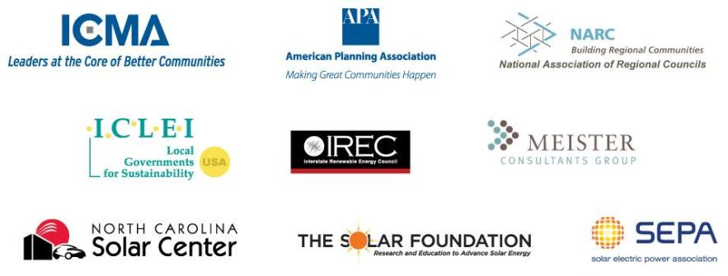
About the SunShot Solar Outreach Partnership
The SunShot Solar Outreach Partnership (SolarOPs) is a U.S. Department of Energy (DOE) program designed to increase the use and integration of solar energy in communities across the US.

Slide 3
Topic Area Outline
Solar 101
Project characteristics
PV industry context
State practices
State assessment/valuation laws
Property tax implications for owners
Issues
Problems encountered in valuation and policy
Unanswered questions

Slide 4
Solar Industry 101
Real Property Type:
Residential, Commercial, Agricultural, Exempt
System Configuration:
Behind the meter (on-site use), in front of the meter (wholesale sale)
System Ownership Configuration:
Owned by real property owner, owned by a third party (leased or PPA)
Real Property Ownership:
Owned by project owner, roof/land lease

Slide 5
Net Metering
Net metering allows customers to export power to the grid during times of excess generation, and receive credits that can be applied to later electricity usage
Notes:
Net metering addresses the issue of the intermittency of solar energy generation by allowing customers to export power to the grid during times of excess generation, and receive credits that can be applied to later electricity usage

Slide 6
Net Metering: Market Share
More than 93% of distributed PV Installations are net-metered
Source: IREC (http://www.irecusa.org/wp-content/uploads/IRECSolarMarketTrends-2012-web.pdf)
Notes:
93% of distributed solar installations in the US rely on net metering

Slide 7
Net Metering: State Policies
www.dsireusa.org / August 2012.
DC
43 states,
+ Washington DC
& 4 territories,have adopted a net metering policy.
Note: Numbers indicate individual system capacity limit in kilowatts. Some limits vary by customer type, technology and/or application. Other limits might also apply. This map generally does not address statutory changes until administrative rules have been adopted to implement such changes.

Slide 8
Renewable Portfolio Standard
Renewable Energy
Any electricity source

Slide 9
Renewable Portfolio Standard
Solar carve-out
Renewable Energy
Any electricity source

Slide 10
Renewable Portfolio Standard
e⁻
$
Fossil Fuel
Two revenue streams
Utility
e⁻
$
$
REC
Solar Energy System
Notes:
In general, SRECs are a form of Renewable Energy Certificate
SREC sale opportunities exist in states that have RPS legislation with specific requirements for solar energy, usually referred to as a "solar carve-out"
States define SRECs differently
State policy variations ultimately determine what an SREC is worth and how the generator is able to receive value from its sale

Slide 11
Renewable Portfolio Standard
www.dsireusa.org / March 2013.
29 states,+ Washington DC and 2 territories,have Renewable Portfolio Standards
(8 states and 2 territories have renewable portfolio goals).

Slide 12
Third Party Ownership: PPA
Power Purchase Agreement
$
$
e⁻
e⁻
$
$
Incentives
Customer
Developer
Notes:
Solar power developer finances, owns and operates the system
Customer receives benefits of on-site electric generation (i.e., lower electric bill) and compensates the owner through electricity purchases or lease payments
Benefits: Tax incentive utilization, up-front costs reduced/eliminated, lower “hassle factor”

Slide 13
Assessment Basics
Property taxes are a significant source of local government revenue
Real property and personal property
Three methods
Sales comparison/market
Cost
Income
Which one for solar?

Slide 14
PV Valuation Issues
Comparable Sales
Limited/no data available
Typically ball-parked at 20 times the value of annual energy savings
LBL study in CA put it at 14 -22 times the value of energy savings, but…
Hard to isolate the impact of PV from other factors
Directly applies only to a limited and unique market
Bottom line: At this point it is very challenging to reliably estimate

Slide 15
PV Valuation Issues
Cost
Cost basis (Incentives? Adjustments?)
Transferrable vs. non-transferrable to buyer
What is the right depreciation schedule?
Found ranges from 5 – 50 years
Abnormal obsolescence?
Front-loads property tax burdens
Market vs. depreciated original
How reliable is market data?
Bottom Line: Perceived reasonableness varies

Slide 16
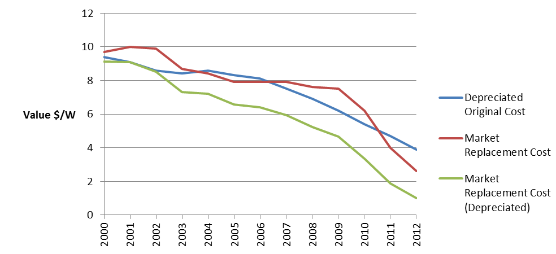
Market vs. Depreciated Original
Notes:
The value of a PV installation arrived at through a market replacement cost estimate may differ considerably from one arrived at using depreciated original costs. Figure 6 illustrates how these two approaches compare to one another for a hypothetical PV system installed in 1999 at an installed cost of $10 per watt. The depreciated cost calculation uses the 18-year Percent Good table established by the state of North Carolina for valuing PV systems. The market replacement cost line reflects representative average installed cost estimates from Lawrence Berkeley National Lab Tracking the Sun reports and more recent estimates from GTM Research. The striking detail here is that by 2012, the original depreciated cost of a 12-year old PV system is 50% greater than the market replacement cost (i.e., a brand new system) and nearly 4 times higher than the value arrived at if depreciation is applied to market cost estimates.

Slide 17
PV Valuation Issues
Income
Complicated (unless a standardized tool is used)
May require information that is hard to obtain or impossible to forecast
Electricity prices
SREC values
Capitalization rate
May depart from traditional valuation of some properties
Do power or SREC sales constitute a true “income” motivation, regardless of site/owner?

Slide 18
Current Practices: 15 States
State | Exemption or Equivalent | Other Policy/Properties | Other Methods/Notes
Arizona | Behind the meter systems are exempt (TPO unclear) | Valued at 20% depreciated cost (30-yr SL, 10% floor); 20% assessment rate | Assessment rate for utility and industrial property varies from year to year
California | Value excluded for locally assessed properties | Utility or very large scale projects are centrally assessed (no exclusion) | Exclusion lost at change in PV property ownership; sale leasback and flip do not trigger
Colorado | Residential behind the meter systems exempt, including third-party owned up to 100 kW | 2 MW-AC or less locally assessed at value of $1,171/kW and 20-yr economic life; 29% assessment rate | Larger than 2 MW-AC uses income approach equalized to cost approach with standard values
Florida | No statewide policy | Residential typically real property; non-residential typically personal property (cost and/or income) | No set depreciation schedule, but commonly 25 - 30 years; FL PSC schedule is 30 years
Hawaii | All counties have local exemptions for behind the meter systems, 25% exports permitted | County practices vary; some counties offer additional exemptions for wholesale | Cost approach typically used where exemption does not exist
Illinois | Law unclear, but all behind the meter systems appear to be exempt | Special assessment may apply to wholesale; personal vs. real property likely important | No business personal property tax; 33.3% assessment ratio
Maryland | All behind the meter systems are exempt | Wholesale gets 50% exemption; valued at depreciated cost (30-yr SL, 25% floor) | Local property tax credits exist in several counties (typically limited to residential)
Massachusetts | 20-yr exemption for behind the meter systems located on taxable property | Non-exempt systems likely cost approach; no standard depreciation. | For wholesale, some components may be assessed as real property

Slide 19
Current Practices: 15 States
State | Exemption or Equivalent | Other Policy/Properties | Other Methods/Notes
Nevada | All behind the meter systems are exempt | Valued at depreciated cost (1.5% annually for 50 years); 10+ MW get 55% abatement for 20 years | Typically locally assessed; abatements seeking personal property classification denied
New Jersey | All behind the meter systems are exempt | No business personal property tax; wholesale facilities most likely personal property | Pending legislation would apply $7,000/MW standard rate for wholesale facilities
New Mexico | Residential systems not treated as physical improvement, therefore exempt | All other PV assessed centrally using depreciated cost (20-yr SL, 20% floor); 33.3% assessment rate | Residential exemption lasts only until change is home ownership
New York | Residential behind the meter exempt; local option 15-yr exemption for other facilities or PILOT | If opted-out, no personal property tax, but one ORPTS opinion called wind farm real property | No apparent ownership or on-site use requirements for 15-yr local option
North Carolina | Residential behind the meter exempt as non-business personal property | Valued at depreciated cost (18-yr SL with inflation added, 25% floor); 80% of appraised value exempt | Utility-owned centrally assessed using composite; 80% exemption applied to cost method
Ohio | All systems 250 kW-AC or less exempt | PILOT of $7,000 - $9,000/MW for non-exempt systems placed in service by 2013 | Additional requirements for PILOT if facility is 5 MW or larger
Pennsylvania | No statewide policy so local variation possible | For residential, no comparable sales. Non-residential may be commercial equipment (exempt) | Wholesale likely income capitalization, unless considered commercial equipment

Slide 20
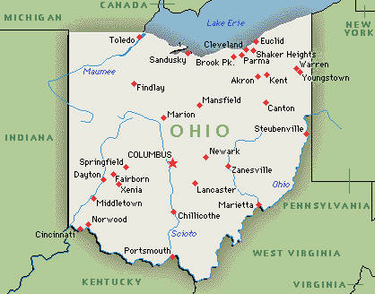
Financial Implications: Examples
OH (PILOT at $7,000/MW): $6 – 7/MWh (slightly back-loaded due to production declines)
Reduction of ~90% compared to former system (as utility property)

Slide 21
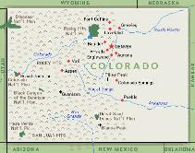
Examples
CO ($1,173/kW value, 20-yr life, 29% assessment rate, varied mill rates):
Avg. MW rate = $11,000 - $22,000 /MW (front-loaded in theory)
Avg. MWh rate = $7 – 17/MWh (front-loaded in theory)
Increases in threshold capital cost have a significant influence
5% increase increases valuations by 65% over 20 years
16% increase increases valuations by 600% over 20 years

Slide 22
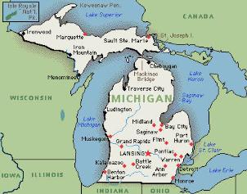
Examples
MI (Depreciated Market Cost)
147 kW facility in Kalamazoo valued at $7.3M per MW
Owner contends cost was 50% of that
Property tax owned in Year 1: $120/MWh, more than the retail value of electricity

Slide 23
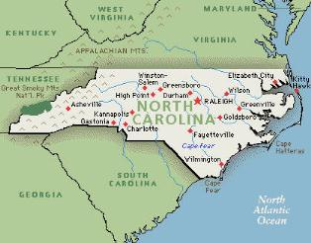
Examples
NC (Depreciated Original Cost; 80% abatement, 18-year trended schedule)
At $5.33/W taxes owed = $4-5/MWh

Slide 24
Policy Issues
Classification as real or personal property
Whether the property classification is explicitly stated or implied by state law or regulation
The potential for injury to the PV property or to the underlying real property upon removal of the equipment
The physical character of the facility, including the degree to which various components are “attached” to each other or the underlying real property

Slide 25
Real vs. Personal Cont…
Classification of real or personal property
The details of other indicators of the permanence of the facility, such as any associated contracts or leasing arrangements
The degree to which a system functions as an integrated whole rather than a collection of independent pieces of machinery and equipment, including whether it is uniquely adapted for a specific site or use
Whether or not a system is being put to a business use of some type

Slide 26
Policy Issues
Clarity of terms and treatment
What is a “conventional system” with respect to PV?
Treatment of grid-supply vs. behind the meter systems
Lack of differentiation
Ambiguous language (e.g., third-party owned systems)
Attention to market variations

Slide 27
Policy Issues
System vs. Value Added
Ultimately mean different things
Most visible where system is owned by a third-party
Systems on Exempt Property
Exclusive use and default to taxation
Income producing?
Different ownership scenarios
Systems on Specially Assessed Farmland

Slide 28
“Standard” Practices
Ignore or exempt behind the meter systems or those put to personal use
If exemption does not apply, use the replacement cost method for behind the meter systems (usually business personal property)
Use income and/or cost in combination for grid supply systems
Exempt grid supply/commercial systems in favor of a negotiated or standard PILOT

Slide 29
Policy Considerations
Careful attention to market context and how changes affect property taxes
Simplicity vs. accuracy and ease of implementation
Fairly implementing changes (e.g., timing)
Clear determinations of real vs. personal property classification

Slide 30
Policy Considerations Cont…
Collection of information to support comparable sales analysis and relative burden
Use of simplified or standard income-based tools (e.g., PV Value).
Guidance and data for the use of cost approaches
Impacts on local revenue and projects

Slide 31
Questions for Further Discussion
Can we define PV as real or personal property?
What is the best valuation method for different circumstances?
Is one-size fits all a good approach?
What does equality mean in terms of property taxes on traditional generation and PV (or other renewables)?
Is there “value” in having a good solar site (e.g., a roof, vacant land)

Slide 32
Justin Barnes
Chad Laurent
Keyes, Fox and Wiedman, LLP
jbarnes@kfwlaw.com
Meister Consultants Group, Inc.
chad.laurent@mc-group.com
(617) 209-1986

