Slide 1
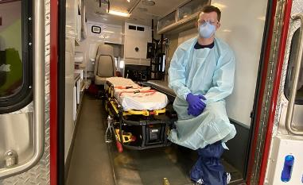
COVID-19 Emergency Medical Services’ Role and Impact
Tom Wieczorek
Center for Public Safety Management
Chip Decker
Richmond Ambulance Authority
President, AIMHI
Veer Vithalani, M.D., FAEMS
MedStar Mobile Healthcare
Matt Zavadsky
MedStar Mobile Healthcare
Notes:
Tom - MODERATOR
Thank you for joining us for today’s webinar, EMS roles and impacts of COVID-19
Each speaker introduces themselves

Slide 2
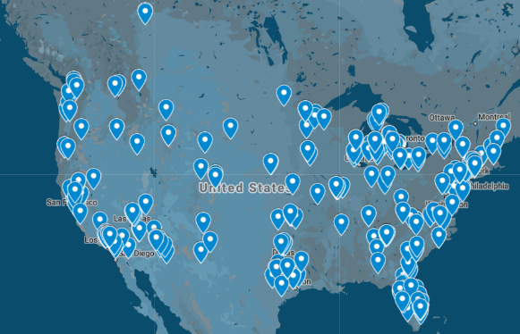
About The Center for Public Safety Management
The Center for Public Safety Management has conducted 348 projects, in 44 states & Canada and 256 jurisdictions.
Workload and Operations Analysis
Combining consulting and experience in managing over 300 public safety agencies to assess the workload and/or operations of client agencies.
This involves data collection and analysis, interviews, comparison analysis and observation.
Recommendations are developed for balancing workload and service needs within local budgets.
The goal is more efficient and effective public safety service delivery that is grounded in data and best practices.
Notes:
Tom

Slide 3
Notes:
Chip –
The Academy of International Mobile Healthcare Integration (AIMHI) represents high performance emergency medical and mobile healthcare providers in the U.S., and Canada.
Member organizations are high-performance systems that employ business practices from both the public and private sectors.

Slide 4
Tell us about this virus?
Notes:
Veer – in layman’s terms – why are people so ‘freaked out’ about the virus as opposed to say, the flu?

Slide 5
COVID-19
Disease first identified in Wuhan, China in December 2019
Caused by novel (new) coronavirus, named “SARS-COV-2”
Different than the 4 standard human coronaviruses, SARS, or MERS
Disease called “Corona Virus Disease 2019” or COVID-19
Now in more than 100 countries, including the USA
Currently considered a “pandemic” due to sustained person-to-person transmission
Notes:
Veer

Slide 6
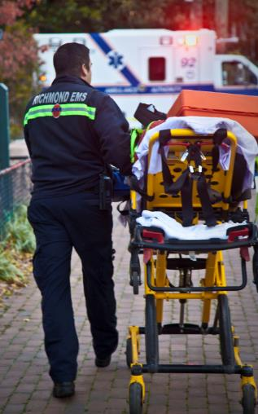
Background
Majority (80%) infections are mild – 15% severe – 5% ICU
Transmissibility (R0) - ~2.4
Case Fatality Rate - ~2%
Highest risk in 60+ and/or heart/lung disease
Notes:
Veer

Slide 7
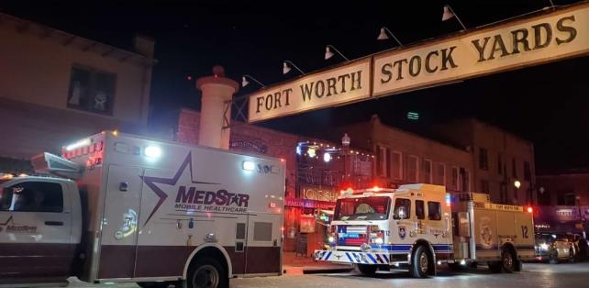
COVID-19 Impact on EMS Operations?
Notes:
Matt:
Many areas to discuss
Workforce
Dispatch processes & protocols
Response processes
Clinical protocols
Response volume
Healthcare system integration
EMS’ role in the community
Economics

Slide 8
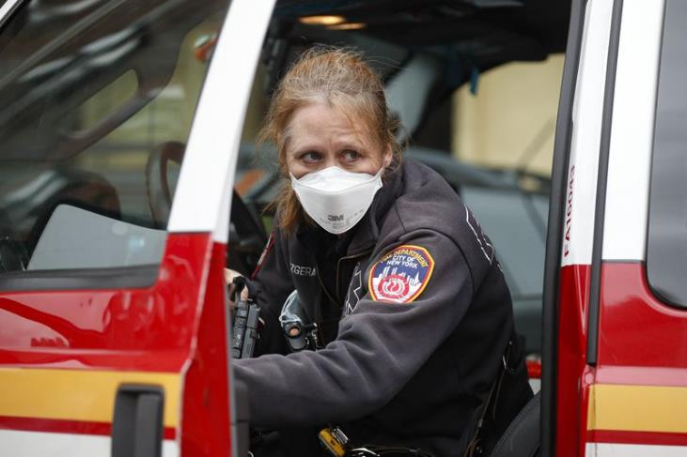
Workforce…
Notes:
Chip & Matt:
Concerns/fears
Questions and communication
6 x per week ALL STAFF conference calls
Alternate living arrangements
Testing to release to work
Workforce (screening, isolation, alternate resident locations)

Slide 9
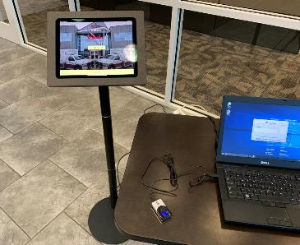
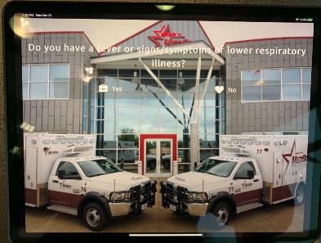
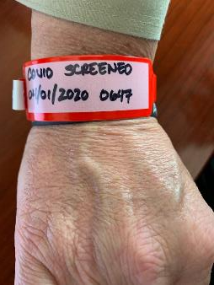
Workforce…
Notes:
Example - Matt:
Screening all workers
Keep campus personnel safe
Ease screening into other healthcare settings

Slide 10
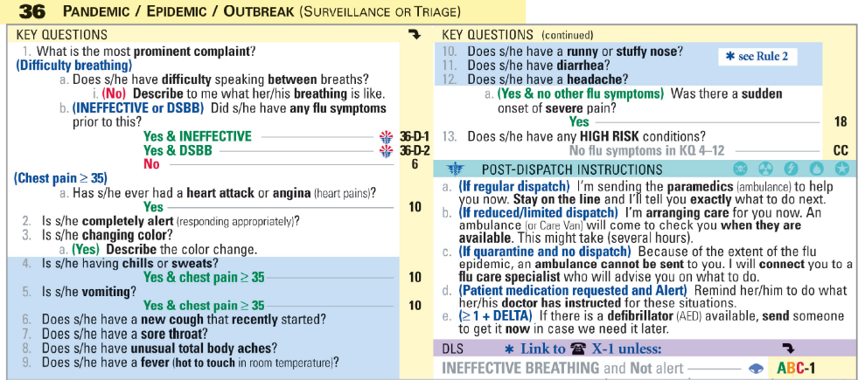
Dispatch Processes…
Notes:
Veer:
Types of calls (Card 36 reclassification)
“Hear and Treat” via local protocols to reduce EMS responses

Slide 11
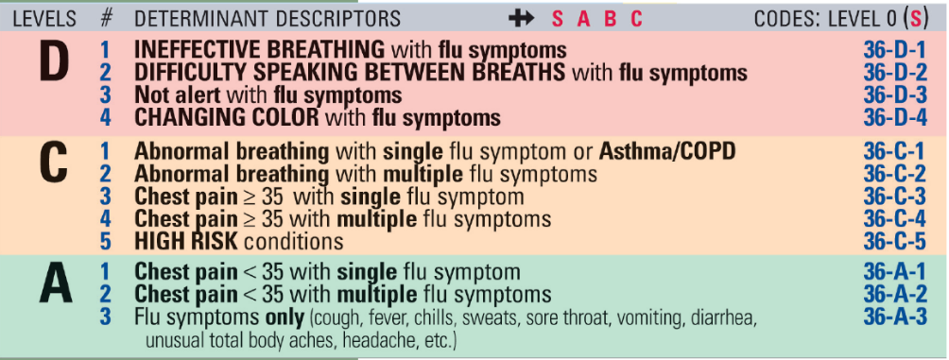
Dispatch Processes…
Notes:
Veer:
Types of calls (Card 36 reclassification)
“Hear and Treat” via local protocols to reduce EMS responses
Chip/Matt:
Enhanced radio comms for communication enroute and on-scene
Response plans to minimize personnel contact with patient (and PPE use)

Slide 12
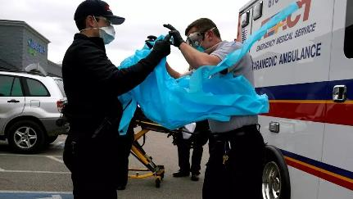
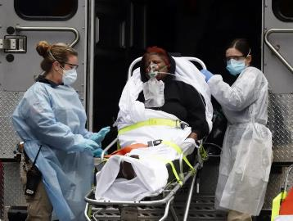
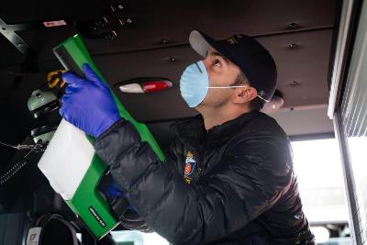
Response Processes…
Notes:
Chip & Matt:
PPE use
On-scene processes (minimize personnel in contact with ALL patients)
NO RIDERS
Hospital drop off/interface
Decon and impact on task times

Slide 13
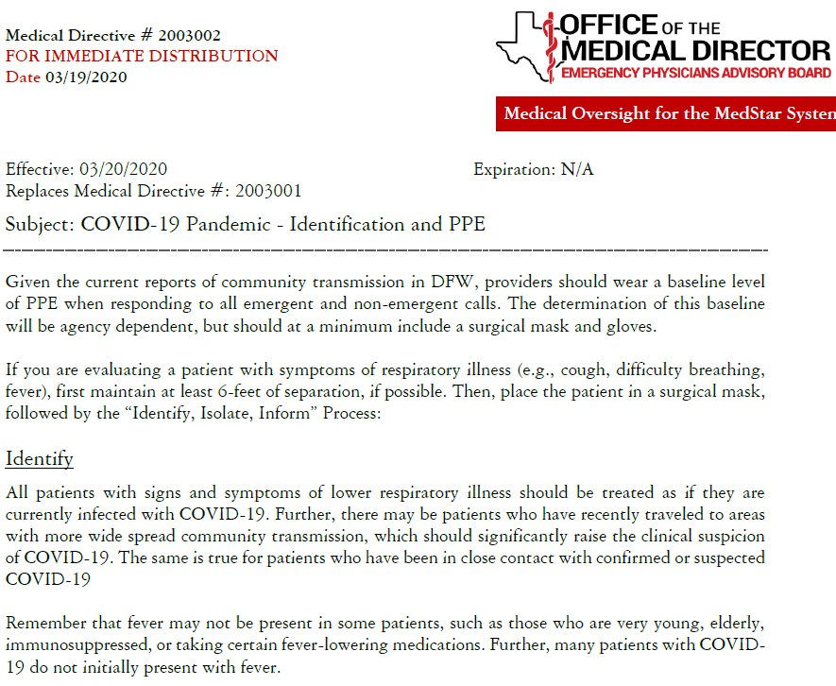
Clinical Protocols…
Notes:
Dr. V –
Re-enforce PPE use
Special attention, NY’s announcement to NOT transport cardiac arrest victims – rationale and not really a thing?

Slide 14
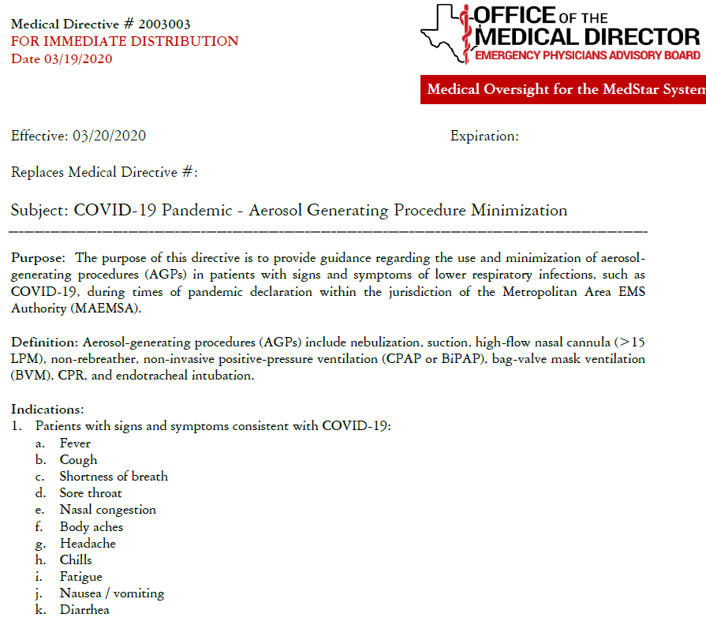
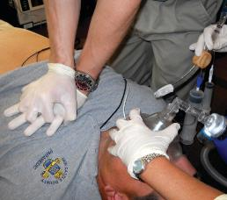
Clinical Protocols…
Notes:
Dr. V –
Cautions/limiting APG procedures
Response/destination protocols

Slide 15
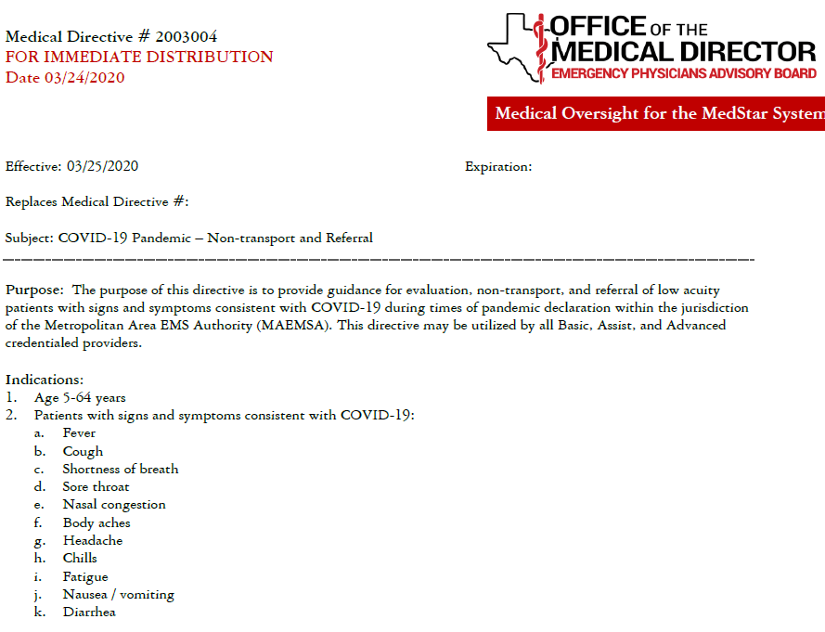
Clinical Protocols…
Notes:
Dr. V –
Treat on scene and referral

Slide 16
Notes:
Dr. V –
On-scene instructions, no transport

Slide 17
Notes:
Dr. V –
On-scene instructions, no transport

Slide 18
Response Volume…
Response Volume Analysis
Through April 14, 2020
 | Response Volume | Transports | Days | Responses per Day | % Change | Transports per Day | % Change | Transport Ratio
Jan-20 | 12,766 | 9,909 | 31 | 411.8 |  | 319.6 |  | 77.6%
Feb-20 | 11,608 | 8,911 | 29 | 400.3 | -2.8% | 307.3 | -3.9% | 76.8%
Mar-20 | 11,831 | 8,583 | 31 | 381.6 | -4.7% | 276.9 | -9.9% | 72.5%
Apr-20 | 4,675 | 3,074 | 14 | 333.9 | -12.5% | 219.6 | -20.7% | 65.8%
Totals | 40,880 | 30,477 | 105 | 389.3 |  | 290.3 |  | 74.6%
January to April Response Change: -18.9%
January to April Transport Change: -31.3%
Notes:
Chip & Matt:
Roller coaster
Low, then high (potentially)
Examples from NYC, Detroit, New Orleans
Types of calls (Card 36 reclassification)
**UPDATE THIS SLIDE PRIOR TO PRESENTATION**

Slide 19
Response Volume…
 | All Incidents |  |  | Card 36 Determinant
 | Total Responses | Total Transports | Transport Ratio | Response Volume | % of Responses | Transports | % of Transports | Hours | Responses per Hour | Transports per Hour | Transport Ratio
21-Mar | 335 | 248 | 0.740 | 58 | 17.3% | 45 | 18.1% | 24 | 2.4 | 1.9 | 0.776
22-Mar | 320 | 213 | 0.666 | 66 | 20.6% | 51 | 23.9% | 24 | 2.8 | 2.1 | 0.773
23-Mar | 363 | 266 | 0.733 | 65 | 17.9% | 48 | 18.0% | 24 | 2.7 | 2.0 | 0.738
24-Mar | 384 | 297 | 0.773 | 87 | 22.7% | 72 | 24.2% | 24 | 3.6 | 3.0 | 0.828
25-Mar | 379 | 238 | 0.628 | 80 | 21.1% | 48 | 20.2% | 24 | 3.3 | 2.0 | 0.600
26-Mar | 336 | 219 | 0.652 | 65 | 19.3% | 38 | 17.4% | 24 | 2.7 | 1.6 | 0.585
27-Mar | 366 | 242 | 0.661 | 63 | 17.2% | 39 | 16.1% | 24 | 2.6 | 1.6 | 0.619
28-Mar | 337 | 221 | 0.656 | 66 | 19.6% | 44 | 19.9% | 24 | 2.8 | 1.8 | 0.667
29-Mar | 323 | 212 | 0.656 | 69 | 21.4% | 41 | 19.3% | 24 | 2.9 | 1.7 | 0.594
30-Mar | 352 | 244 | 0.693 | 72 | 20.5% | 52 | 21.3% | 24 | 3.0 | 2.2 | 0.722
31-Mar | 292 | 203 | 0.695 | 50 | 17.1% | 31 | 15.3% | 24 | 2.1 | 1.3 | 0.620
1-Apr | 349 | 231 | 0.662 | 65 | 18.6% | 41 | 17.7% | 24 | 2.7 | 1.7 | 0.631
2-Apr | 331 | 222 | 0.671 | 56 | 16.9% | 41 | 18.5% | 24 | 2.3 | 1.7 | 0.732
3-Apr | 324 | 204 | 0.630 | 61 | 18.8% | 38 | 18.6% | 24 | 2.5 | 1.6 | 0.623
4-Apr | 307 | 195 | 0.635 | 67 | 21.8% | 45 | 23.1% | 24 | 2.8 | 1.9 | 0.672
5-Apr | 295 | 180 | 0.610 | 61 | 20.7% | 38 | 21.1% | 24 | 2.5 | 1.6 | 0.623
6-Apr | 313 | 211 | 0.674 | 70 | 22.4% | 49 | 23.2% | 24 | 2.9 | 2.0 | 0.700
7-Apr | 363 | 241 | 0.664 | 58 | 16.0% | 41 | 17.0% | 24 | 2.4 | 1.7 | 0.707
8-Apr | 383 | 240 | 0.627 | 62 | 16.2% | 42 | 17.5% | 24 | 2.6 | 1.8 | 0.677
9-Apr | 332 | 221 | 0.666 | 56 | 16.9% | 37 | 16.7% | 24 | 2.3 | 1.5 | 0.661
10-Apr | 349 | 223 | 0.639 | 59 | 16.9% | 38 | 17.0% | 24 | 2.5 | 1.6 | 0.644
11-Apr | 373 | 259 | 0.694 | 54 | 14.5% | 33 | 12.7% | 24 | 2.3 | 1.4 | 0.611
12-Apr | 338 | 229 | 0.678 | 65 | 19.2% | 47 | 20.5% | 24 | 2.7 | 2.0 | 0.723
13-Apr | 318 | 206 | 0.648 | 58 | 18.2% | 36 | 17.5% | 24 | 2.4 | 1.5 | 0.621
14-Apr | 302 | 216 | 0.715 | 55 | 18.2% | 41 | 19.0% | 24 | 2.3 | 1.7 | 0.745
Avg | 339 | 227 | 0.671 | 64 | 18.8% | 43 | 18.9% |  | 2.6 | 1.8 | 0.678
Notes:
Chip & Matt:
Roller coaster
Low, then high (potential)
Types of calls (Card 36 reclassification)
**UPDATE THIS SLIDE PRIOR TO PRESENTATION**

Slide 20
Response Volume…
 |  | Disposition
 | Crew = COVID Follow-up Warranted | Transported | AMA | COVID 19 Protocol | Refused All Care | Flight Crew | DOS
21-Mar | 33 | 30 | 3
22-Mar | 29 | 25 | 3 |  |  | 1
23-Mar | 26 | 24 | 2
24-Mar | 34 | 33 | 1
25-Mar | 30 | 24 | 4 | 2
26-Mar | 33 | 29 | 2 | 2
27-Mar | 38 | 30 | 5 | 1 |  | 1 | 1
28-Mar | 32 | 24 | 3 | 2 | 2 |  | 1
29-Mar | 34 | 28 | 2 | 4
30-Mar | 34 | 29 | 3 | 2
31-Mar | 24 | 23 |  | 1
1-Apr | 42 | 38 | 2 | 1 | 1
2-Apr | 33 | 27 | 3 | 1 | 2
3-Apr | 31 | 22 | 4 | 5
4-Apr | 37 | 35 |  | 2
5-Apr | 27 | 24 |  | 1 |  |  | 2
6-Apr | 26 | 25 | 1
7-Apr | 35 | 33 |  | 2
8-Apr | 37 | 23 | 3 | 9 | 1 |  | 1
9-Apr | 27 | 21 | 4 | 2
10-Apr | 39 | 28 | 4 | 6 |  | 1
11-Apr | 31 | 25 | 1 | 3 |  |  | 2
12-Apr | 33 | 29 | 1 | 3
13-Apr | 18 | 17 |  | 1
14-Apr | 34 | 30 | 3 | 1
Running Total | 797 | 676 | 54 | 51 | 6 | 3 | 7
Daily Average | 31.9 | 27.0 | 2.2 | 2.0 | 0.2 | 0.1 | 0.3
Notes:
Chip & Matt:
Roller coaster
Low, then high (potential)
Types of calls (Card 36 reclassification)
**UPDATE THIS SLIDE PRIOR TO PRESENTATION**

Slide 21
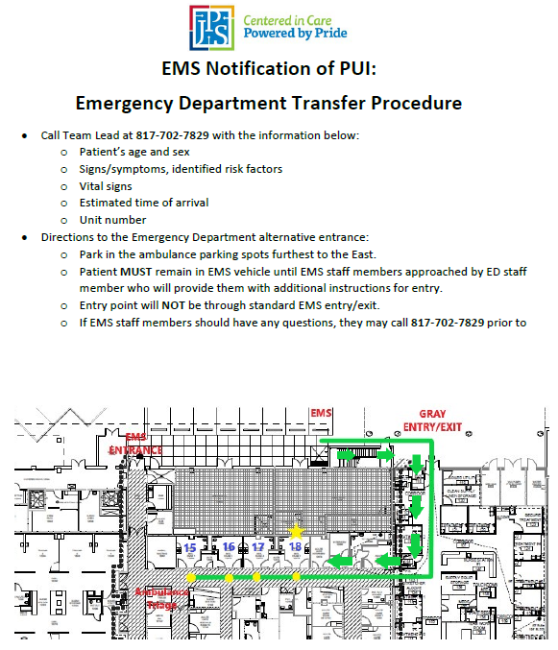
Healthcare System Integration…
Notes:
Veer & Chip:
Communication!
Processes for patient hand-off to the ED
Processes to enhance hospital capacity
Inter-facility transports to distribute volume

Slide 22
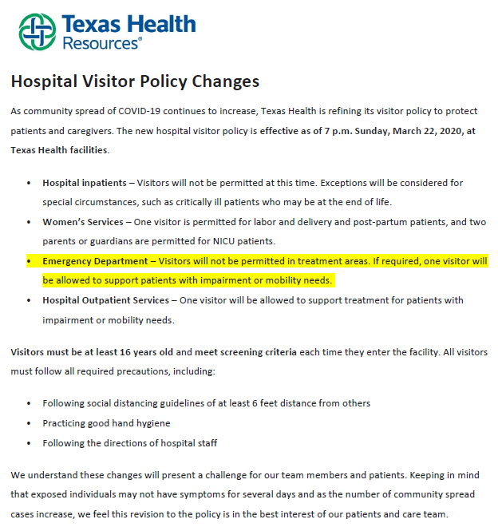
Healthcare System Integration…
Notes:
Veer & Chip:
Communication!
Processes for patient hand-off to the ED
Processes to enhance hospital capacity
Inter-facility transports to distribute volume

Slide 23
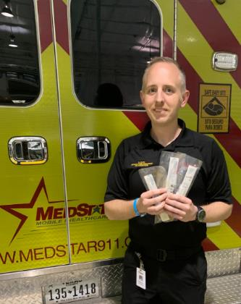
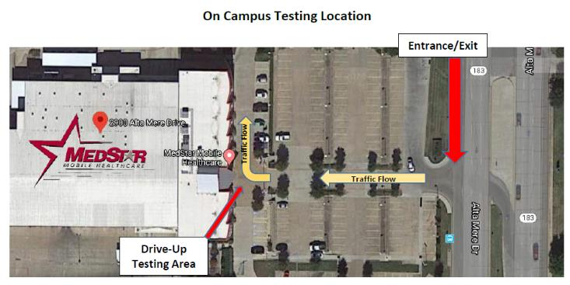
EMS’ Enhanced Role in the Community
Notes:
Chip/Veer/Matt:
Enhanced communications/coordination with local and regional stakeholders
Patient navigation vs. patient transportation
Home visits to prevent hospital use (post-discharge, etc.)
In-home testing of PUIs
Staffing/hosting testing sites for HCW/1st Responders
Medical Operations Center coordination/leading

Slide 24
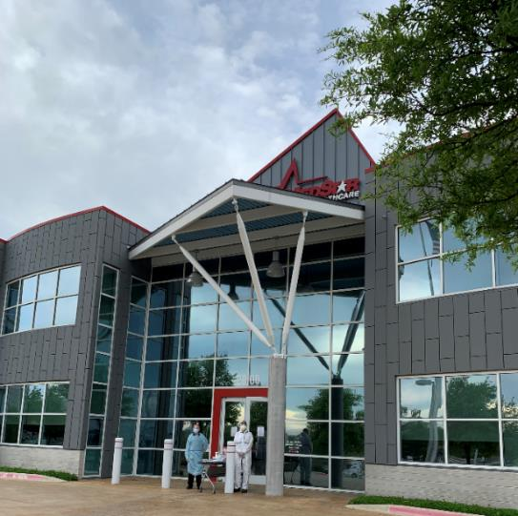
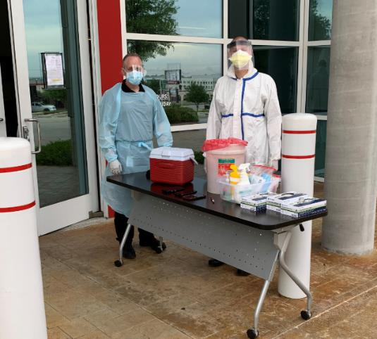

Slide 25
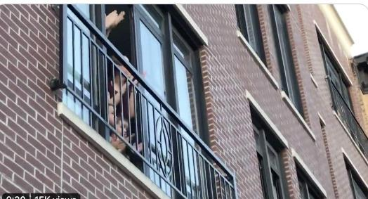
Community Support…
Notes:
Chip & Matt:
Even more than after 9/11
Donations, recognition

Slide 26
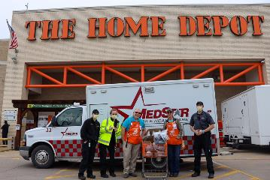
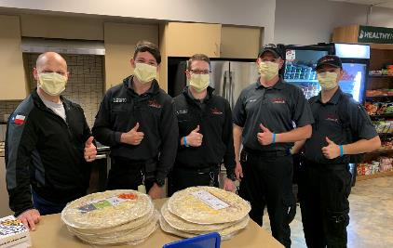
Community Support…
Notes:
Chip & Matt:
Even more than after 9/11
Donations, recognition

Slide 27
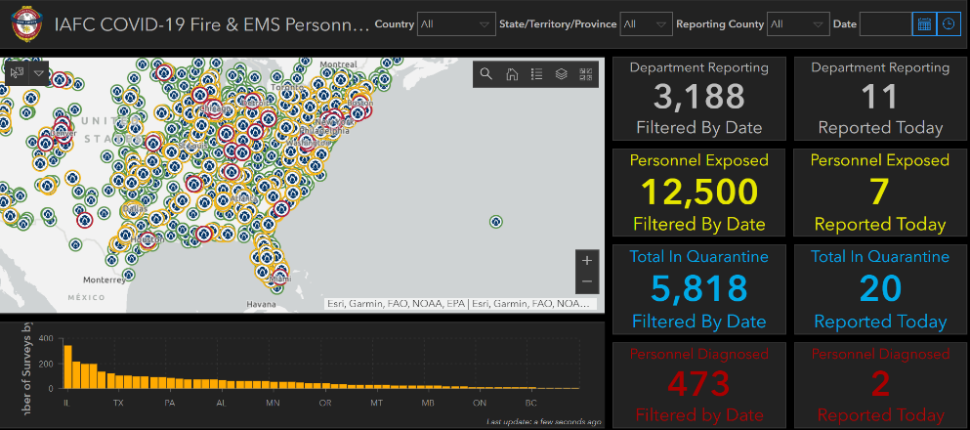
Current EMS Challenges
Notes:
Chip/Veer/Matt:
Workforce issues
Staffing/isolation

Slide 28
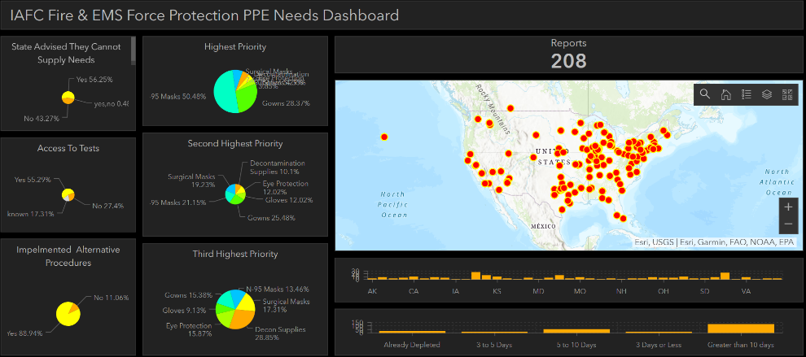
Current EMS Challenges
Notes:
Chip/Veer/Matt:
PPE

Slide 29
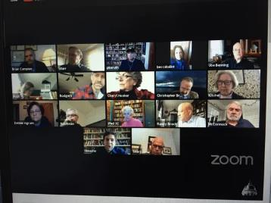
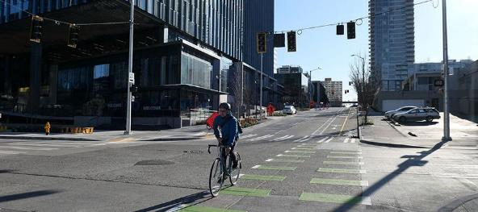
Current EMS Challenges
Notes:
Chip/Veer/Matt:
Information overload
Changing federal/regional direction
Shutdown of support services
Time management

Slide 30
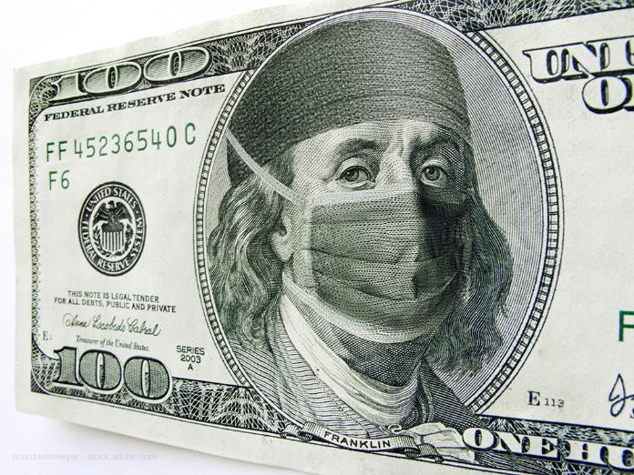
Current EMS Challenges
Notes:
Chip/Veer/Matt:
Expenses/cashflow/budget overages
Expenses up, call volume down
Business office staff working remotely

Slide 31
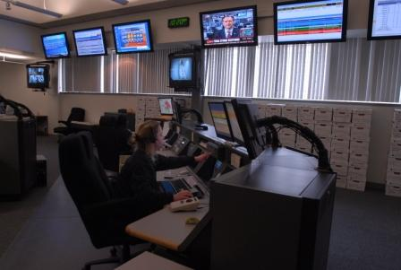
Best Practices
Notes:
Chip:
Nimble EMS operations
Structure that supports change/innovation
Supportive city/county leadership

Slide 32
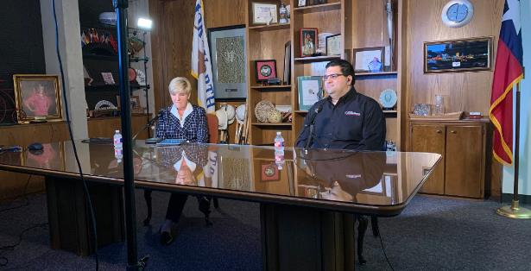
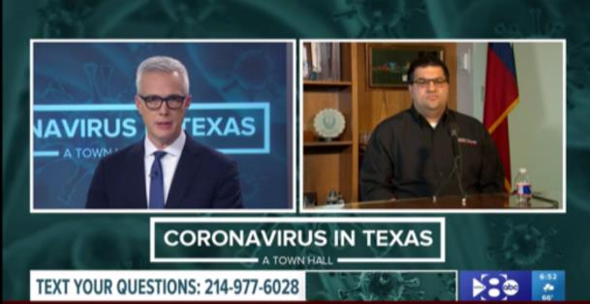
Best Practices
Notes:
Matt:
Engaged Medical Director
Plugged into the EMS, healthcare and public
Flexible medical protocols
Veer:
Flexible operations
Communicate/Communicate/Communicate
Daily meetings w/ops
TMOC, etc.

Slide 33
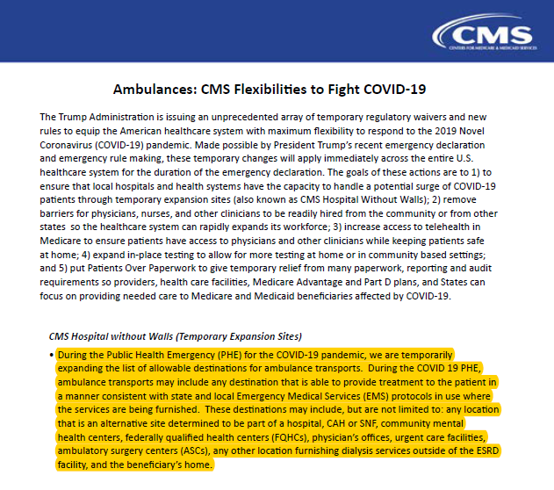
Best Practices
Notes:
Chip:
Economic relief – support alternate payment models
Treat and refer, alternate destinations Enhance health system capacity
Minimize economic losses
Recent CMS rule

Slide 34
Best Practices
Notes:
Chip:
Economic relief – support alternate payment models
Treat and refer, alternate destinations Enhance health system capacity
Minimize economic losses
Recent CMS rule

Slide 35
Notes:
Tom aids with Q&A question relay logistics.

Slide 36
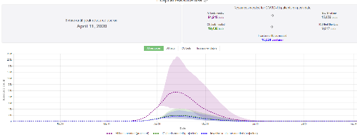
Thank You!
Tom Wieczorek
Center for Public Safety Management
Chip Decker
Richmond Ambulance Authority
President, AIMHI
Veer Vithalani, M.D., FAEMS
MedStar Mobile Healthcare
Matt Zavadsky
MedStar Mobile Healthcare
Notes:
Tom -
Thank you for joining us for today’s webinar, EMS roles and impacts of COVID-19

