Slide 1
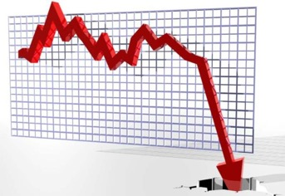




Budgeting During a Crisis:
Responding to the COVID-19 Recession
April 17, 2020

Slide 2
Objectives of Today’s Webinar
1
2
3
4
Offer initial projections about potential financial impacts of COVID-19 on cities
Explore phases of response, from forecasting to cutbacks to policy solutions
Preview sample forecasting tool to help project the impact of the COVID-19 downturn
Share strategies for addressing this emergency

Slide 3
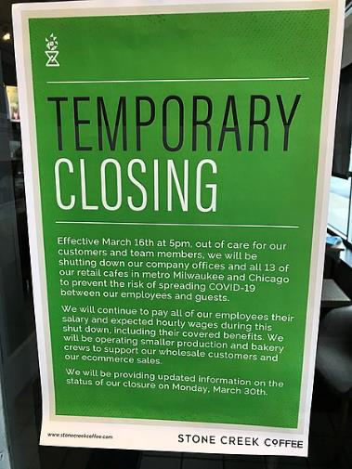
The COVID-19 Recession:
Much of the Economy Immediately Shut Down
About 95% of U.S. population, about 306 million people, are under stay-at-home orders
Consequently, economic activity has been greatly decreased
Local governments, especially cities, depend on economic activity for tax revenues

Slide 4
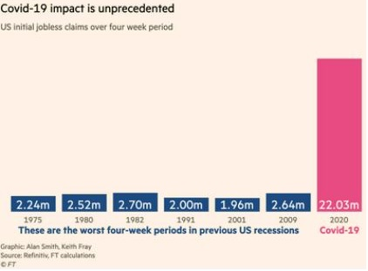
The COVID-19 Recession:
Unemployment Spike, Retail Collapse
Nearly 22 million new unemployment claims were filed in the past month, while retail sales plunged a record-breaking 8.7 percent.

Slide 5
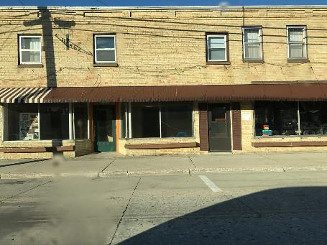
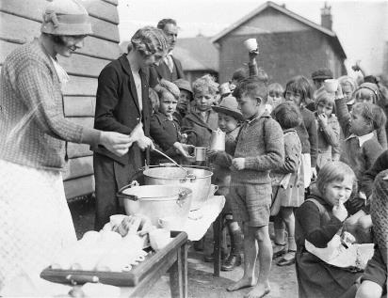
The COVID-19 Recession:
Swift, Severe Impact
During the Great Recession, 8.7 million jobs were shed over two years; half the job loss in 2020 so far.
The International Monetary Fund predicts the current downturn will be the worst since the Great Depression in the 1930s.
Notes:
Recovery could take years as we won’t approach resumption of normal activity until a vaccine is developed

Slide 6
The COVID-19 Recession:
Local Governments Hit Hard
Nearly 9 in 10 city leaders say they expect major budget shortfalls according to a survey of 2,400 local leaders by National League of Cities and U.S. Conference of Mayors
CARES Act is putting $2 trillion into economy, direct aid to cities under 500,000 is still unclear, but it appears to be about $170 per capita (California numbers)
Local governments must submit certifications by April 17
https://forms.treasury.gov/caresact/stateandlocal

Slide 7
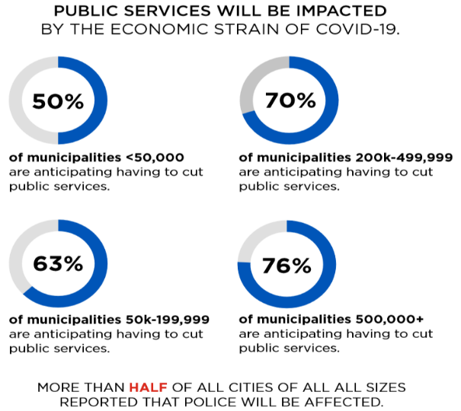
The COVID-19 Recession:
Local Governments Hit Hard
Source: National League of Cities survey

Slide 8


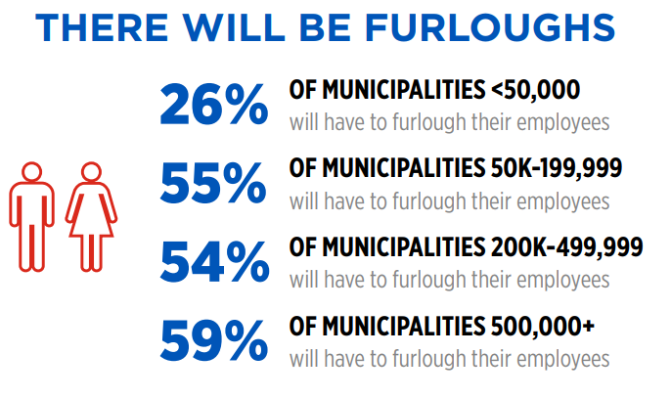
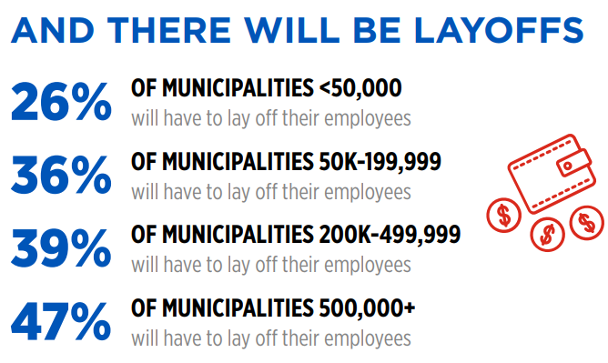
The COVID-19 Recession:
Local Governments Hit Hard
Source: National League of Cities survey

Slide 9
Step 1: Understand the next 6 to 18 months
Forecast how revenues will be affected by the pandemic-induced economic downturn.
Develop a range of scenarios tied to assumptions about the downturn’s severity.
Determine how soon General Fund resources might be depleted.
Timing of the impact will depend on each jurisdiction’s major revenue sources and elasticity of sources
Each city is unique – some will see major problems as early as this fall

Slide 10

Local Agency Revenue Impacts Vary by Source
Property Tax
Income Tax
Sales Tax, Hotel Tax, Property Transfer Tax
Business License Tax
Utility Users Tax, Franchise Payments
Recreation and Fee Programs
Notes:
This is the key slide - important to emphasize state differences ... if you're sales or earnings tax (or hotel tax) dependent you have a big problem right away; if not, could have a year or so to plan.

Slide 11
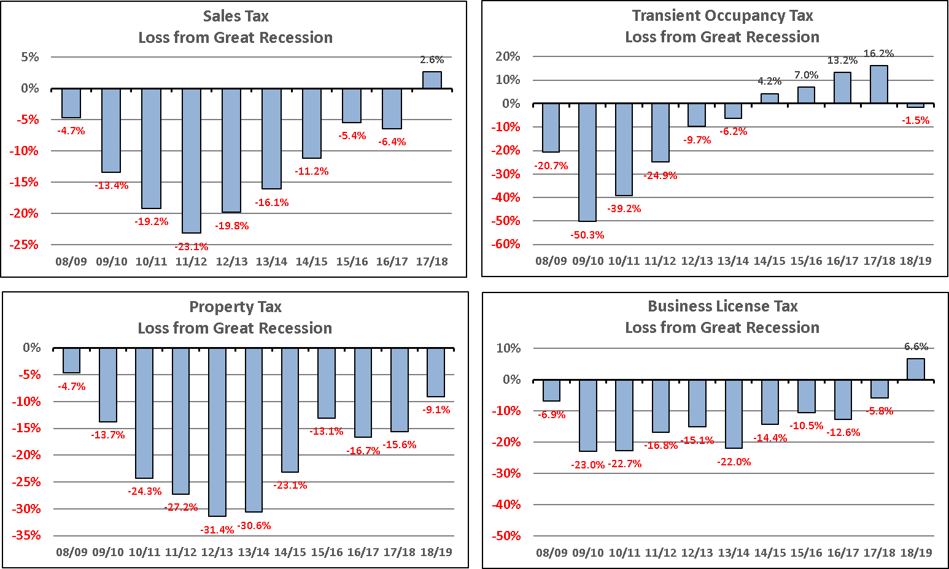
What Will This Recession Look Like?
Need to forecast magnitude and duration of impact to be set by revenue source by fiscal year
Losses are compared to a pre-recession forecast
Notes:
Turn over to Bob at the start of this slide. Need to forecast the magnitude and duration of revenue impacts by source and fiscal year" (that's the response to the question in the header) Losses are compared to a pre-recession forecast

Slide 12
Elements to Include in a Short-Term Forecast
Agency-specific data
Recent and budgeted (pre-recession) revenues and expenditures by category, fund balance
Different scenarios
No-recession forecast
Recession forecast
Allow for flexibility
Dashboard of charts showing fund balance, annual shortfall, revenue loss, cash flow

Slide 13
Elements to Include in a Short-Term Forecast
Key assumptions
Magnitude and duration of losses, by source by fiscal year
Pre-recession growth rates by revenue source
Payroll growth by police/fire/other; set growth rates such as pension, O&M, debt, capital
New local sales tax, budget cuts, budget increases
Potential federal aid or cash flow loan

Slide 14
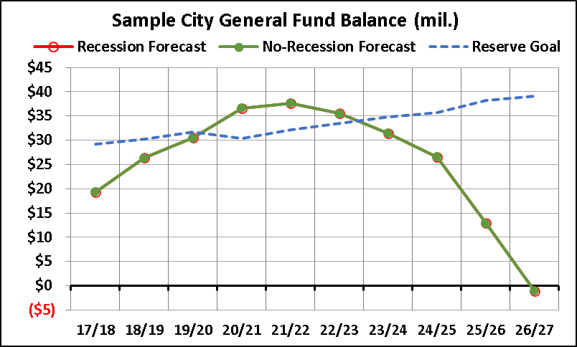
Sample Forecast – Before the Covid-19 Recession
Here is a city that is doing pretty well in the near-term, assuming no recession
They are at or near their reserve goal until 2025, when rising pension costs will drive down their available fund balance
Corrective actions will eventually be needed, even without a recession

Slide 15
Sample Forecast – Define Scale & Timing of Revenue Loss
Flexibility needed given range of potential impacts
This particular model allows magnitude of loss to be defined by revenue source, by fiscal year
Shows severe impact in first two years, declining impact over next four years
Numbers are amount below the pre-recession forecast in each year, not percent change over prior year; zero means no loss compared to a no-recession scenario

Slide 16
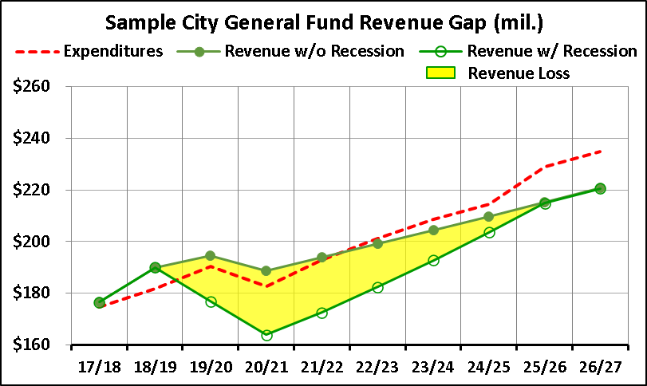
Sample Forecast – Resulting Revenue Loss
This particular scenario results in a $99M revenue loss over six years
  Loss highlighted in yellow
Revenue loss is before any:
  Federal assistance
  Short- or medium-term borrowing to bridge cash flow shortfall
  Corrective budget actions to cut spending or increase revenues

Slide 17
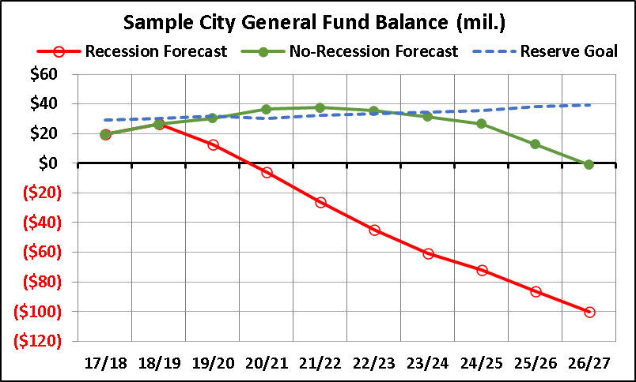
Sample Forecast – After the Covid-19 Recession
With this magnitude of revenue loss, and no mitigating actions, city is in deficit by FY 20/21
Urgent action required, given time needed to craft and implement budget cuts or revenue increases

Slide 18
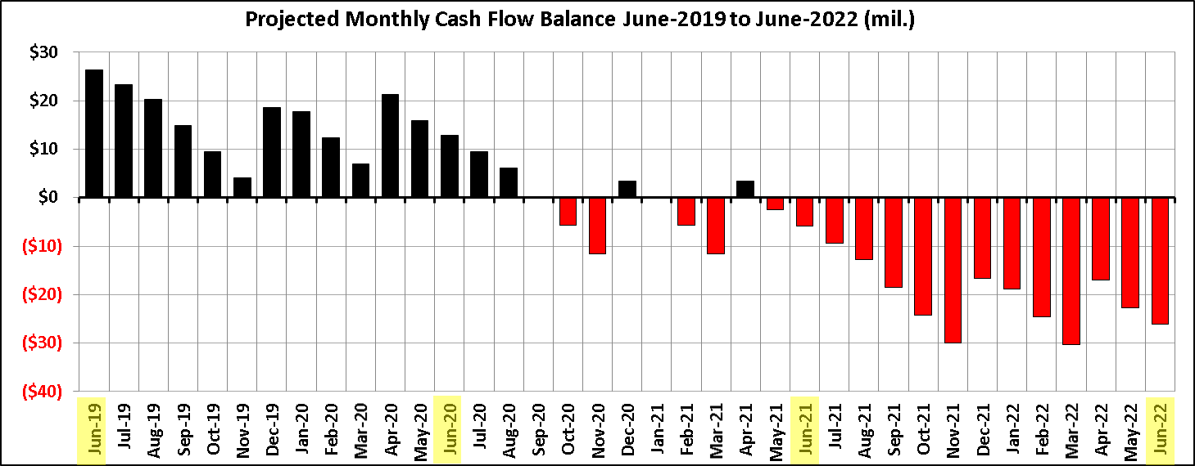
Sample Forecast – Cash is King
Examine your monthly cash flow for closer look at time available to your agency to enact budget strategies
Under this scenario, the city is permanently in the red by May 2021

Slide 19
Sample Forecast – Scenario Planning
Before: Baseline Revenues and Expenditures
  Adjust pre-recession revenue growth rates
  Vary growth rates of key areas such as staffing levels, salaries, pension, health, O&M, debt, capital
After: Incorporate Revenue Loss from COVID-19 Recession
  Vary severity of loss and recovery period, and continually adjust impacts as better information becomes available on local economic activity
Mitigation: Model Impact of Corrective Measures
  Budget reductions, tax increase
  Federal assistance, borrowing

Slide 20
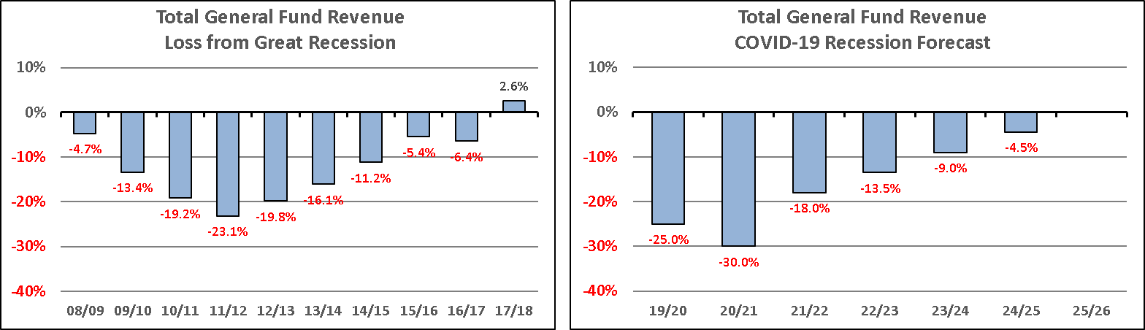
Sample Forecast – Comparison to Great Recession
Percentages are amount below a revenue forecast that assumes the Great Recession did not happen
Percentages are amount below revenue forecast without COVID-19 recession
Dust off old data, create a pre-Great Recession forecast, and compare to actuals for that period
Then compare to what your scenarios show for COVID-19 recession
This example shows a more severe initial loss under COVID-19, whereas Great Recession impact built up over several years, and the recovery took longer than this sample forecast assumes for COVID-19; this is only one potential outcome

Slide 21
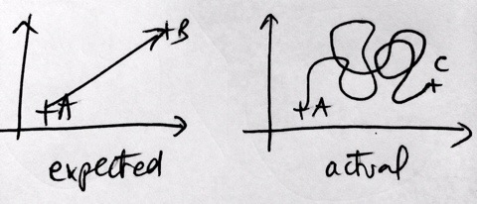

There is No Single “Right” Answer
Local economy and revenue sources vary among agencies
Many moving parts, and outcomes you don’t control
Uncertainty is unavoidable, you inevitably will be wrong
But difficult policy decisions need the best information available to support them
Develop a forecast using reasonable estimates, and create a plan capable of responding to a range of potential outcomes

Slide 22
Step 2: Reduce Spending
Reduce capital asset investments
Defer some purchases
Improve capital project management
Reexamine maintenance and replacement standards
Refinance debt
Notes:
Andy takes over here

Slide 23
Step 2: Find New Resources
Increase interfund charges where there is a case for it
Reassess internal service fund and cost allocation formulas
Redesignate general fund reserves
Consider monetizing assets
Implement new or revised fees where appropriate
Consider short-term borrowing
Notes:
Mention service sharing, but that’s longer than the short time frame we’re talking about

Slide 24
Step 2: Reduce Materials or Contractor Costs
Close facilities where social distancing isn’t possible
Eliminate lower-value or no-use programs
Review contractor costs and renegotiate if possible
Rethink subsidies, as painful as this might be

Slide 25
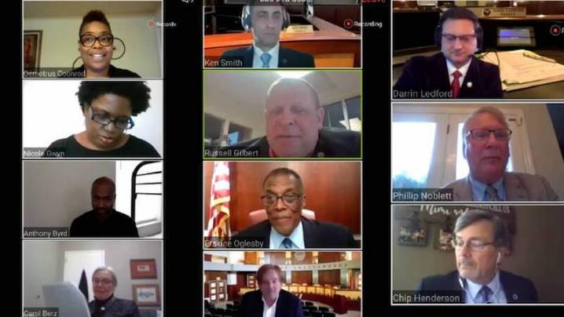
Step 3: Communicate and Engage
Once managers know the extent of the problem, they must help elected officials, employees and community members understand the challenges and gather input on possible solutions.
Solution scenarios can be run as they are developed
Notes:
Nancy starts here

Slide 26

Step 3: Communicate and Engage
Use videoconferencing, Facebook Live, other technology to get the word out and gather feedback
Technology allows new voices to participate
Use social media and the city’s website to provide updates
Solution scenarios can be run as they are developed

Slide 27
Step 4: Support Decision-Making
Understanding impacts to revenues and possible scenarios is key to good decision-making
Solutions supported by governing body form the basis of action
Solution scenarios can be run as they are developed
Clear graphics help communicate a message, especially in online meetings

Slide 28
Conclusion
Our financial world is uncertain, and the 2020-21 budget picture is unclear.
Cities are starting now to plan ahead for a possible 6- to 18-month recession unlike any other.
The four steps of the COVID-19 Recession Response form the foundation of a local government’s plan to address the crisis.
Communication with the community and governing body is key to finding solutions.

Slide 29

Thank You!
Andy Belknap, Senior Vice President
Nancy Hetrick, Vice President
nhetrick@managementpartners.com
(408) 674-3369

