Slide 1
Fiscal & Organizational Strategies During a crisis
Notes:
Poll the audience – reactive vs. proactive/opportunity; or both?

Slide 2
Team #wittypigeons
Jim Mann
Senior Municipal Advisor, Ehlers
jmann@ehlers-inc.com
Austin Good
Assistant to the City Manager, Lone Tree, Colorado, Austin.Good@cityoflonetree.com
Nina Vetter
District Manager, Pueblo West Metro District, Colorado, nvetter@pwmd-co.us
Kennie Downing
City Administrator, Baraboo, Wisconsin
kdowning@cityofbaraboo.com

Slide 3
Why are we here?
31 Dec. 2019
China confirms unknown pneumonia
11 Jan. 2020
First known death
30 Jan.
WHO declares an emergency
29 Feb.
First recorded COVID-19 death
6 Mar.
President signs $8.3 B emergency spending
11 Mar.
WHO declares a pandemic
11–17 Mar.
The days sports died
27 Mar.
COVID-19 Stimulus V1
24 Apr.
COVID-19 Stimulus V2
5 May
Convergence of Taco Tuesday and Cinco de Mayo all but ignored

Slide 4
Market Volatility
What will the recovery look like?
Source: NBER Working Paper “The Unprecedented Stock Market Impact of COVID-19”

Slide 5
Transition plan for the next 3 months - the 2 P’s!
What are you prioritizing (money, programs, projects)?
What flexibility, opportunities, space to experiment, and guidance are you giving your people?

Slide 6
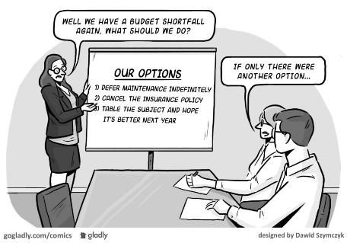
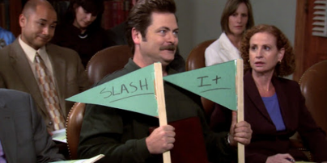
Prioritizing the money, programs, projects

Slide 7
Short-term thoughts
Cut 3% from every department budget in the next month
Don’t do any CIP projects
Defer all maintenance projects
Not the time for large economic development projects
Only provide core services
Freeze all hiring
Wait 3 months, then go back to “normal” operations
Notes:
Poll – what have you implemented or are considering implementing

Slide 8
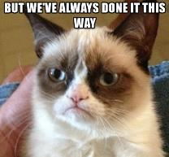
Strategic, long-term questions
Rethinking your core services:
Transitioned online? Staggering work schedules? Reassigning work functions? What’s working well that you changed?
Any staff not have “enough” to do from home?
Did you stop providing a service that might not be of a lot of value & isn’t worth bringing back?
What TRULY requires in-person contact?
*ResourceX great resource!

Slide 9
Strategic, long-term questions
What programs and projects don’t work with social distancing?
What activities require large groups of people to gather?
What programs and projects will best help with an economic recovery?
Construction hasn’t stopped; projects still have momentum?

Slide 10
PWMD Examples
Things we have changed or are going to change:
Our new administration building
Online payments
Reassignments- Centralized customer service
Things we won’t stop:
Economic development projects
Community engagement (yes, mostly virtual)
Notes:
Poll – has your focus been short term or long term?

Slide 11
Finance, Debt & Strategy
Investments & Policy
Develop cash flow forecast
Review/Modify Policy as necessary
How will revenues impact our ability to make our debt payments?
Revenue Forecasting
Will we be able to make our payments without tapping DSRFs?
Future Payment(s)?
Continuing Disclosure Reporting?

Slide 12
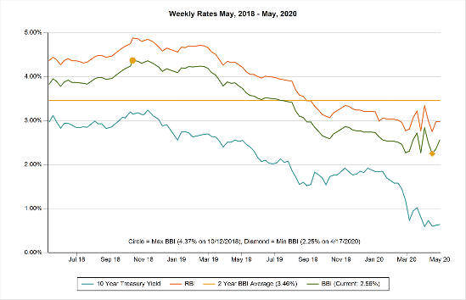
Finance, Debt & Strategy
Refunding/Restructuring
Taxable Advance Refunding
Cinderella Bonds
Current Refunding
Notes:
Poll – have you employed your reserve capital to help out small businesses in your community?

Slide 13
Putting capital to work - City of Baraboo, WI
City of Baraboo (pop.12,140), located in central Wisconsin, has a thriving downtown square consisting of restaurants, unique retail shops, and a historic theatre that are popular local and statewide shopping and tourist attractions.
Problem: How to prevent loss of our small businesses financially affected by the COVID-19 closure?
Solution: Offer an Emergency Assistance Fund – Small Business Loan Program

Slide 14
Features of the Emergency Assistance Fund- Small Business Program
Utilized $100,000 in available funds from a TID/TIF, and $150,000 available Economic Development Funds to create the loan program of $250,000.
$5,000 loan available to City of Baraboo businesses with 25 or less employees and have been financially affected by COVID-19 closures.
Businesses must be current with other City payments; Not in bankruptcy.
Loans due July 15, 2021 with 0% interest through December 31, 2020. Interest at 2% annum January 1, 2021 – July 15, 2021.
Funding priority given to business that commit to retaining employees and/or jobs for the duration of the loan term.
Business owner signs Promissory Note
Fast loan approvals within one week of application.

Slide 15
Ideas to fund the Small Business Loan Program
Use available economic development funds, e.g. TID
Forego capital projects for one year and re-direct that money
Use room/bed tax revenue
*Loan guidelines available on our website at www.cityofbaraboo.com

Slide 16
What flexibility, opportunities, space to experiment, and guidance are you giving your people?
What are you communicating?
How are you supporting experimentation?

Slide 17
Communication matters
“I know I should be focused on our strategic goals, but I’m busy getting us through this crisis!”
“I’m too busy to work on anything else but this crisis”
“Just keeping working on all the things, let me know if you need anything”
“In the next two weeks, let’s all review our pages on the website and make edits to make it more user-friendly, informative and engaging”
“In the next week, watch at least one webinar on leadership or working from home/virtually“
“Thank you for being adaptable and willing to change how we provide services so quickly.”

Slide 18
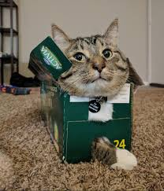
It’s a great time to experiment!

Slide 19
Example: City of Lone Tree
Temporarily reorganized our organization around priority areas.
Recovery Initiatives:
Core City Services
Public Health
Public Safety
Community Connection & Well-Being
Economic Resilience & Recovery
Communications

Slide 20
Example: City of Lone Tree
Rethinking how our team was organized led to incredible projects.

Slide 21
Example: City of Lone Tree
Keys to Success & Continued Improvement:
Empower staff to think outside their traditional roles.
Harness community member enthusiasm.
Redirect passion instead of just shutting down ideas.
Watch what other cities/organizations are doing.
New communication tools = opportunity for transparency.

Slide 22
Team #wittypigeons
Jim Mann
Senior Municipal Advisor, Ehlers
jmann@ehlers-inc.com
Austin Good
Assistant to the City Manager, Lone Tree, Colorado, Austin.Good@cityoflonetree.com
Nina Vetter
District Manager, Pueblo West Metro District, Colorado, nvetter@pwmd-co.us
Kennie Downing
City Administrator, Baraboo, Wisconsin
kdowning@cityofbaraboo.com

